Slide 1

Gibraltar DoE Education Conference 2025
Working Effectively with Other Adults Building Partnerships
Gareth D Morewood

Slide 2
What is going to happen?
To think about the SNSLA role – what does it mean in your school?
To consider new, more effective ways of record keeping and informing provision
To understand data better and how to share information as part of the learning partnership
To consider what kinds of support are the most effective in helping students make progress

Slide 3
What types of support are there?
Think about the types of support and styles you see in your setting…
What type of support is most appropriate for what activity?
Why?
What skills are required?

Slide 4
Support models – from the past?
‘Velcroed’ support
‘Helicopter’ support
‘Bridge Builder’ support
Class / year support
Specialist support
Subject-specific support

Slide 5
What is effective practice?
Effective practice in relation to SNSLAs involves contributions that:
foster the participation of learners in all aspects of learning and development - the academic and social processes of the school
seek to enable learners to become more independent learners and understand their own needs
help to raise standards of learning for learners and narrow gaps in attainment with peers and expectations

Slide 6
1. Assess current situation…
Undertake a reflection/self-assessment exercise
Speak to staff, all staff – what do they think?
Observe support in lessons – with a clear focus and as part of positive development
Work with learning and teaching colleagues to ensure there is an inclusive view of support staff in partnership with teachers
Always seek to model good practice and support positive partnership working – examples of good practice

Slide 7
How do you know your impact?
What is the impact on student progress and how do you analyse whether strategies are effective?
This is very important but often ‘overlooked’
How does this work in partnership?
What ‘could’ we do?

Slide 8
Record keeping – what do you do?
Your thoughts?
What do you do?
Why are records important?
Joint planning and record keeping always generates debate .... Is it possible?
What can you do? ... and why?

Slide 9
Daily Record Sheets…
Joint planning – is it impossible?
How can you gauge progress and be more aware of learners’ capabilities with regard to their prior learning and understanding and plan very effectively to build on these?
How can you help learners understand in detail how to improve their work and are consistently supported in doing so?
This is what you can do ...
Make sure there is a positive system linked into these outcomes ... What do you do?

Slide 10
2. Set out a plan…
Consider key findings and remember to highlight positives/good practice
Think about deployment and roles – are strengths of staff utilised?
What do teaching staff say works well?
What do SNLSAs say works well?
What does the data/outcomes of students say?
Identify areas where there is significant impact and places that have gaps?

Slide 11
3. Ensure high quality training…
Build in training that supports SNLSA development (from your evidence)
Ensure opportunities for CPD as well as personal development
Consider ‘high impact’ strategies as part of partnership working; include teaching staff to develop effective classroom partnerships
Review and ensure recruitment is thorough; get the right people – skills are more important than qualifications

Slide 12
Making an impact in a new way…
Research (Higgins et al) demonstrates that how staff are used can be extremely effective in narrowing gaps in attainment
It is important that SNLSAs don’t simply do things for a young person and create a ‘learned helplessness’; but are pro-active in using evidence-based techniques that are proven
This may require a ‘new way of working’, but is essential in order to meet modern need and work effectively in partnership with teaching staff
Let us consider ‘high impact’ methods…

Slide 13
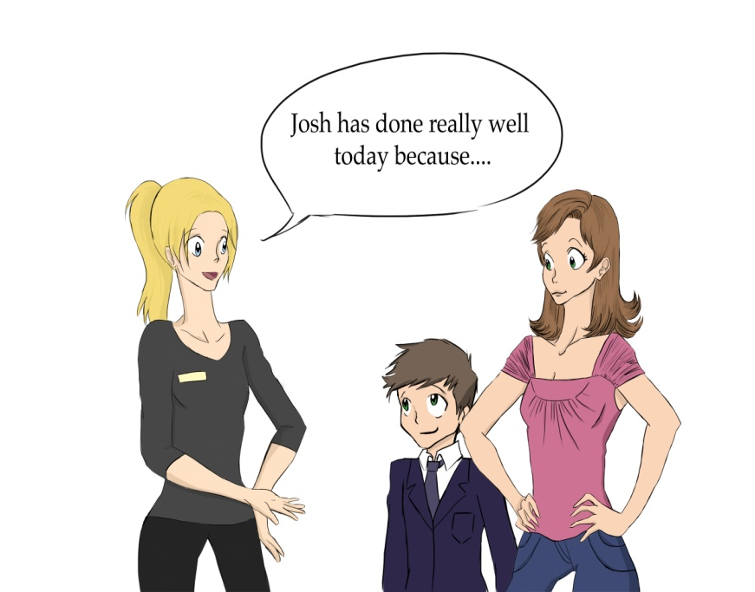
Effective Feedback - Very High Impact
Research suggests that providing effective feedback is
challenging. To be effective, it should be:
• About challenging tasks or goals rather than easy ones;
• Given sparingly so that it is meaningful;
• About what is right more often than about what is wrong;
• Specific, accurate and clear, e.g. not just “correct” or “incorrect”;
• Provide examples of what is correct and not just tell students when they are wrong;
• Encouraging and supportive of further effort without threatening a learner’s self-esteem;
(from Education Endowment Foundation - http://educationendowmentfoundation.org.uk/toolkit)

Slide 14
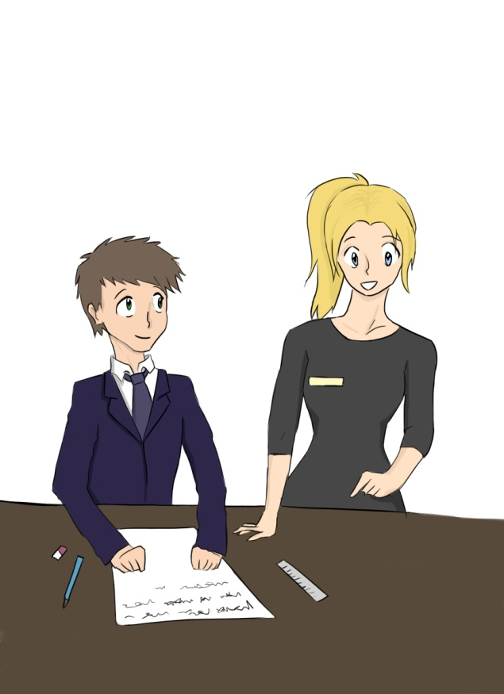
Metacognition & Self-Regulation – High Impact
Research suggests that:
• Teaching approaches which encourage learners to plan, monitor and evaluate their learning have very high potential, but require careful implementation.
• Teach students explicit strategies to plan, to monitor and to evaluate their learning and give them opportunities to use them with support and then independently.
• When using approaches for planning, ask students to identify the different ways that they could plan (general strategies) and about the best approach for a particular task (specific technique).
• Monitoring involves identifying the key steps they need to be aware of as they go through a task to keep it on track – where might this go wrong; what will be the difficult parts …
(from Education Endowment Foundation - http://educationendowmentfoundation.org.uk/toolkit)

Slide 15
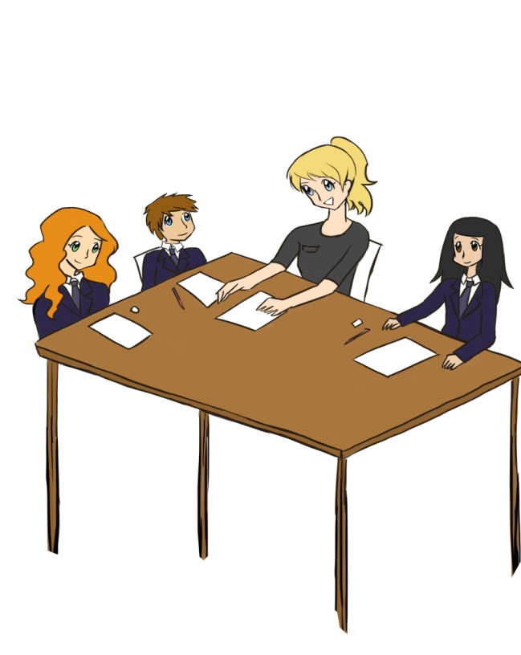
Small Group Tuition - High Impact
Research suggests that:
• Intensive tuition in small groups is very effective;
• Students can be grouped according to current level of attainment or specific need;
• It is important to assess students’ needs accurately and provide work at a challenging level with effective feedback and support;
• The cost effectiveness of one-to-two and one-to-three indicates that greater use of these approaches would be productive in schools;
• Professional development and evaluation are likely to increase the effectiveness of small group tuition;
(from Education Endowment Foundation - http://educationendowmentfoundation.org.uk/toolkit)

Slide 16
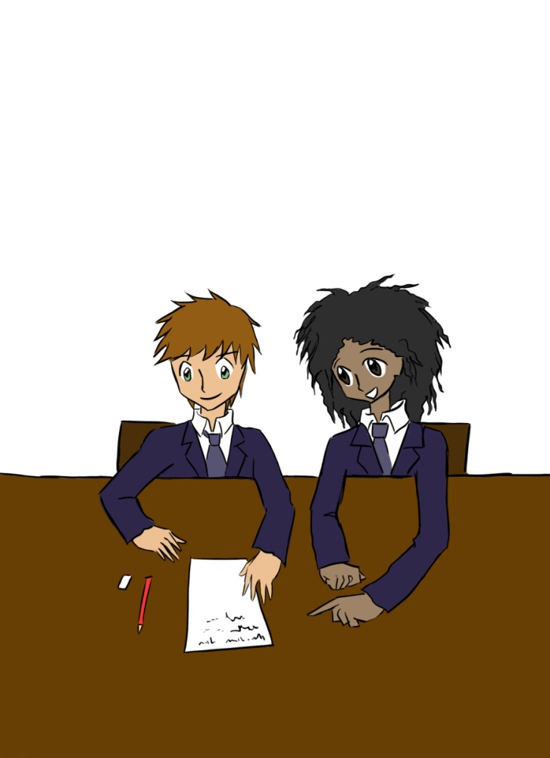
Peer Tutoring – Very High Impact
Research suggests that:
• Activities should be sufficiently challenging for the tutee that they can benefit from the tutor’s support but not too difficult that they cannot succeed with support;
• There are several different approaches to peer-tutoring which make different demands on the teacher(s) organising the pairs and on the tutors and tutees;
• Reviewing challenges and successes with tutors will improve their skills and learning;
• Relatively short but intensive periods of tutoring over 4-10 weeks are likely to be more effective than for a longer period with more routine sessions;
(from Education Endowment Foundation - http://educationendowmentfoundation.org.uk/toolkit)

Slide 17
‘Insanity: doing the same thing over and over again and expecting different results.’
NOT Einstein
Deploying additional adults to simply answer
‘Best Buys’ are what works well for you …
Support Staff are essential as part of a whole-school approach; not simply THE answer on its own …
REMEMBER …
…effective support is essential for students with SEND and other vulnerable groups to make progress – additional adults form an important part of that support – when used effectively.

Slide 18

Training and development…
Successful Classroom Partnerships: Making the most of teaching assistants
© Gareth D Morewood 2013, Published by Optimus Education.
ISBN 978-1-907927-38-6; Foreword by Professor Neil Humphrey. June 2013

Slide 19
A graduated approach…
Assess – Plan – Do – Review
Including new focus on mental health:
1. Communication and interaction
2. Cognition and learning
3. Social, mental and emotional health
4. Sensory and/or physical

Slide 20
21st Century Children…a key message!
The young people in our schools are very different now, than 15 years ago...
Neo-natal survival rates and advances in medicine mean more children are surviving with complex needs and are now in our classes...
Learning & Teaching is different now; it has to be ... so we have to evolve too…
Schools need to respond to meet ‘modern need’…

Slide 21
Support the Vocabulary You Use
Key Words & Meanings

Slide 22
Evidence Based Learning Strategies
Spaced Practice
Retrieval Practice
Elaboration
Interleaving
Concrete Examples
Dual Coding
The Learning Scientists - www.learningscientists.org

Slide 23
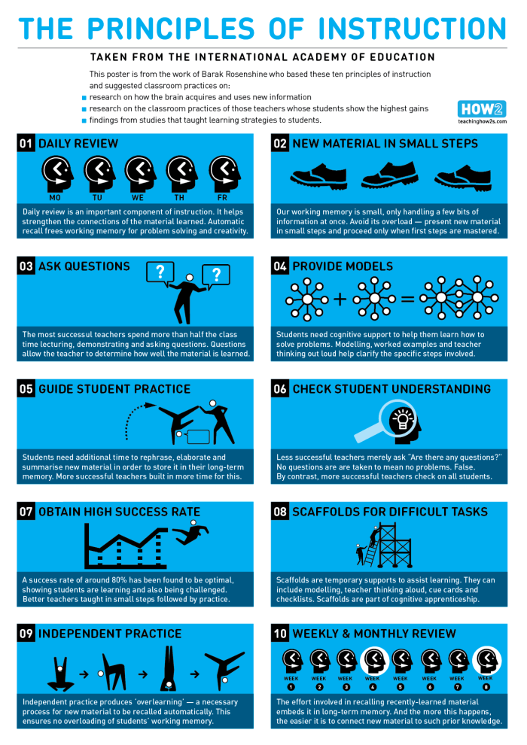
Using as a Guide – Not a Checklist
Two short films…
https://youtu.be/ZO8abw3DHxs
https://youtu.be/Pjrqc6UMDKM
www.retrievalpractice.org
https://lovetoteach87.com/2019/11/24/retrieval-practice-the-myths-versus-reality/

Slide 24
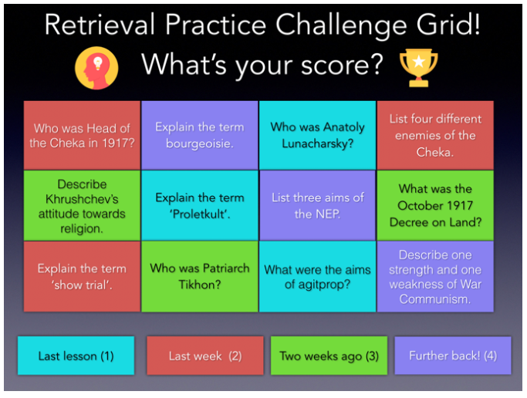
Kate Jones – @KateJones_teach
https://lovetoteach87.com/2018/01/12/retrieval-practice-challenge-grids-for-the-classroom/

Slide 25
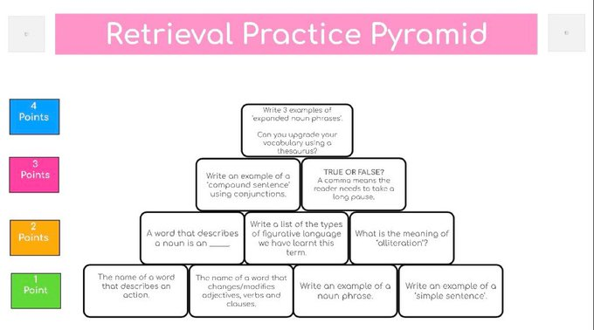
@mr_alfredb

Slide 26
https://www.learningscientists.org/videos

Slide 27
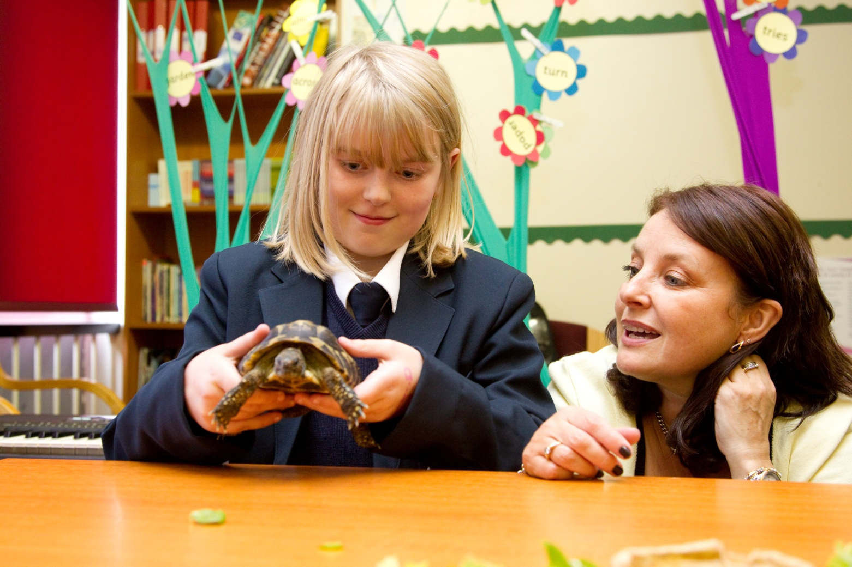
Consider different TA skills & interests...

Slide 28
The Plan!
Assess current provision
Plan your improvement strategy from the assessment
Do the plan – including training and impact measures
Review the provision at regular intervals

Slide 29

Have we found the final piece?

Slide 30
‘We need schools where difference is valued and where there is less emphasis on conformity and greater focus on harnessing strengths in order to enable all, staff and students alike….to be the best they can become’
Professor Rita Jordan
‘Personalisation NOT Normalisation’
Dr Damian Milton

Slide 31
MEDICAL MODEL THINKING | SOCIAL MODEL THINKING
Person is faulty | Person is valued
Diagnosis | Strengths and needs defined by self and others
Labelling | Identify barriers and develop solutions
Impairment becomes the focus of attention | Outcome based programme designed
Assessment, monitoring, programmes of therapy imposed | Resources are made available to ordinary services
Segregation and alternative services | Disability Equality Training for All
Ordinary needs put on hold | Encourage social relationships
Re-entry if normal enough OR Permanent Exclusion | Diversity welcomed and disabled person is Included
Society remains unchanged | Society evolves
(Adapted from Micheline Mason 1994 & R. Rieser 2005)

Slide 32
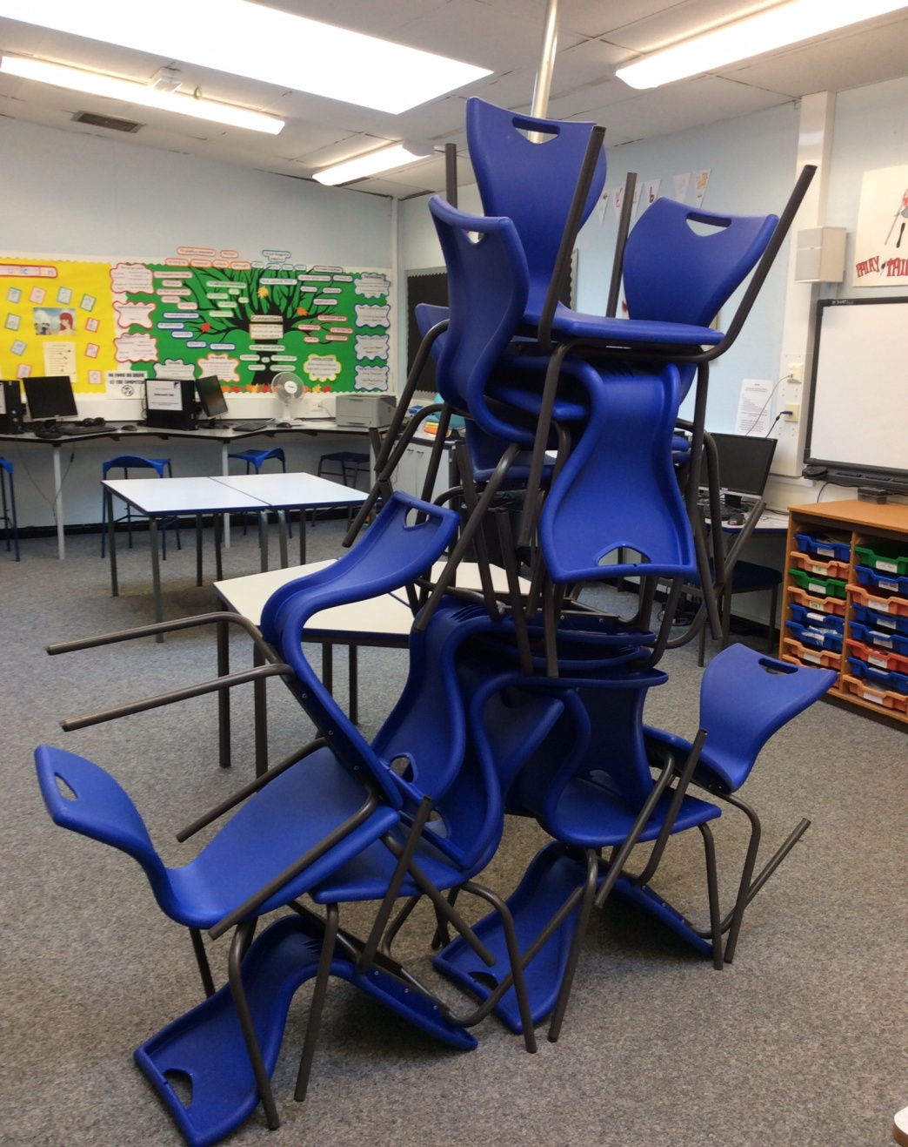

Slide 33


Slide 34
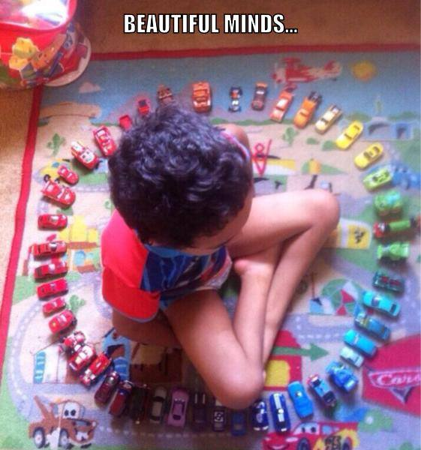

Slide 35
21st Century Children…A Key Message!
The young people in our schools are very different now, than 15 years ago...
Neo-natal survival rates and advances in medicine mean more children are surviving with complex needs and are now in our classes...
Learning & Teaching is different now; it has to be ... so we have to evolve too…
Schools need to respond to meet ‘modern need’…

Slide 36
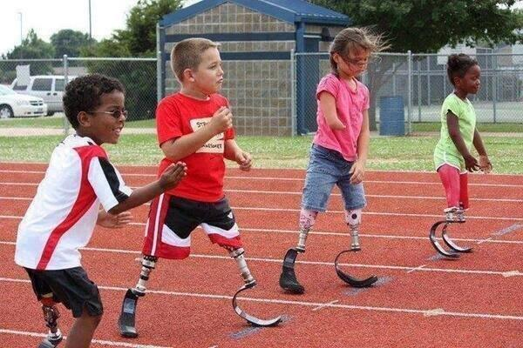

Slide 37


Slide 38
Support the Vocabulary You Use
Key Words & Meanings

Slide 39
Evidence Based Learning Strategies
Spaced Practice
Retrieval Practice
Elaboration
Interleaving
Concrete Examples
Dual Coding
The Learning Scientists - www.learningscientists.org

Slide 40
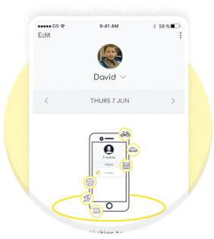
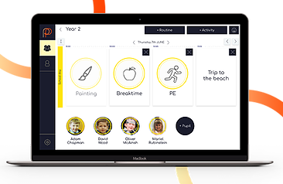
Digital Visual Timetable
www.mypicturepath.com
https://www.studio3.org/post/app-review-picturepath

Slide 41
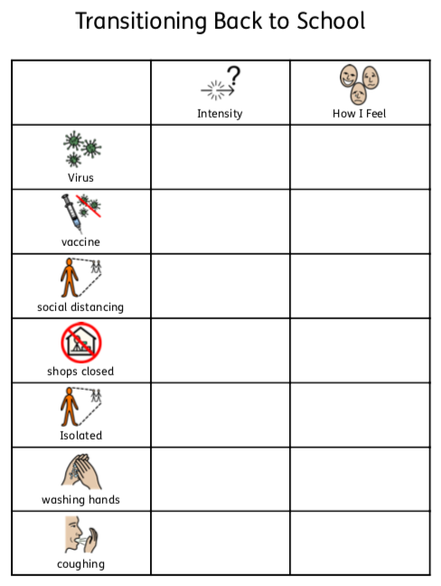
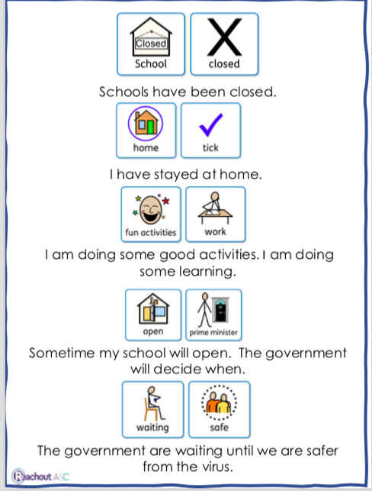
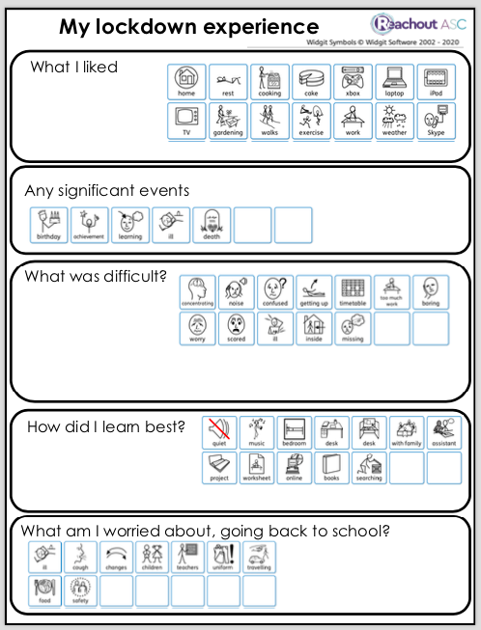

Visual Supports - Downloadable Resources - Reachout ASC - Lynn McCann

Slide 42

© Liz Elks and Henrietta McLachlan 2015

Slide 43
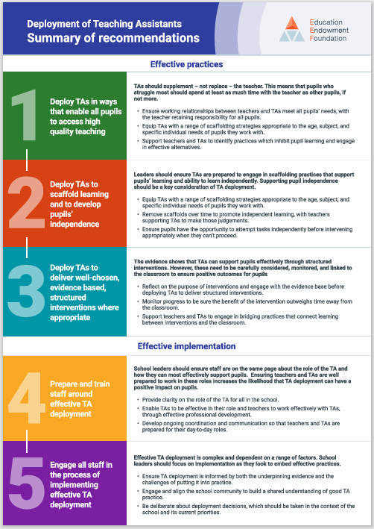

Slide 44
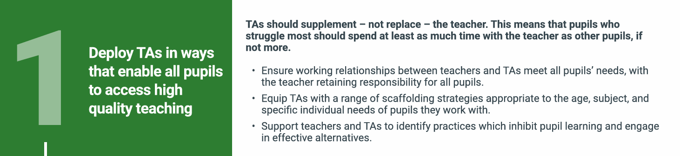
TAs should supplement – not replace – the teacher. This means that pupils who
struggle most should spend at least as much time with the teacher as other pupils, if
not more:
Ensure working relationships between teachers and TAs meet all pupils’ needs, with the teacher retaining responsibility for all pupils
Equip TAs with a range of scaffolding strategies appropriate to the age, subject, and specific individual needs of pupils they work with
Support teachers and TAs to identify practices which inhibit pupil learning and engage in effective alternatives.

Slide 45
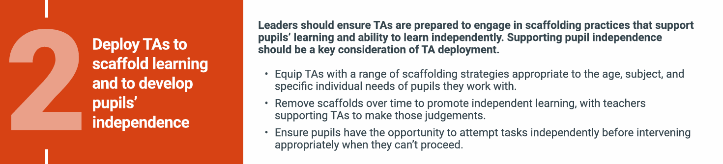
Leaders should ensure TAs are prepared to engage in scaffolding practices that support pupils’ learning and ability to learn independently. Supporting pupil independence should be a key consideration of TA deployment
Equip TAs with a range of scaffolding strategies appropriate to the age, subject, and specific individual needs of pupils they work with
Remove scaffolds over time to promote independent learning, with teachers supporting TAs to make those judgements
Ensure pupils have the opportunity to attempt tasks independently before intervening appropriately when they can’t proceed.

Slide 46
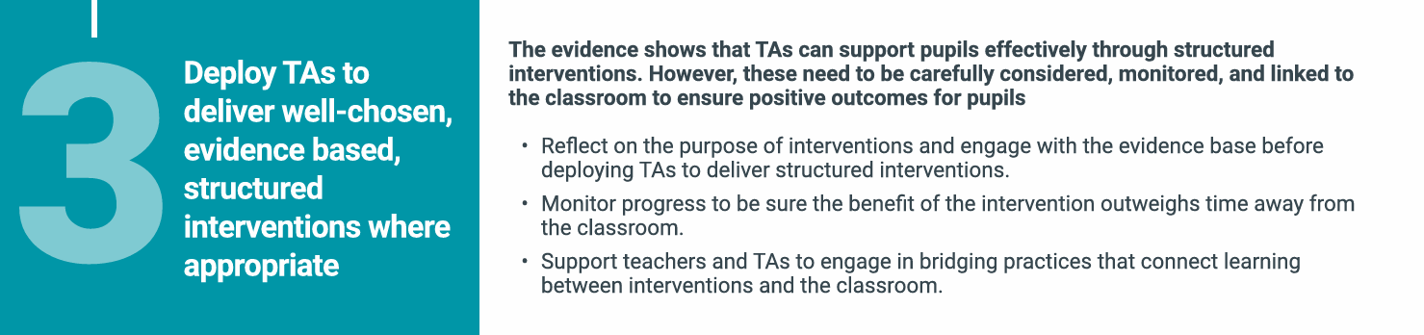
The evidence shows that TAs can support pupils effectively through structured interventions. However, these need to be carefully considered, monitored, and linked to the classroom to ensure positive outcomes for pupil
Reflect on the purpose of interventions and engage with the evidence base before deploying TAs to deliver structured interventions
Monitor progress to be sure the benefit of the intervention outweighs time away from the classroom
Support teachers and TAs to engage in bridging practices that connect learning between interventions and the classroom.

Slide 47
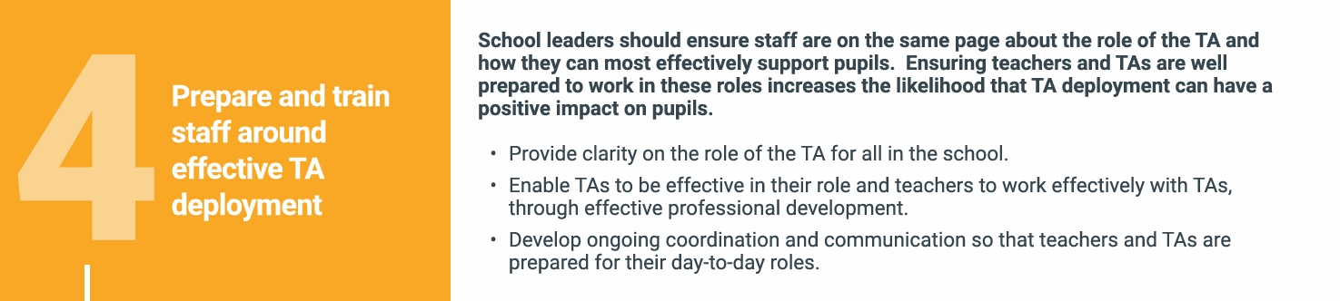
School leaders should ensure staff are on the same page about the role of the TA and how they can most effectively support pupils. Ensuring teachers and TAs are well prepared to work in these roles increases the likelihood that TA deployment can have a positive impact on pupils
Provide clarity on the role of the TA for all in the school
Enable TAs to be effective in their role and teachers to work effectively with TAs, through effective professional development
Develop ongoing coordination and communication so that teachers and TAs are prepared for their day-to-day roles.

Slide 48
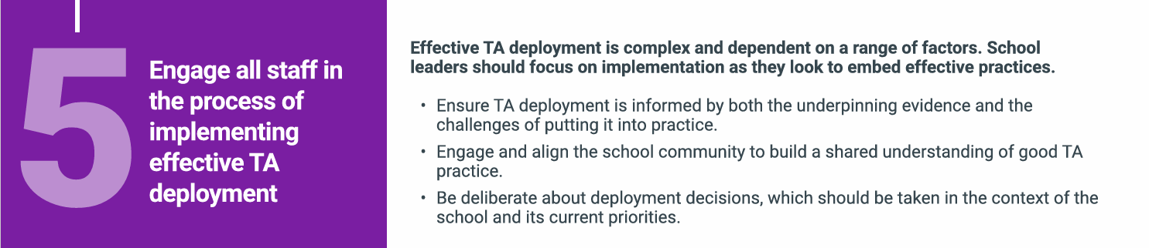
Effective TA deployment is complex and dependent on a range of factors. School leaders should focus on implementation as they look to embed effective practices
Ensure TA deployment is informed by both the underpinning evidence and the challenges of putting it into practice
Engage and align the school community to build a shared understanding of good TA practice
Be deliberate about deployment decisions, which should be taken in the context of the school and its current priorities.

Slide 49

New Book - Available for £10 today
‘I’d recommend this to all parents looking to support their child in school and to all teachers who want to build a collaborative approach with pupils and parents.’
Richard Nurse, parent and founder of Picturepath.
‘This book’s grounded, compassionate and practical approach will be a boon for all involved in the education of autistic teenagers. I highly recommend it.’
Mary Myatt, education writer and curator of Myatt and Co.
‘This should be essential reading for parents of autistic children who attend a mainstream secondary school. A remarkable achievement.’
Neil Humphrey, Sarah Fielden Chair: Psychology of Education, University of Manchester.
‘Drenched in lived experience, this is a superb guide. You’ll learn something new in every chapter.’
Matt Keer, parent contributor to Special Needs Jungle website.

Slide 50
Links
FREE webinars - www.studio3.org/free-webinars
LASER Prog - www.studio3.org/laser-online
Low Arousal Training - www.studio3.org/low-arousal-online
Films - Videos Archives - Gareth D Morewood (gdmorewood.com)
SENCology Blog - SENCology | Optimus Education Blog (optimus-education.com)

Slide 51


Slide 52


Slide 53


www.studio3.org @studioiii

