Slide 1

Gibraltar DoE Education Conference 2025
How To Develop Stress Support Plans
Gareth D Morewood

Slide 2
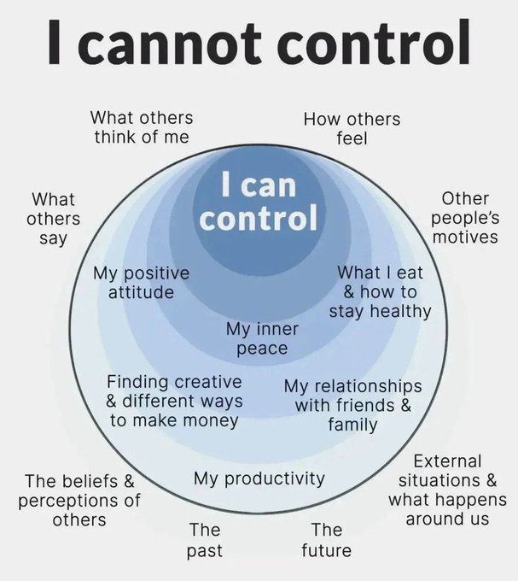


Slide 3
Why Can School Be Such a Challenging Place?
For the student
    Learning in a social setting, reading social situations, deciphering the unwritten rules
    Learning in a complex language environment with limited visual support
    Understanding and communicating with other students and adults
    Coping with change, transitions and unexpected breaks in routine
    Day to day organisation
    Generalising learning beyond the setting in which it took place

Slide 4
Why Can School Be Such a Challenging Place?
For the peer group
  Lack of understanding
  Resenting extra attention
  Social advances that are ignored or rejected
  Distraction or disruption
  Feeling that double standards are applied (‘getting away’ with things)
  Being nervous or fearful
  Ignoring, teasing, winding up, bullying (Morewood, Humphrey & Symes, 2011)
For staff and parents
    Gaining, maintaining and refocusing attention
    Motivation
    Differentiation of language and/or curriculum
    Managing behaviour ***WARNING***
    Accommodating special interests

Slide 5
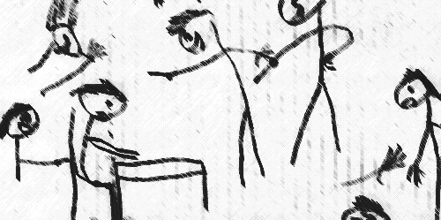
Why Can School Be Such a Challenging Place?
Taken from Humphrey & Lewis (2008)

Slide 6
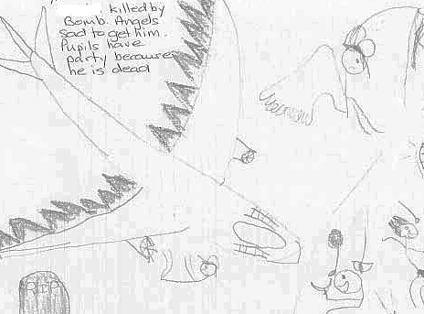
Why Can School Be Such a Challenging Place?
Taken from Humphrey & Lewis (2008)

Slide 7
We Can Inadvertently Be Triggers
The vast a majority of challenging situations are inadvertently triggered by supporters.
We are often unaware that we can trigger situations.
Reflective practice is a cornerstone of low arousal approaches.

Slide 8
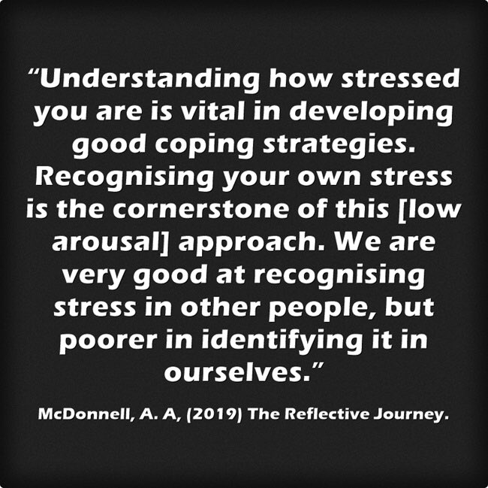
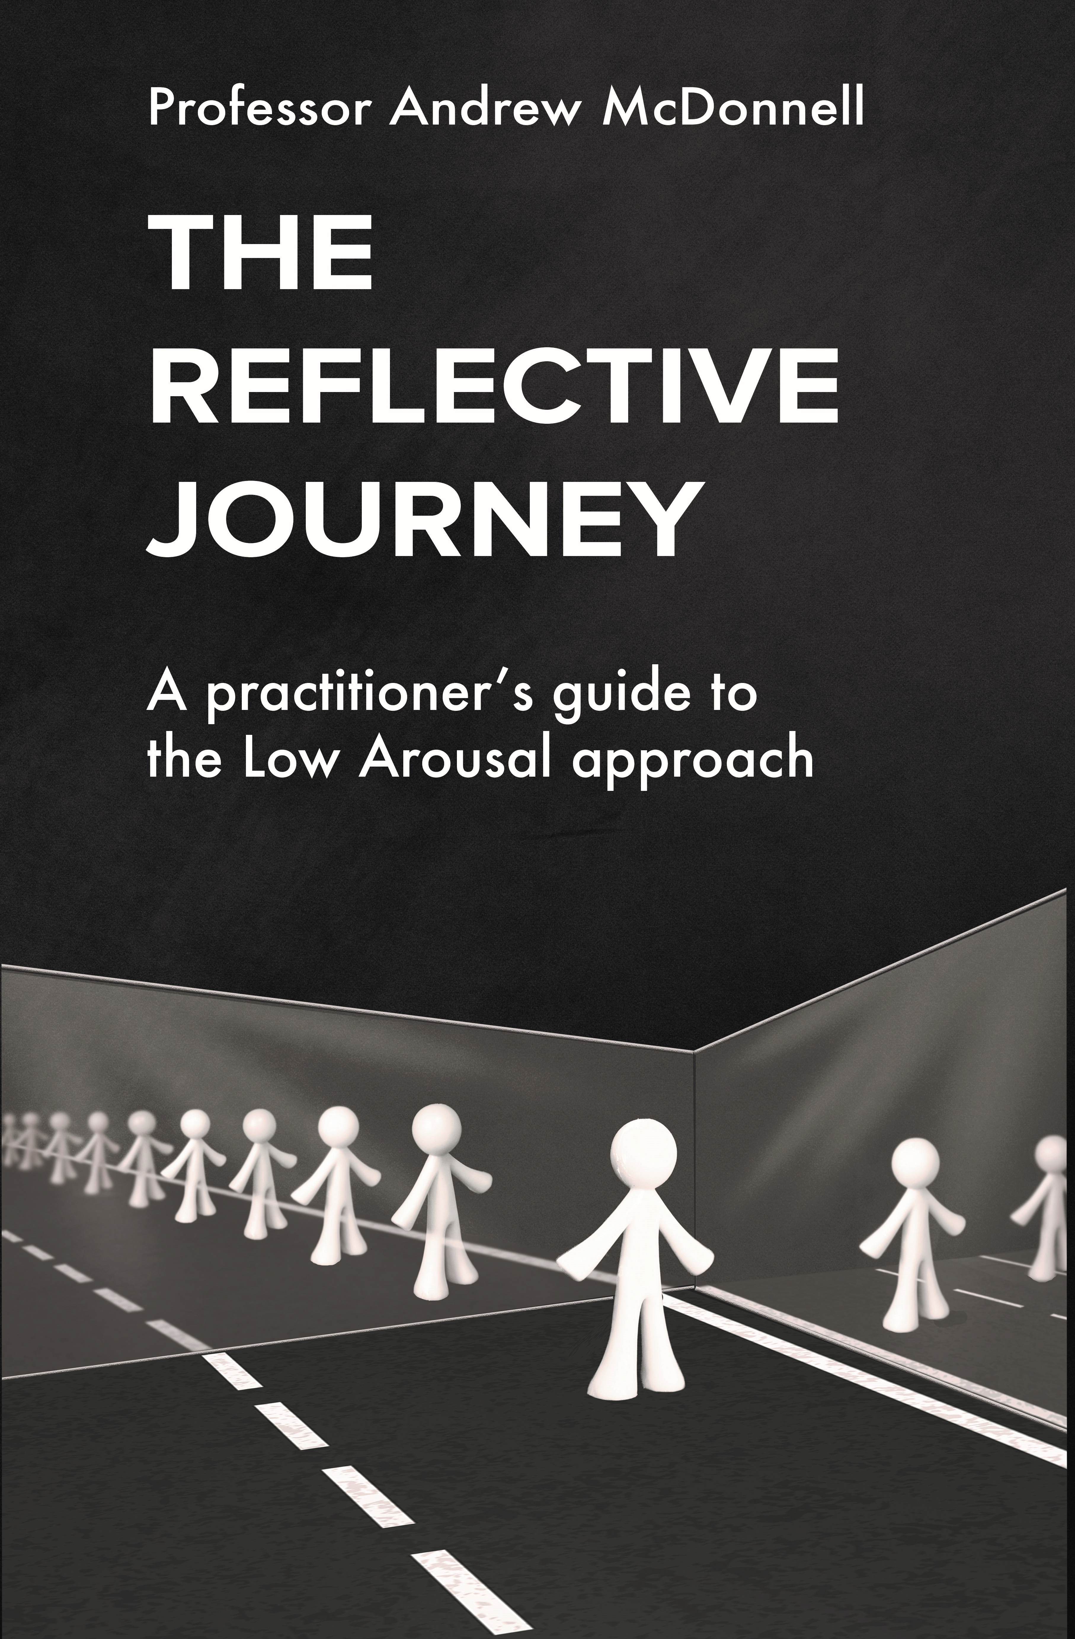
‘The Reflective Journey: A Practitioner’s Guide to the Low Arousal Approach’ is available from www.studio3.org/product-page

Slide 9
What Is the "Spoons Theory" of Autism?
Autistic people often experience burnout and fatigue.
"Spoons theory" encourages autistic people to think of their energy in terms of a limited number of spoons.
Conceiving of energy in this way can help autistic people stop themselves from taking on too much.
Being realistic about their energy and deliberate in how they use it can help autistic people avoid fatigue.

Slide 10
Understanding Stress
Stress, anxiety and trauma are proposed as potentially significant factors regarding behaviours of concern for young people, particularly autistic learners (Lipsky, 2011; Bradley and Caldwell, 2013; McCreadie and McDermott, 2014).
Whilst we often see the term anxiety used widely in academic literature (Attwood, 2007), stress is used much less. However, the construct is much broader and focuses more on transactional processes.

Slide 11
Understanding Stress
Lazarus and Folkman’s (1984) description of a transactional model of stress emphasises interaction between an individual and their environment.
Stress occurs when the demands of stressors outweigh coping responses.
There is a clear interaction between environmental and physiological events.

Slide 12
Understanding Stress
Implicit in this model is the cognitive appraisal of threat, as some individuals will have difficulties in regulating their emotional responses (as discussed previously) and therefore communicating them (Frith, 2003).
An individual’s coping responses are important in our understanding of stress, as it is almost impossible in the modern world to be ‘stress free’.

Slide 13

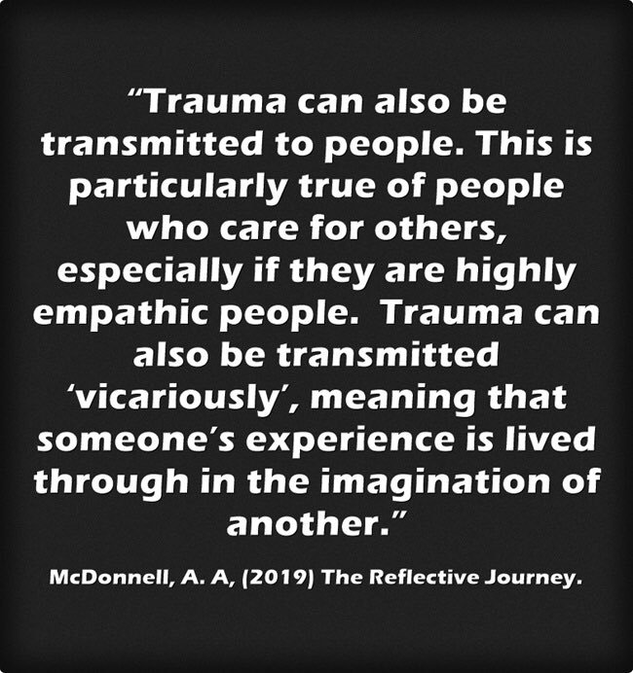

Slide 14

Understanding Stress

Slide 15
Learning to Recognise Stress
You are walking home after a relatively good day, having finished all of your work for the week. It’s Friday night and you feel great! You open the front door and hear your partner and your teenage child arguing. They are not shouting or talking loudly but the argument is heated and intense. As you walk into the house you hear that they are disagreeing about their relationship and upcoming plans. You are about to walk into the living room where they are arguing...
How do you feel?

Slide 16


Slide 17


Slide 18


Slide 19


Slide 20


Slide 21
“Masking Is Life”: Experiences of Masking in Autistic and Nonautistic Adults. Autism in Adulthood
www.liebertpub.com/doi/10.1089/aut.2020.0083
Double Empathy: Why Autistic People Are Often Misunderstood
Double Empathy: Why Autistic People Are Often Misunderstood · Frontiers for Young Minds (frontiersin.org)

Slide 22
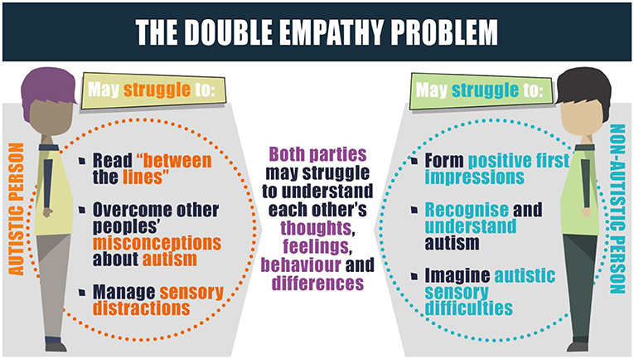

Slide 23
Understanding Stress
It is our coping responses that determine how we adapt to stress.
Many young people have very few 'coping tools’.
Some restricted or repetitive behaviours may have very real and vital coping functions.
For example, a person may engage in stereotyped movements which help them to regulate their arousal (McDonnell and Gayson, 2014).

Slide 24
Understanding Stress
We therefore need to consider carefully our own perspectives on such behaviour.
Interventions that attempt to reduce certain types of restricted, repetitive or stereotyped behaviour because we perceive them as ‘abnormal’ may be taking away one of a person’s coping mechanisms, without providing them with an effective alternative.
We wouldn’t remove a wheelchair or hearing aid from a student, yet we often deny young people their own coping mechanisms through unintended consequences of wider systems and policies.

Slide 25
Understanding Stress
Trying to understand many different contexts (situations) can create great stress in individuals and lead to behaviours of concern (Vermeulen, 2012).
From the perspective of the non-autistic observer, behaviours that can appear to be bizarre or unusual are more meaningful when taking an inside-out approach (Williams, 1996).
Stress is strongly associated with the need for positive coping strategies (McCreadie and McDermott, 2014).

Slide 26
Understanding Stress
‘In essence, stable wellbeing is when individuals have the psychological, social and physical resources they need to meet a particular psychological, social and/or physical challenge. When individuals have more challenges than resources, the see-saw dips, along with their wellbeing, and vice-versa.’
(Dodge et al, 2012, p 230)

Slide 27
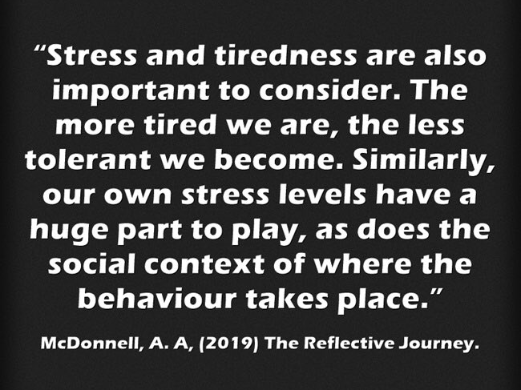
Understanding Stress

Slide 28
Combating Stress Pro-actively
Individual Exercise
Individually, consider the following three things:
What coping strategies do you use in your own life?
Identify some coping strategies you have seen pupils use.
How could your setting implement these coping strategies as an inclusive part of the curriculum?

Slide 29
Starting With Your Own Stress is Essential
Good arousal reduction strategies focus on our own arousal as well as our pupils/children/relatives.
Two (three) key aspects of arousal regulation include:
          (Mindfulness)
          Increased cardiac exercise
          Achieving and encouraging flow states (‘tune in’ and ‘tune out’)

Slide 30
Increased Cardiac Exercise
Cardiac exercise is an important area to focus on.
Exercise can serve a de-arousing function (McDonnell et al, 2015).
There is a growing body of literature that suggests links between cardiac exercise (Kohl & Cook, 2013) and stress.
We do not fully understand the complex mechanisms that lead to these results (Donnelly et al, 2016); however, the evidence suggests that mathematics and reading are the academic activities that are most influenced by physical activity.

Slide 31
Increased Cardiac exercise
Exercise can have powerful effects on learning and evidence
suggests that the hour after exercise is an optimum time for
learning.
Three key questions:
How much cardiac exercise do you partake in in average week?
How much cardiac exercise do your students/children partake in in the average week?
How much short-term exercise is in your daily curriculum/home life?

Slide 32

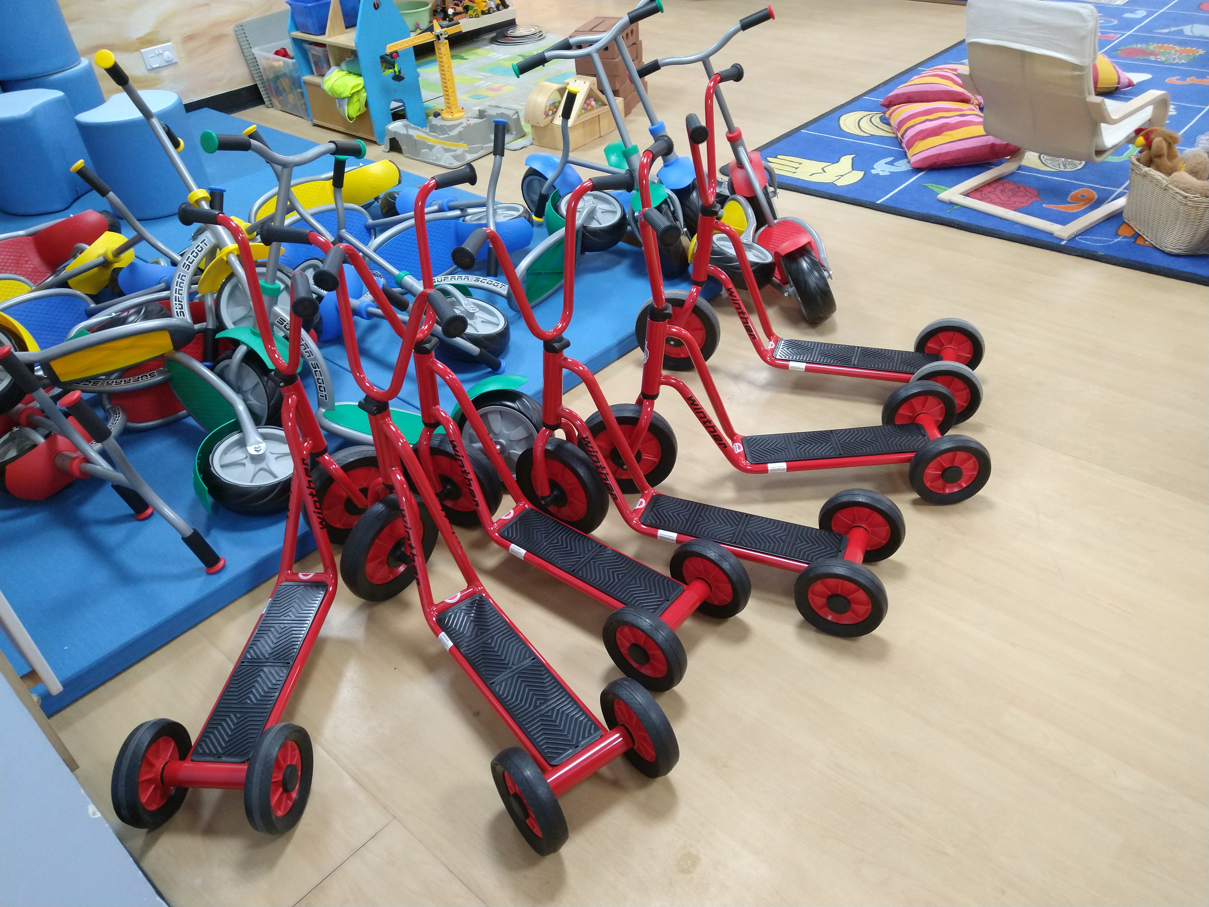

Slide 33
A Stress and Well-being Framework
Do you engage at least weekly with any of the following:
Light cardiac activity (2-3 hours of walking per week)?
Intensive cardiac exercise (1-2 hours a week)?
Participate in a physical sport?
10-15 minutes per day of some form of Mindfulness or meditation?
Drink more than 2 litres of fluid per day?
Have any absorbing hobbies or interests?
Regularly eat 3 meals (of whatever size) per day?
Suffer from gastric complaints, headaches and other minor ailments on a regular basis?

Slide 34
Achieving and Encouraging Flow States
Achieving a sense of flow is an important component of wellbeing and good stress management.
Flow experiences require complete immersion in an activity, whether playing a musical instrument, completing a complex technical task, or reading a book (Nakamura and Csikszentmihalyi, 2009).
Athletes can often refer to such states as ‘being in the zone’.

Slide 35
Achieving and Encouraging Flow States
Flow can also happen within social interactions.
For example: when one is talking to a good friend or playing with a young child (Csikszentmihalyi, 1990).
A flow state can also be achieved when the skills and resources available to an individual are fully engaged in managing an activity.

Slide 36
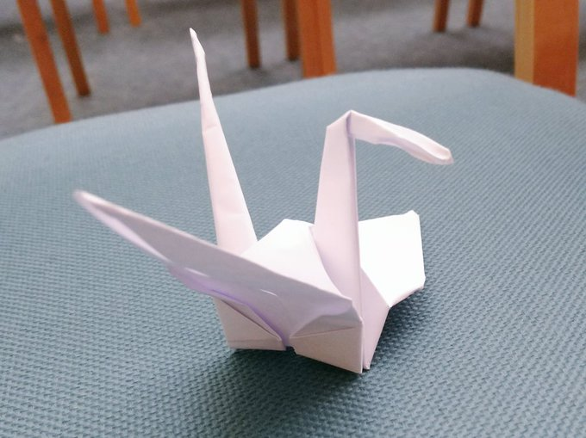
Achieving and Encouraging Flow States

Slide 37
Positive Psychology - Three Good Things Exercise
Participants were asked to write down three things that went well each day and their causes every night for one week (Seligman, 2005).
In addition they were asked to provide a causal explanation for each good thing.
You can see how Seligman’s ideas can be translated to school/home environments.
For 1 week at the end of each day, staff could write about 3 positive things that occurred in their day.
You can also ask them to describe 3 things that made them smile.

Slide 38
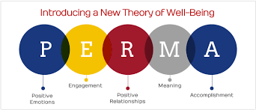
Positive Psychology – The PERMA Model
Seligman’s PERMA model of positive psychology is a useful tool for frontline staff to employ
Focus on positive recording, moments of happiness and building meaningful relationships with the young people we support

Slide 39
Positive Psychology – Happiness
‘The Happy School’ – Celebrating moments of happiness leads to a genuine and happy school ethos
Exercise:
Consider moments of happiness that have occurred previously in your school setting.
What strategies can we use to increase moments of happiness like these?

Slide 40
www.youtube.com/watch?v=jTSsT8ixdrw
Stress
Time

Slide 41
Using Metacognition with Student Passports
Student Passport
Teacher
Teaching Assistant
Parent/ Carer
Student /Learner
Keeps the young person central to provision
Essential as part of our student centred approach
A useful tool to engage parents/carers

Slide 42
Using Metacognition with Student Passports
Student Passports
Watch the film - http://ow.ly/PXUn30pIgTh
Read an article - http://ow.ly/EXKI30pIgTi
Also these #SENCology blogs http://ow.ly/HuHG30pIgTf (2015) http://ow.ly/DDK230pIgTg (including revised template, 2018)

Slide 43
Thinking about you – what is stressful?
Take 5 minutes to write down things you find stressful …

Slide 44
Thinking about you – how do you cope?
Take five minutes to consider strategies that help you cope…

Slide 45
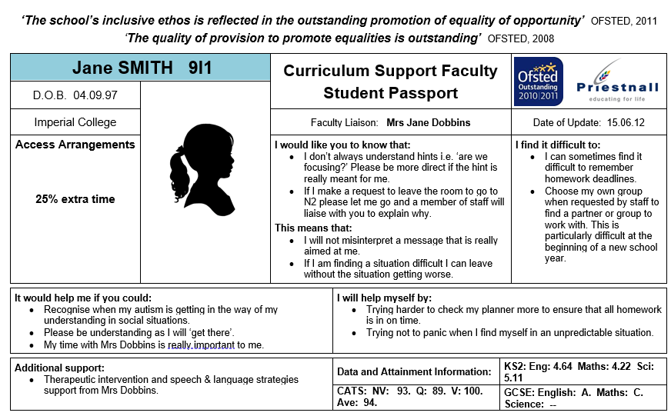
Examples … (with caveats!)

Slide 46
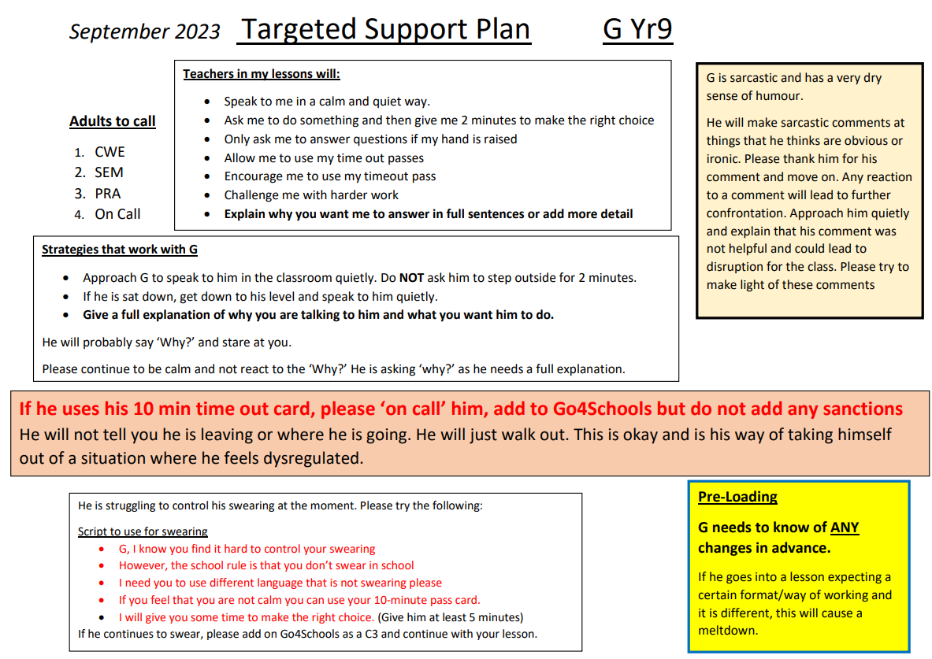
Examples … (with caveats!)

Slide 47
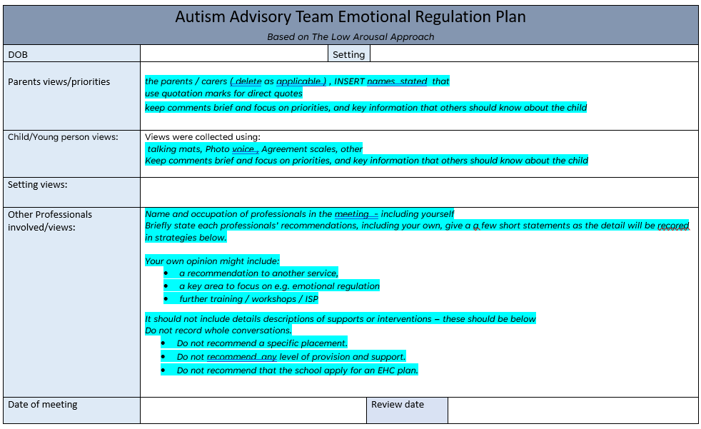
Examples … (with caveats!)

Slide 48
Examples … (with caveats!)
Link to word document

Slide 49
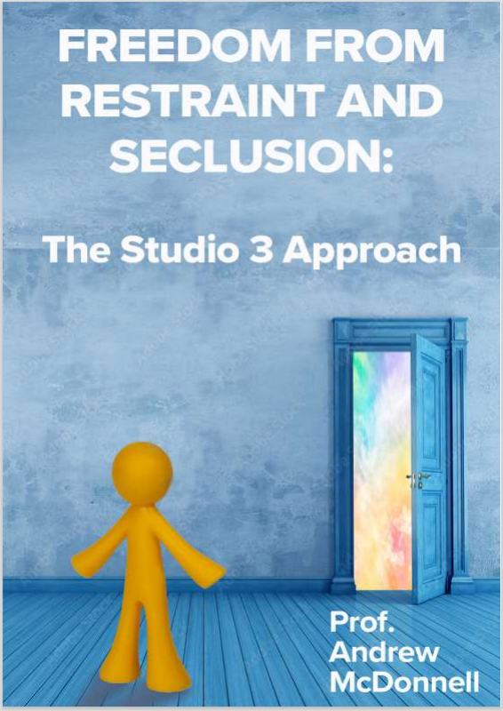
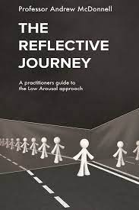
Available Now

Slide 50

New Book
‘I’d recommend this to all parents looking to support their child in school and to all teachers who want to build a collaborative approach with pupils and parents.’
Richard Nurse, parent and founder of Picturepath.
‘This book’s grounded, compassionate and practical approach will be a boon for all involved in the education of autistic teenagers. I highly recommend it.’
Mary Myatt, education writer and curator of Myatt and Co.
‘This should be essential reading for parents of autistic children who attend a mainstream secondary school. A remarkable achievement.’
Neil Humphrey, Sarah Fielden Chair: Psychology of Education, University of Manchester.
‘Drenched in lived experience, this is a superb guide. You’ll learn something new in every chapter.’
Matt Keer, parent contributor to Special Needs Jungle website.

Slide 51
Spot What Is Going Well & Develop
‘If you were the boss managing a team, and you only ever spoke to them when there was something to criticise, the chances are you’d not have a very motivated team. The same psychology works here…’
‘Tell them what they did right and why! There’s nothing in the word ‘no’ that tells a school what it should be doing instead.’
Championing Your Teen at Secondary School

Slide 52
About Studio 3
At Studio 3 we also offer bespoke training in managing distressed behaviour. There are several training options including:
Low Arousal Training – Introductory and Advanced courses in applying Low Arousal Approaches
Managing Signs of Stress 3-day training in stress reduction, coping, Low Arousal Approaches and gentle physical skills
The Atlass Masterclass in Stress and Coping for families, staff and carers who support vulnerable people
Trauma-Informed Care Training for residential and foster carers
Train the Trainer Programme for future Studio 3 trainers
We also offer a range of clinical services including assessments and advice for families, individuals and organisations.

Slide 53

Low Arousal Training
Available online and in person for professionals, families and staff teams
Introduction to Low Arousal Approaches
Going beyond crisis management towards proactive de-escalation
Practical methods for creating Low Arousal environments
Focus on staff/supporters’ behaviour
Online training every Friday

Slide 54
Managing Signs of Stress
3-day course run on a bespoke basis within your organisation
Promotes a person-centred approach to crisis management
Gentle physical skills taught with a goal to reduce restrictive practices and physical interventions
De-escalation training focused on the prevention of re-occurrence
Understanding causes of behaviour
Low Arousal Approaches

Slide 55
Atlass Masterclass
This is a 3-day course with two, 2-day follow-ups over the following 6 months
Masterclass in managing your own stress, and recognising stress in the people you work with and support
Framework of positive psychology, well-being and Low Arousal Approaches
A focus on autism, but applicable to a wide range of settings
For parents, families, individuals, staff teams and organisations
Coping mechanisms for you and the people you support

Slide 56
Train the Trainer
For individuals who wish to deliver Studio 3 training and become a member of the training team
We currently have trainers throughout the UK, Ireland, Canada and Denmark
Goes beyond teaching physical interventions and in-the-moment crisis management
Limited number of spaces

Slide 57
Clinical Services
We provide clinical inputs to a wide range of sectors
Offer a range of supports including ‘one to one’ therapies, specialist psychological supervision, coaching support, assessments, psychological reports and many more
Our clinicians work within a person-centred framework
Trauma-informed approaches

Slide 58
Assessments
Detailed, individualised autism diagnostic assessments, including for people who may also have demand avoidant profiles, ADHD, trauma, or other multiple diagnoses
Holistic ‘360°’ assessments for neurodivergent people who may require highly specialised, bespoke services to meet their needs in the community

Slide 59
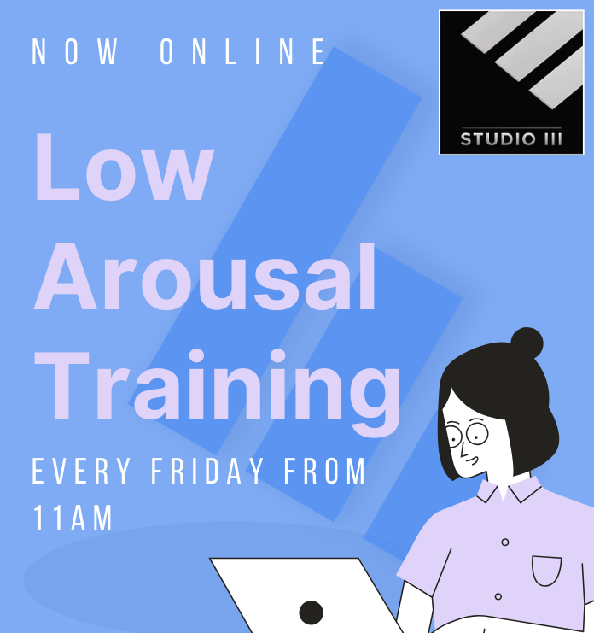
Low Arousal Online Training
Introductory and advanced training in Low Arousal Approaches Online on Fridays.
Visit www.studio3.org for more information

Slide 60
Links
FREE webinars - www.studio3.org/free-webinars
FREE Newsletter - www.studio3.org/so/d5OUpnBWt?languageTag=en
LASER Prog - www.studio3.org/laser-online
Low Arousal Training - www.studio3.org/low-arousal-online
Films - Videos Archives - Gareth D Morewood (gdmorewood.com)
SENCology Blog - SENCology | Optimus Education Blog (optimus-education.com)

Slide 61
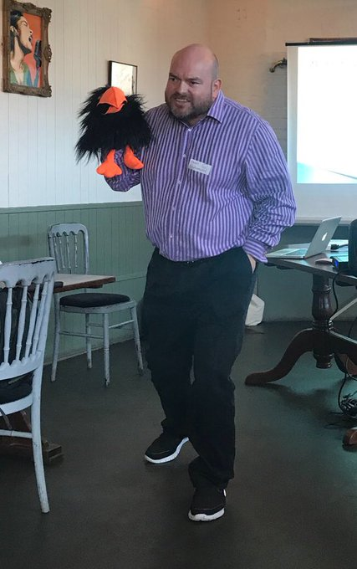

Slide 62
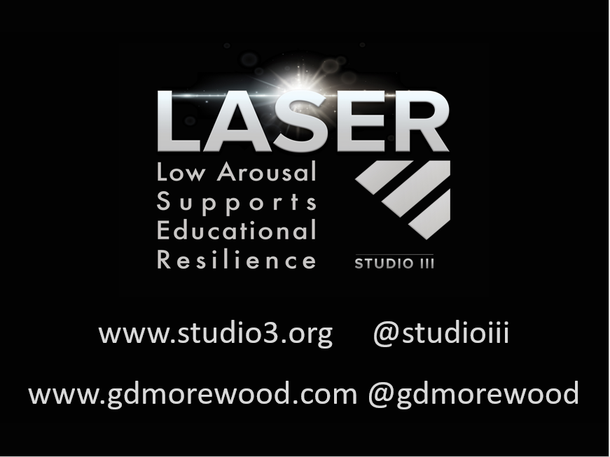
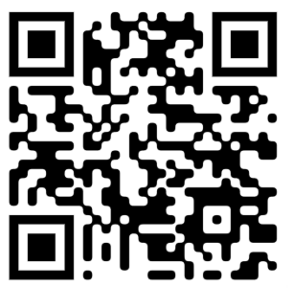
www.studio3.org @studioiii

