Slide 1

The Role of the SNLSA – practical ideas to support YP in the classroom and beyond
Gibraltar DoE Education Conference 2025
Gareth D Morewood

Slide 2
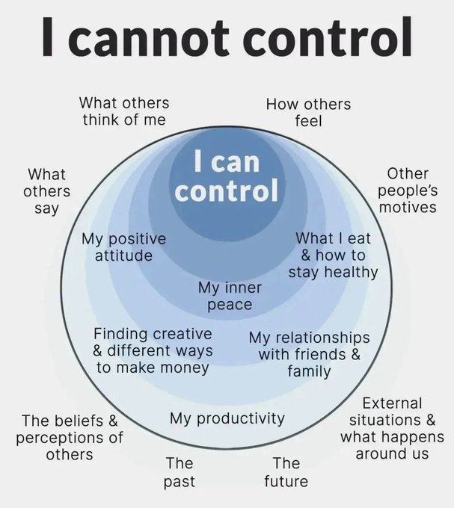

Slide 3
Why Can School Be Such a Challenging Place?
For the student
    Learning in a social setting, reading social situations, deciphering the unwritten rules
    Learning in a complex language environment with limited visual support
    Understanding and communicating with other students and adults
    Coping with change, transitions and unexpected breaks in routine
    Day to day organisation
    Generalising learning beyond the setting in which it took place

Slide 4
Why Can School Be Such a Challenging Place?
For the peer group
  Lack of understanding
  Resenting extra attention
  Social advances that are ignored or rejected
  Distraction or disruption
  Feeling that double standards are applied (‘getting away’ with things)
  Being nervous or fearful
  Ignoring, teasing, winding up, bullying (Morewood, Humphrey & Symes, 2011)
For staff and parents
    Gaining, maintaining and refocusing attention
    Motivation
    Differentiation of language and/or curriculum
    Managing behaviour ***WARNING***
    Accommodating special interests

Slide 5
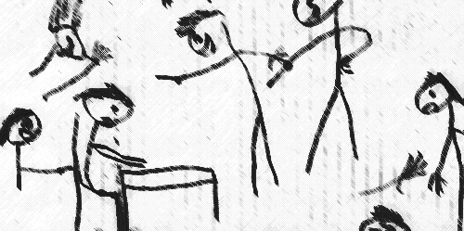
Why Can School Be Such a Challenging Place?
Taken from Humphrey & Lewis (2008)

Slide 6
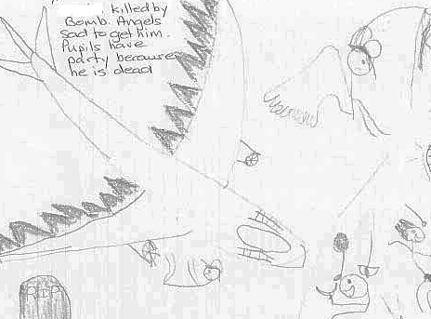
Why Can School Be Such a Challenging Place?
Taken from Humphrey & Lewis (2008)

Slide 7
We Can Inadvertently Be Triggers
The vast a majority of challenging situations are inadvertently triggered by supporters.
We are often unaware that we can trigger situations.
Reflective practice is a cornerstone of low arousal approaches.

Slide 8
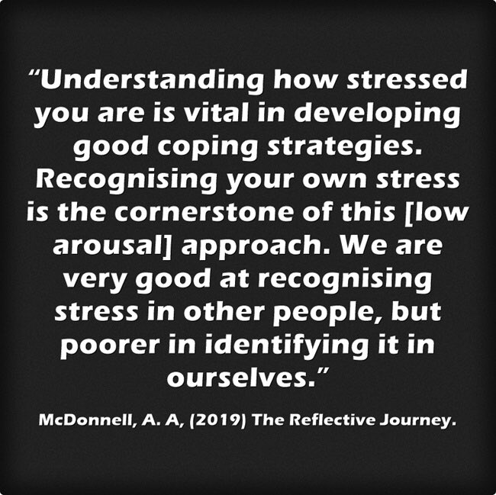
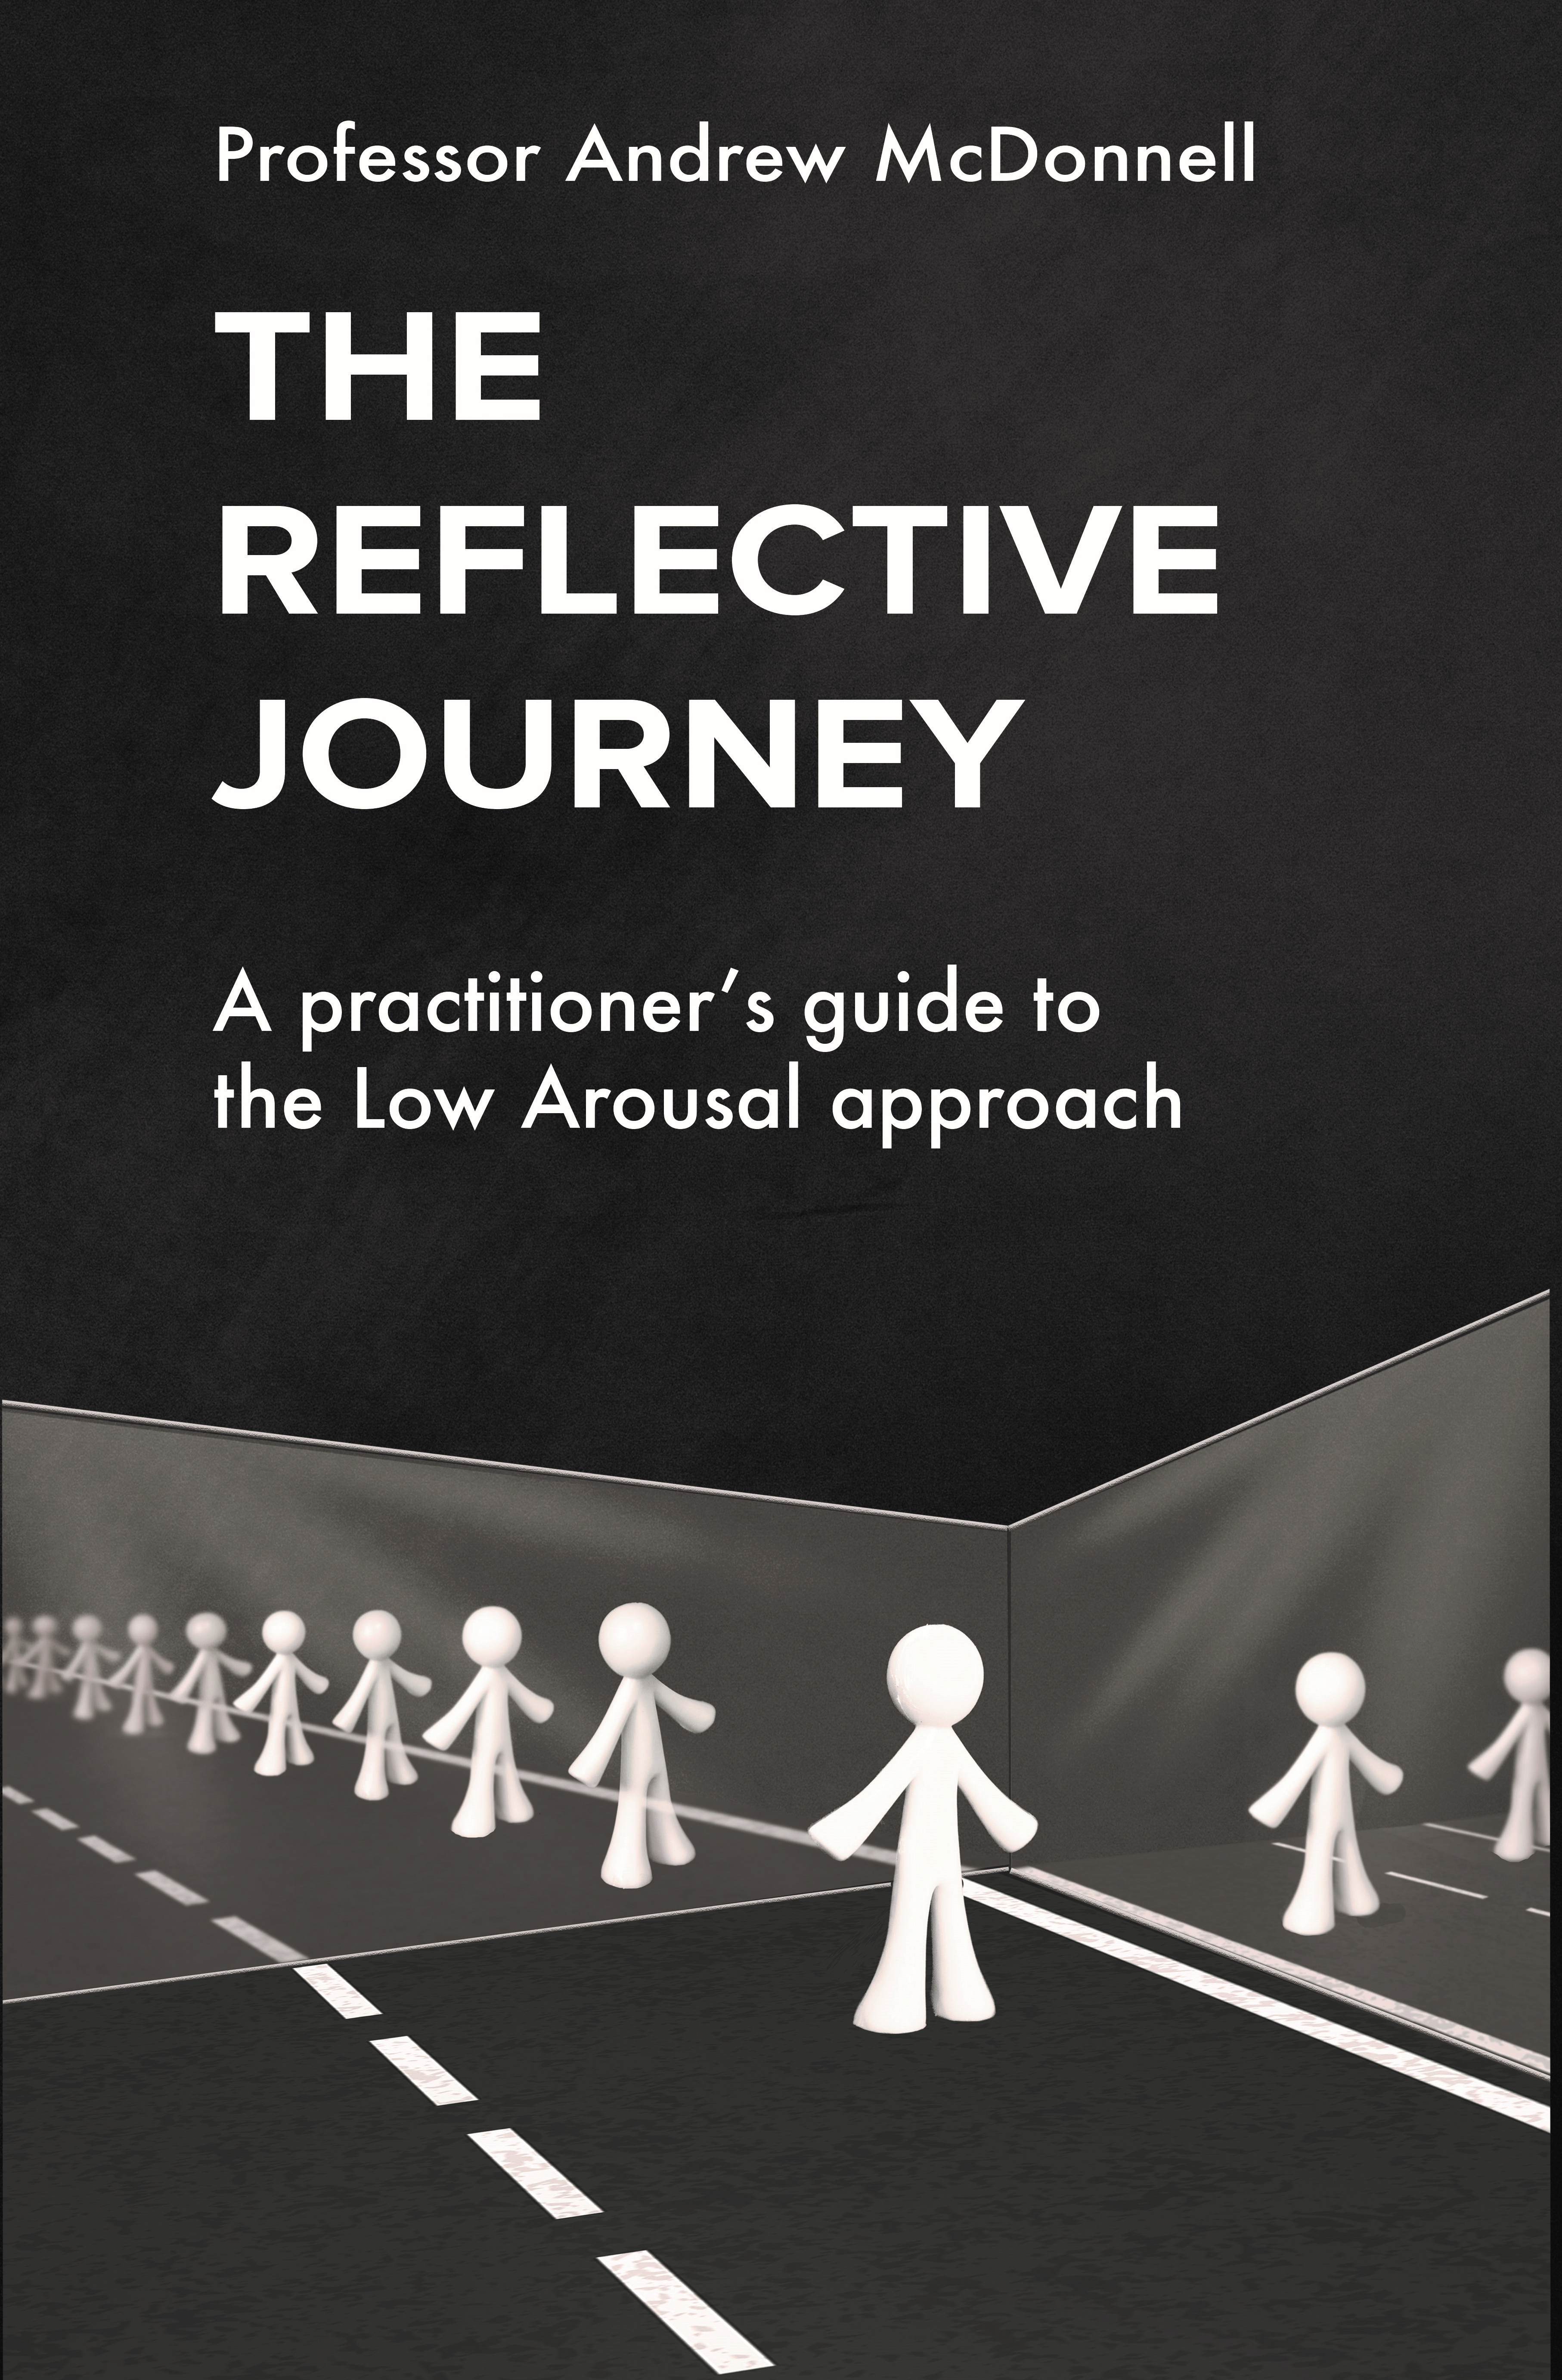
‘The Reflective Journey: A Practitioner’s Guide to the Low Arousal Approach’ is available from www.studio3.org/product-page

Slide 9
What Is the "Spoons Theory" of Autism?
Autistic people often experience burnout and fatigue.
"Spoons theory" encourages autistic people to think of their energy in terms of a limited number of spoons.
Conceiving of energy in this way can help autistic people stop themselves from taking on too much.
Being realistic about their energy and deliberate in how they use it can help autistic people avoid fatigue.

Slide 10
Understanding Stress
Lazarus and Folkman’s (1984) description of a transactional model of stress emphasises interaction between an individual and their environment.
Stress occurs when the demands of stressors outweigh coping responses.
There is a clear interaction between environmental and physiological events.

Slide 11
Understanding Stress
Implicit in this model is the cognitive appraisal of threat, as some individuals will have difficulties in regulating their emotional responses (as discussed previously) and therefore communicating them (Frith, 2003).
An individual’s coping responses are important in our understanding of stress, as it is almost impossible in the modern world to be ‘stress free’.

Slide 12


Slide 13


Slide 14
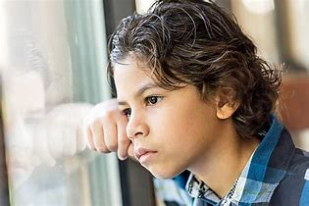

Slide 15


Slide 16


Slide 17
“Masking Is Life”: Experiences of Masking in Autistic and Nonautistic Adults. Autism in Adulthood
www.liebertpub.com/doi/10.1089/aut.2020.0083
Double Empathy: Why Autistic People Are Often Misunderstood
Double Empathy: Why Autistic People Are Often Misunderstood · Frontiers for Young Minds (frontiersin.org)

Slide 18
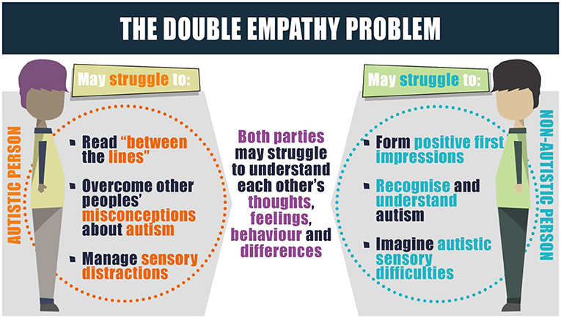

Slide 19
Understanding Stress
It is our coping responses that determine how we adapt to stress.
Many young people have very few 'coping tools’.
Some restricted or repetitive behaviours may have very real and vital coping functions.
For example, a person may engage in stereotyped movements which help them to regulate their arousal (McDonnell and Gayson, 2014).

Slide 20
Understanding Stress
We therefore need to consider carefully our own perspectives on such behaviour.
We wouldn’t remove a wheelchair or hearing aid from a student, yet we often deny young people their own coping mechanisms through unintended consequences of wider systems and policies.
www.youtube.com/watch?v=jTSsT8ixdrw

Slide 21
Understanding Stress
‘In essence, stable wellbeing is when individuals have the psychological, social and physical resources they need to meet a particular psychological, social and/or physical challenge. When individuals have more challenges than resources, the see-saw dips, along with their wellbeing, and vice-versa.’
(Dodge et al, 2012, p 230)

Slide 22
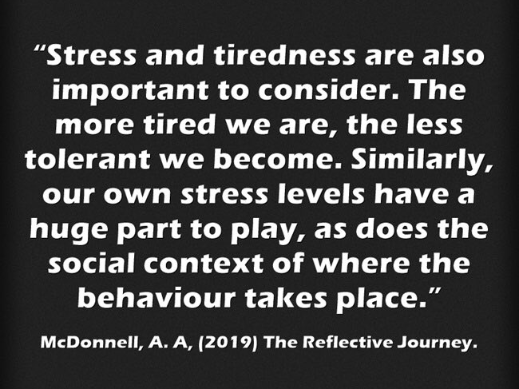
Understanding Stress

Slide 23
Combating Stress Pro-actively
Individual Exercise
Individually, consider the following three things:
What coping strategies do you use in your own life?
Identify some coping strategies you have seen pupils use.
How could your setting implement these coping strategies as an inclusive part of the curriculum?

Slide 24
Starting With Your Own Stress is Essential
Good arousal reduction strategies focus on our own arousal as well as our pupils/children/relatives.
Two (three) key aspects of arousal regulation include:
          (Mindfulness)
          Increased cardiac exercise
          Achieving and encouraging flow states (‘tune in’ and ‘tune out’)

Slide 25
Increased Cardiac Exercise
Cardiac exercise is an important area to focus on.
Exercise can serve a de-arousing function (McDonnell et al, 2015).
There is a growing body of literature that suggests links between cardiac exercise (Kohl & Cook, 2013) and stress.
We do not fully understand the complex mechanisms that lead to these results (Donnelly et al, 2016); however, the evidence suggests that mathematics and reading are the academic activities that are most influenced by physical activity.

Slide 26
Movement / Exercise
There are many studies which demonstrate that regular cardiac exercise is positive for our physical health, being associated with a lower risk of heart failure and increased well-being.
Aerobic exercise can also have a positive impact on cognitive functioning for children in classrooms.
Bidzan-Bluma, I. & Lipowska, M. (2018). Physical Activity and Cognitive Functioning of Children: A Systematic Review. International Journal of Environmental Research and Public Health, 15(4), 800.

Slide 27
Movement / Exercise
Cardiac exercise can produce positive physiological changes in relatively short periods of time, such as reducing levels of the stress hormone cortisol.
Alghadir, A. H., Gabr, S. A. & Aly, F. A. (2015). The Effects of Four Weeks of Aerobic Training on Saliva Cortisol and Testosterone in Young Healthy Persons. Journal of Physical Therapy Science, 27(7), 2029-2033.

Slide 28

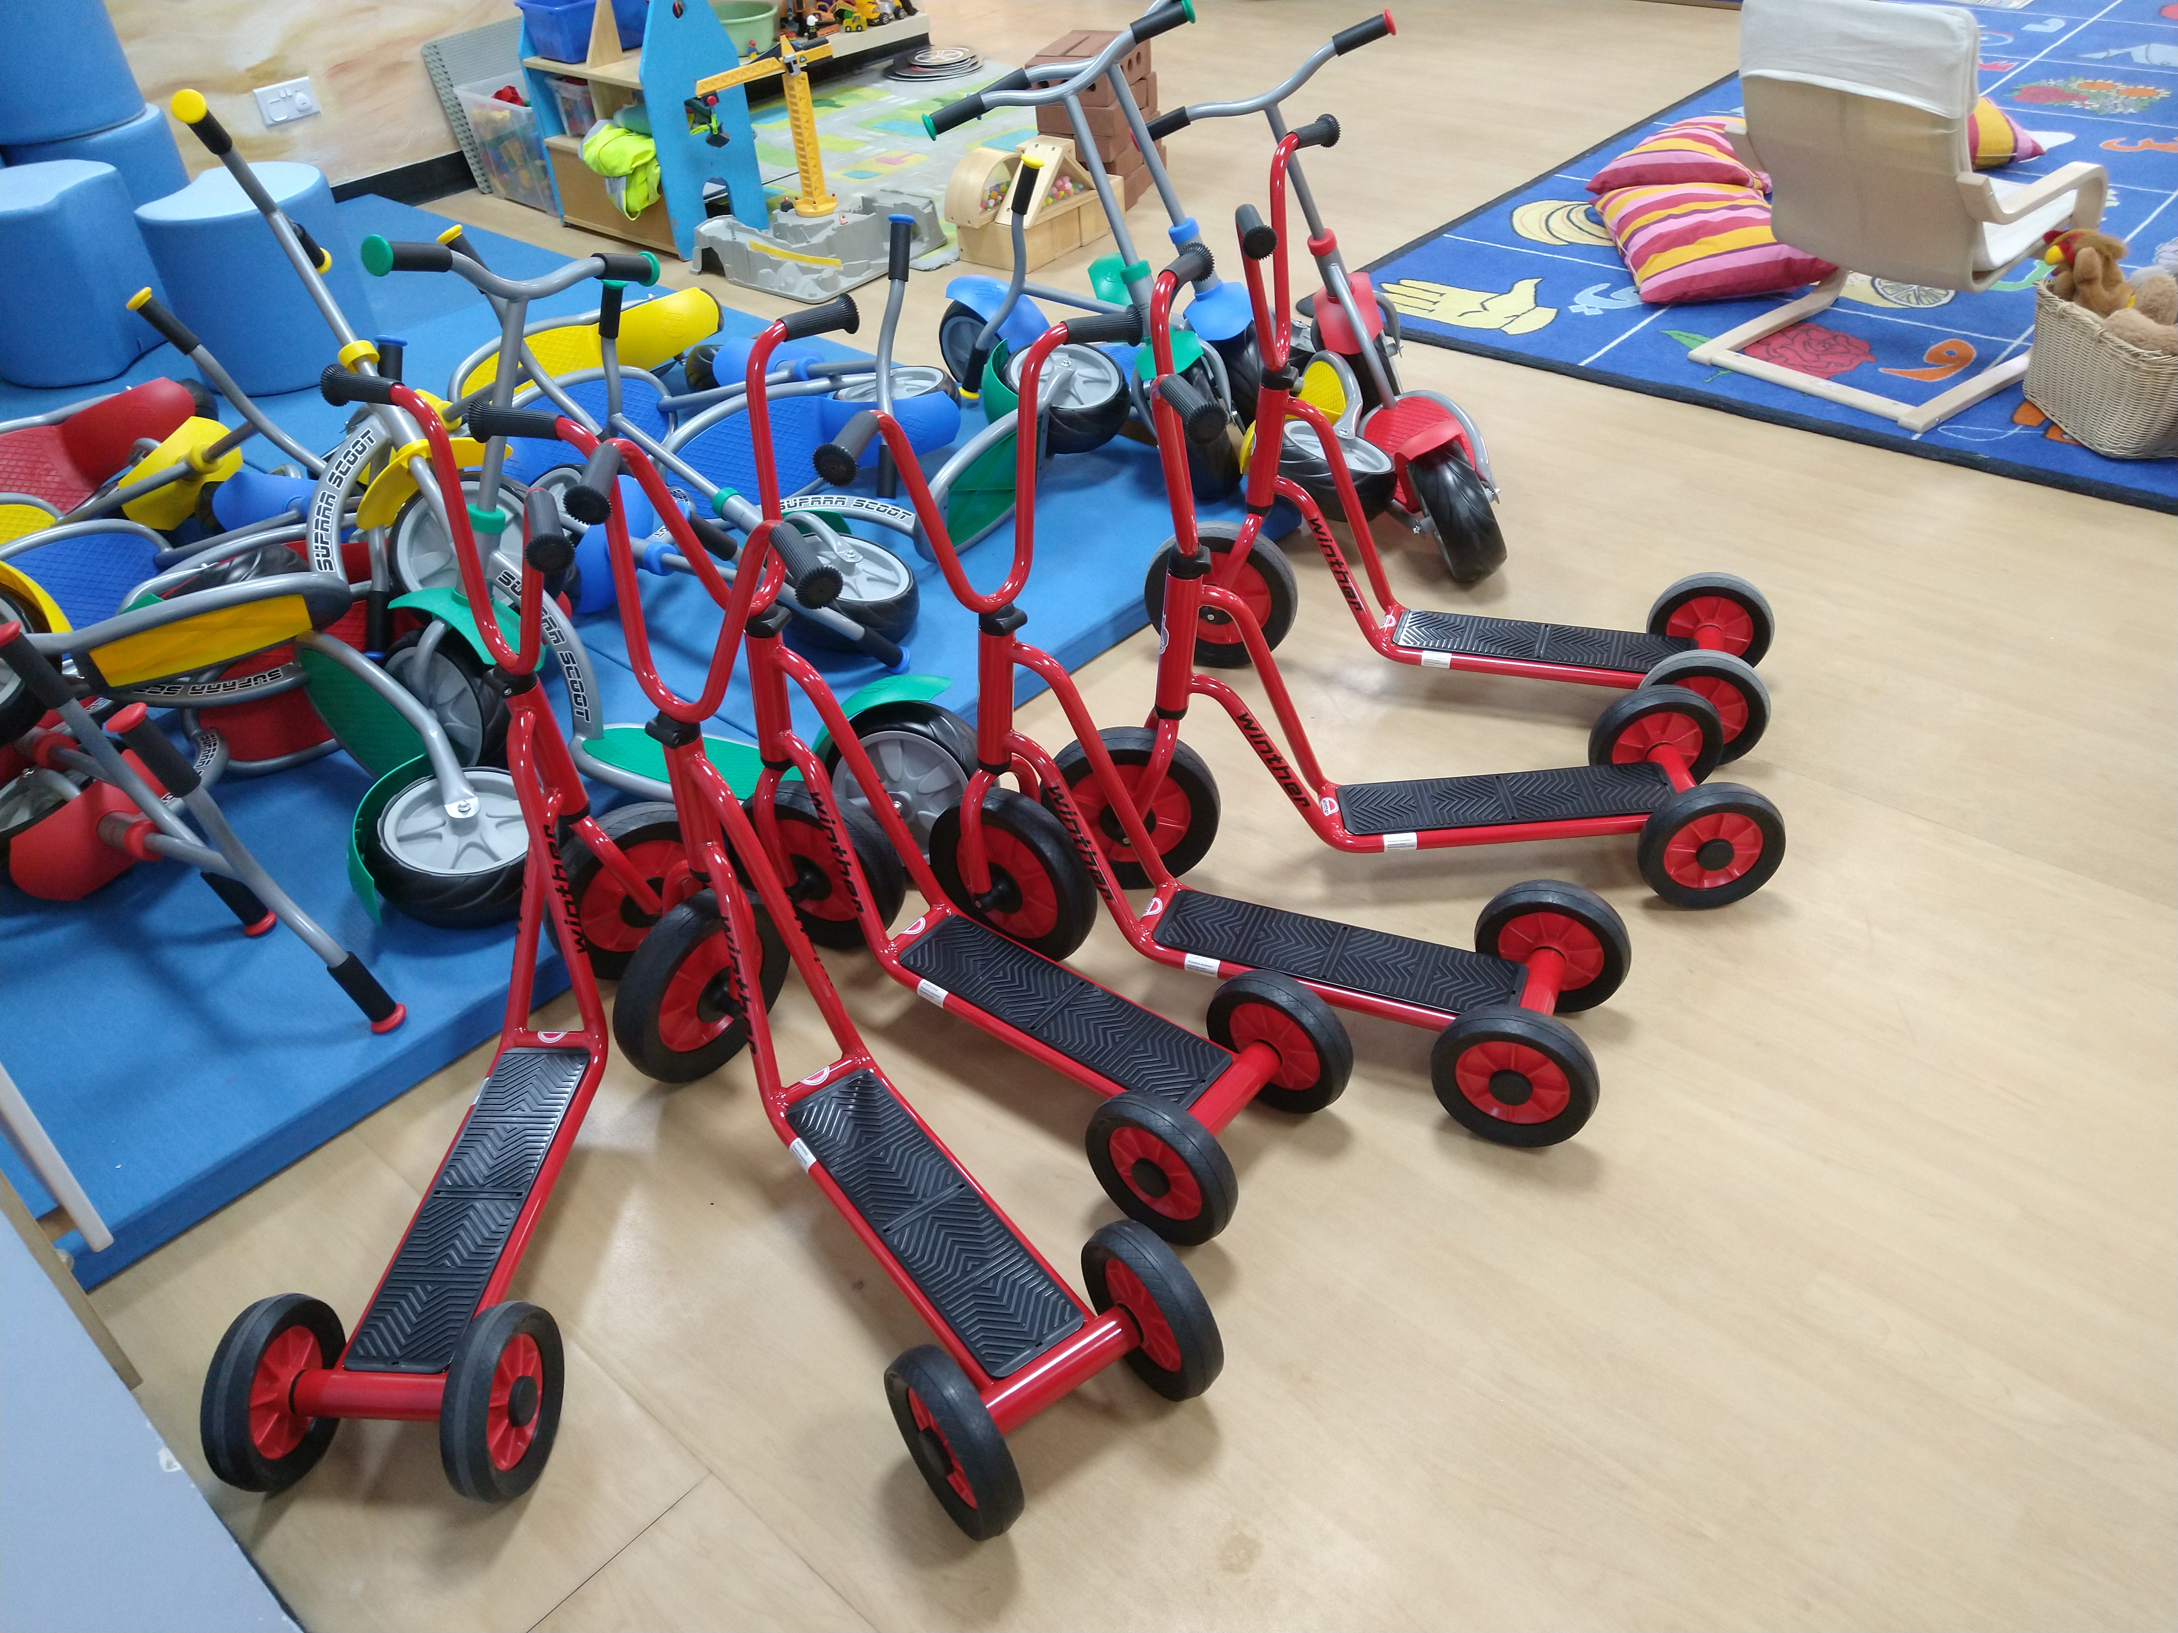

Slide 29
Increased Cardiac exercise
Exercise can have powerful effects on learning and evidence
suggests that the hour after exercise is an optimum time for
learning.
Three key questions:
How much cardiac exercise do you partake in in average week?
How much cardiac exercise do your students/children partake in in the average week?
How much short-term exercise is in your daily curriculum/home life?

Slide 30
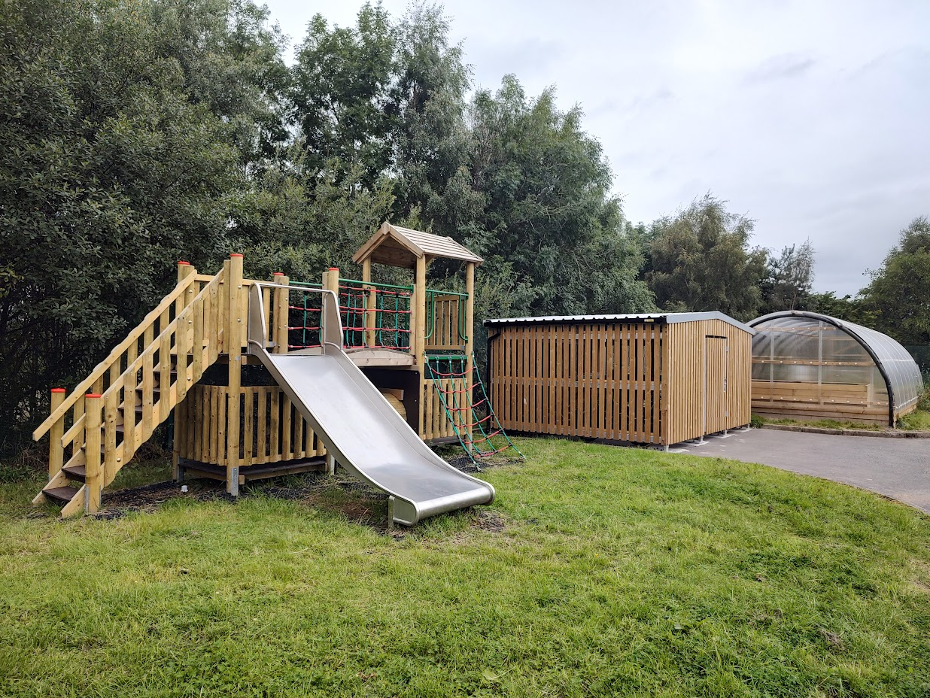
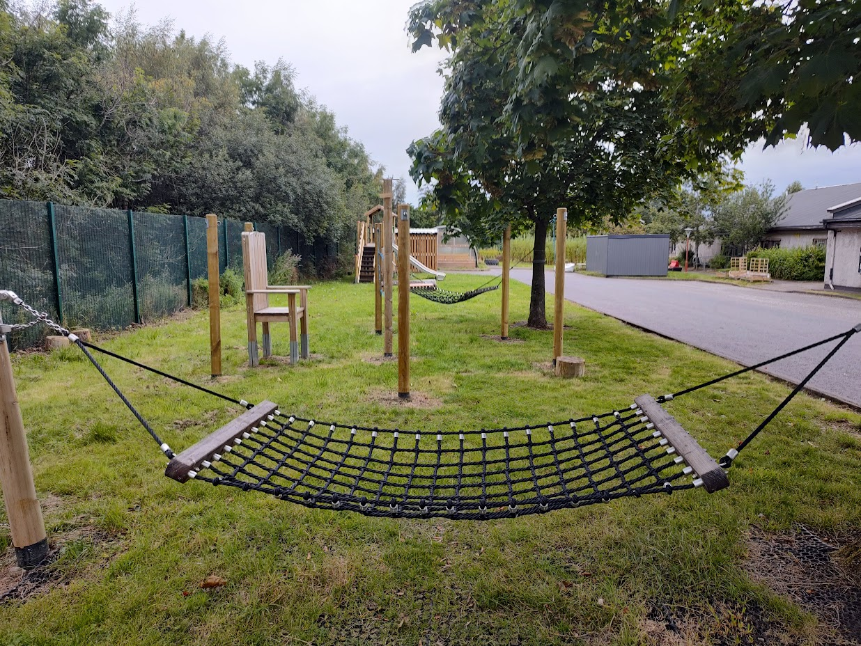
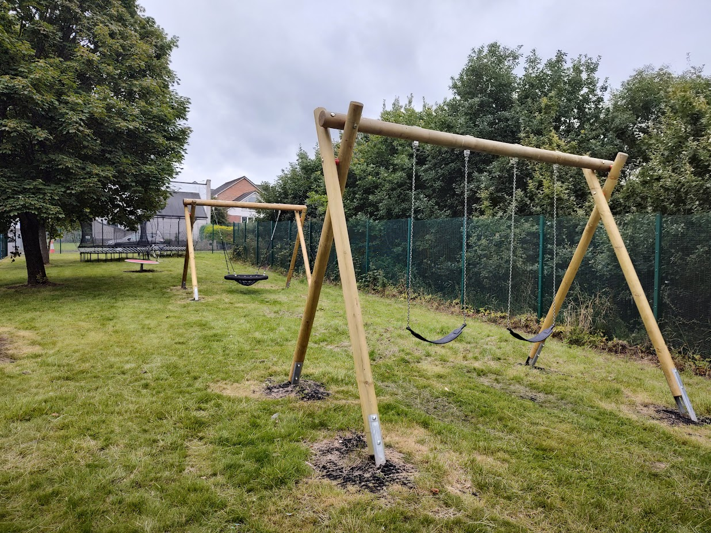
Self-Reg in Glasgow

Slide 31
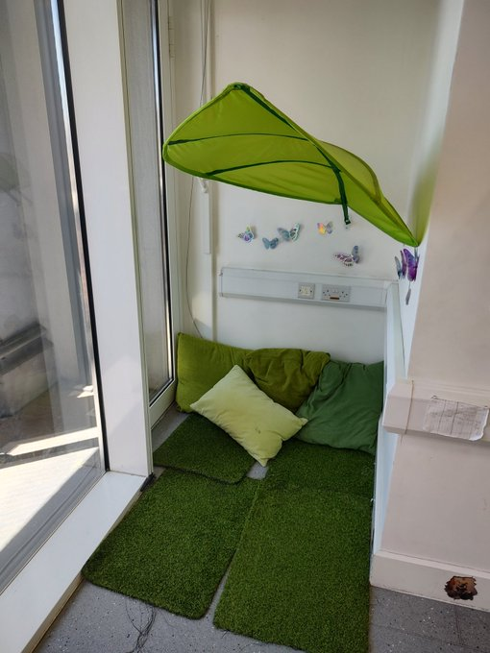
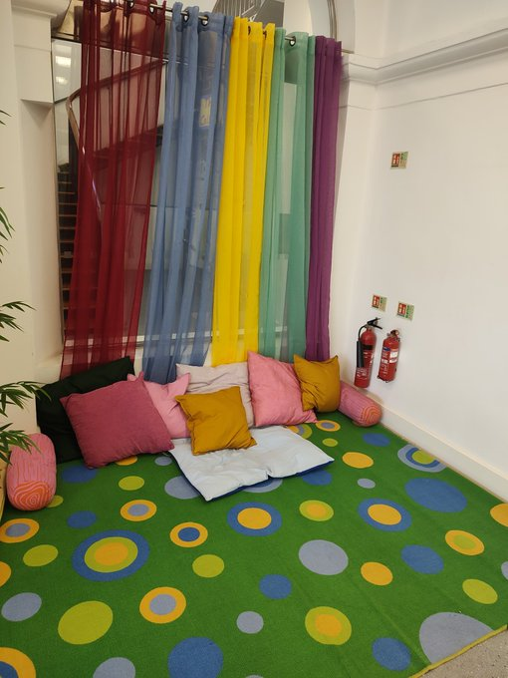
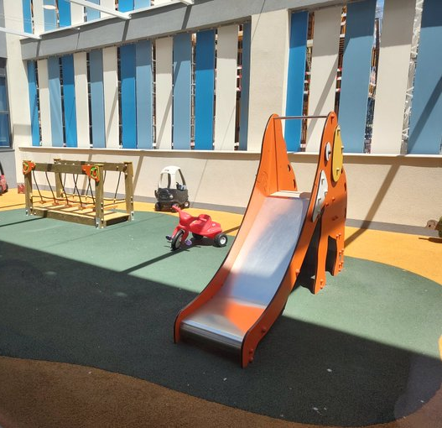
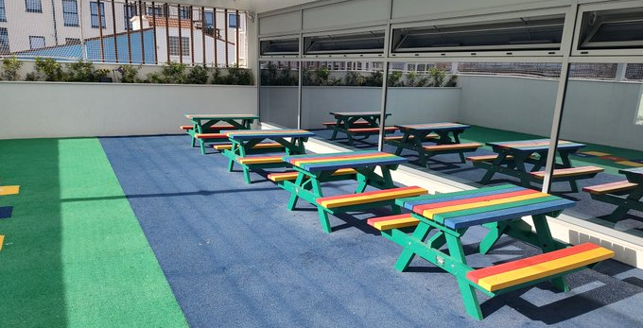
Self-Reg in
Gibraltar

Slide 32
    Self-Regulation / Use of Space
Key questions:
How do we understand and support Planned Escape / Self-Regulation in our settings?
What systems / policies can be developed and adopt to support human responses to stress and coping?

Slide 33
Planned Escape
Planned Escape
From the original interview almost a decade ago
http://ow.ly/h4h030qe7H1
Hear more about establishing a Planned Escape strategy, that worked!
http://ow.ly/ojdf30qe7H2 & http://ow.ly/zAZ330qe7H0

Slide 34
A Stress and Well-being Framework
Do you engage at least weekly with any of the following:
Light cardiac activity (2-3 hours of walking per week)?
Intensive cardiac exercise (1-2 hours a week)?
Participate in a physical sport?
10-15 minutes per day of some form of Mindfulness or meditation?
Drink more than 2 litres of fluid per day?
Have any absorbing hobbies or interests?
Regularly eat 3 meals (of whatever size) per day?
Suffer from gastric complaints, headaches and other minor ailments on a regular basis?

Slide 35
Achieving and Encouraging Flow States
Achieving a sense of flow is an important component of wellbeing and good stress management.
Flow experiences require complete immersion in an activity, whether playing a musical instrument, completing a complex technical task, or reading a book (Nakamura and Csikszentmihalyi, 2009).
Athletes can often refer to such states as ‘being in the zone’.

Slide 36
Achieving and Encouraging Flow States
Flow can also happen within social interactions.
For example: when one is talking to a good friend or playing with a young child (Csikszentmihalyi, 1990).
A flow state can also be achieved when the skills and resources available to an individual are fully engaged in managing an activity.

Slide 37
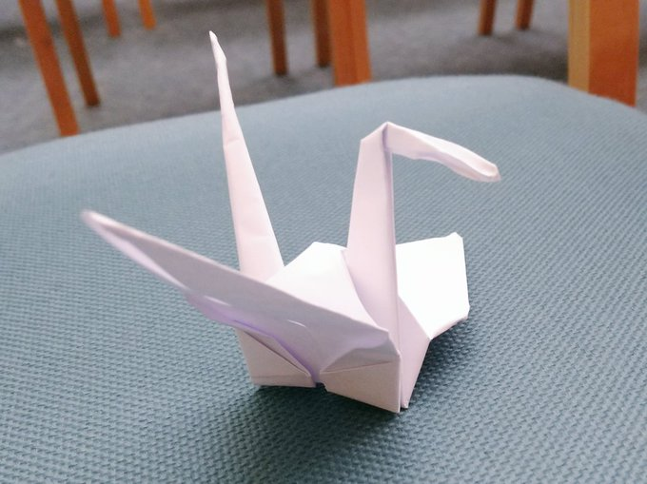
Achieving and Encouraging Flow States

Slide 38
Positive Psychology - Three Good Things Exercise
Participants were asked to write down three things that went well each day and their causes every night for one week (Seligman, 2005).
In addition they were asked to provide a causal explanation for each good thing.
You can see how Seligman’s ideas can be translated to school/home environments.
For 1 week at the end of each day, staff could write about 3 positive things that occurred in their day.
You can also ask them to describe 3 things that made them smile.

Slide 39
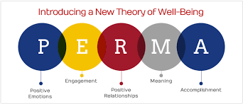
Positive Psychology – The PERMA Model
Seligman’s PERMA model of positive psychology is a useful tool for frontline staff to employ
Focus on positive recording, moments of happiness and building meaningful relationships with the young people we support

Slide 40
Positive Psychology – Happiness
‘The Happy School’ – Celebrating moments of happiness leads to a genuine and happy school ethos
Exercise:
Consider moments of happiness that have occurred previously in your school setting.
What strategies can we use to increase moments of happiness like these?

Slide 41
Supporting the use of
language in accessing
the curriculum

Slide 42
What is it like in class?
‘There is a growing body of evidence indicating that visual factors are associated with Dyslexia. This can take the form of visual distortion of letters, blurring, letters merging into each other and missing lines or words when reading.’
(Peer and Reid, 2003)
What is dyslexia? - Kelli Sandman-Hurley – YouTube
https://youtu.be/zafiGBrFkRM

Slide 43
Writing on the board…
Do not giving large amounts of dictation or work to copy off the board – use handouts
Make sure handwriting on the white board is clear and large enough to see from the back of the classroom
Finish the sentence with a red full stop to draw attention to the need for punctuation
Leave space between each line
Try alternating colours to separate sentences

Slide 44
Handouts…
Many students with visual processing problems prefer off white/cream paper to reduce glare and subsequent eye-strain
An alternative is to use grey or blue ink
A larger font size (14) is helpful as is a clean font such as Ariel or Comic Sans
Use clear unambiguous pictures with keywords or labels
Avoid ‘busy’ worksheets and text books with pictures, speech bubbles and diagrams splattered around, keep things simple and in a logical progression
Use colour where possible or teach students effective ways to use highlighter pens

Slide 45
General recommendations…
Check with students if they mind reading aloud in class
When reading is necessary, give them the text beforehand so they have to time to prepare
Don’t choose students to answer questions – let them volunteer
To encourage full class participation tell some students the question in advance so that they can prepare an answer
When having class discussions reinforce the answers given by students by repeating them back to the class in order to give those with auditory processing issues time think

Slide 46
Listening to and recalling information
Processing information
Language Difficulties
Formulating and using language
Understanding
verbal information

Slide 47
film doorzichtig lichtbron
foto zon kaarsen snelheid
Licht komt in onze ogen zodat wij kunnen zien.
Het licht komt van een _________ zoals de ______, gloeilamp, _______ en camera flits.
Het reist met hoge ________.
Licht kan door _________ materialen schijnen zoals de buitenkant van onze ogen of de lens voor een camera. Het licht dat de _______ raakt in een camera maakt een ______.
Het licht dat de achterkant van onze ogen raakt laat ons zien.

Slide 48
film zon doorzichtig lichtbron foto kaarsen snelheid
Licht komt in onze ogen zodat wij kunnen zien.
Het licht komt van een ________ zoals de _____, gloeilamp, ______ en camera flits.
Het reist met hoge _______.
Licht kan door _______ materialen schijnen zoals de buitenkant van onze ogen of de lens voor een camera. Het licht dat de ______ raakt in een camera maakt een _____.
Het licht dat de achterkant van onze ogen raakt laat ons zien.

Slide 49
Subject Specific (or technical) Words…
How are they learnt???
NAMING words:
Familiar object names, e.g. ‘windpipe’
New names, e.g. ‘trachea’
PROCESS words:
Can see, e.g. ‘evaporation’
Can’t see, e.g. ‘evolution’
CONCEPT Words:
Sensory
Dual Meanings - ‘pitch’
Concept words cannot be understood in isolation

Slide 50

The Impact in the Classroom…
Poor literacy skills
Difficulties retaining and recalling information
Difficulties understanding abstract vocabulary, concepts and ideas, e.g. language of time.
Can impact science, maths, history, etc.

Slide 51
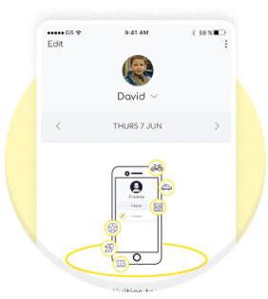
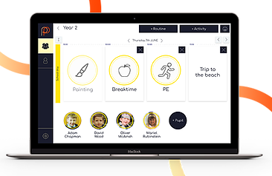
Digital Visual Timetable
www.mypicturepath.com
https://www.studio3.org/post/app-review-picturepath

Slide 52
Not understanding or being understood can be very frustrating and can lead to outbursts and challenging behaviour.
Often students with a history of presenting behavioural difficulties experience underlying Speech & Language difficulties.
Develop positive language-inclusive teaching strategies – DO NOT just ‘react’ to presenting behaviour.

Slide 53

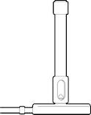

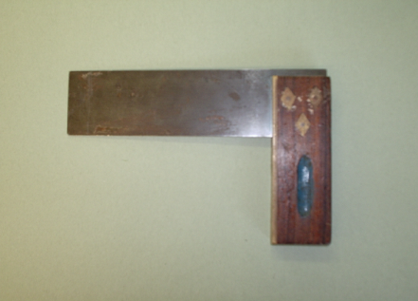
Strategies to develop and use…
Use visual supports as much a possible:
BUNSEN BURNER
TRY
SQUARE

Slide 54
Pre-Learn Key Words & Meanings

Slide 55
Word Walls
active ac tive |  | A volcano which erupts .
equator e qua tor |  | Imaginary line round the middle of the Earth.

Slide 56
Posters
acid
a cid
A sour tasting substance, some acids can be dangerous, e.g. battery acid
alkali
al ka li
A soapy tasting substance. The opposite of acid

Slide 57
Dictionaries
alkali
al ka li
A soapy tasting substance. The opposite of acid.

Slide 58
Consider ‘hidden disabilities’ …
What does that mean to you?
How would you define a Hidden (or ‘invisible) Disability?
Consider what this term means to you?
How many young people do you work with?
‘If children’s perceptions of people who are different from themselves are based on stereotypical thinking it is likely that they will retain this misinformation for the rest of their lives unless positive steps are taken to counter this learning.’
(Brown, 1998)

Slide 59
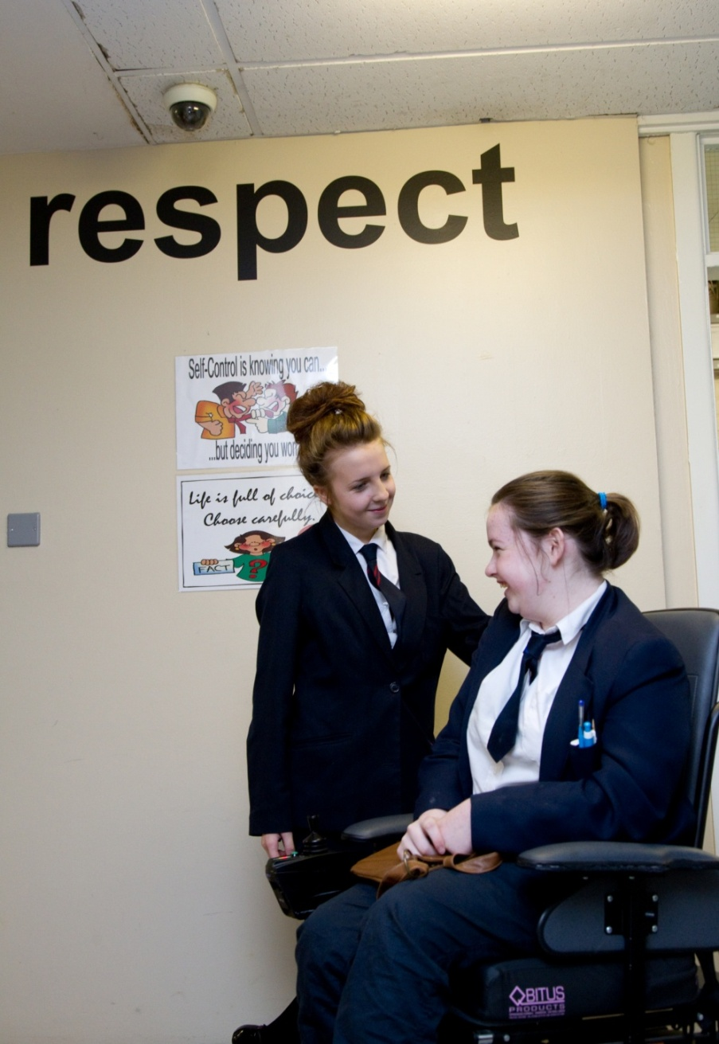
‘The education of the peer group is an essential part of moving towards a truly inclusive community’
Gareth D Morewood (2011)

Slide 60

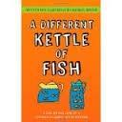


Must-Have Reads for Your Schools
Inclusive Book Store www.anewchapterbooks.com

Slide 61



Curriculum Is Key
Myatt, M. and Tomsett, J. (2023). SEND Huh – curriculum conversations with SEND leaders. John Catt, Woodbridge.
The Interoceptive Curriculum
www.kelly-mahler.com
Motor Skills United
www.tts-group.co.uk/motor-skills-united-therapy-programme/1002394.html

Slide 62
21st Century Children (1)
The young people in our schools are very different now, than 15 years ago ...
Neo-natal survival rates mean more children are surviving with complex needs and are now in our classes ...
Learning & Teaching is different now; it has to be ... so we have to evolve too …
In addition we have more and more young people in our schools who have experienced traumatic early childhood …
These negative attachments can mean increased risks …

Slide 63
21st Century Children (2)
The modern generation of children and young people includes:
  rare chromosomal disorders
  some who survived extreme prematurity or multiple disabilities at birth
  and those affected by prenatal drug and alcohol abuse
These children have complex learning difficulties and disabilities
(CLDD). They learn and respond differently to previous generations
of children with profound and multiple / severe learning difficulties.

Slide 64
So, what works in the classroom?
Structure: clear & consistent routines, boundaries, task completion, rituals, claiming behaviours
Engagement: positive non-verbal praise, using child’s name, early games
Nurture: soothing, supportive, non-verbal, positive care routines
Challenge: learning new skills/small steps/with support and consistency

Slide 65

RESILIENCE
RISK

Slide 66

Successful Classroom
Partnerships: Making the
most of teaching assistants
© Gareth D Morewood (2013)
Published by Optimus
Education
ISBN 978-1-907927-38-6
Foreword by Professor Neil
Humphrey. June 2013
Get Training Pack
Watch Short Film

Slide 67

SEND for New Teachers:
Preparing for quality first,
inclusive teaching
© Gareth D Morewood (2014)
Published by Optimus
Education.
ISBN 978-1-907927-55-3
Foreword by Professor Des
Hewitt. April 2014
Get Training Pack

Slide 68
Assumptions about Behaviour
Viewing a person as always a) in control & b) aware of their behaviour is a dangerous combination.
Seeing people as distressed and traumatised can #flipthenarrative on how we interact with these individuals in crisis situations – but also how we ‘set up’ learning – being pro-active is key!

Slide 69
Potential Causes & Challenges
Communication difficulties
Confusion
Unexpected change – breaking a routine
Environmental factors – heat, overcrowding, noise, etc.
Sensory differences i.e. hyper and hyposensitivity
Pain or medical problems
Medication changes
Inactivity/boredom
Demands and requests
Emotional problems and mental illness
Too many rules and restrictions
Being denied a need or getting something that they don’t want
Staff/Adults/Others
And many more…

Slide 70
Less Reactive – More Pro-active
The more pro-active we are the less reactive we need to be…

Slide 71
"When a person is drowning that is not the best time to teach them how to swim."
(David Pitonyak)

Slide 72
Evidence Based Learning Strategies
Spaced Practice
Retrieval Practice
Elaboration
Interleaving
Concrete Examples
Dual Coding
The Learning Scientists - www.learningscientists.org

Slide 73
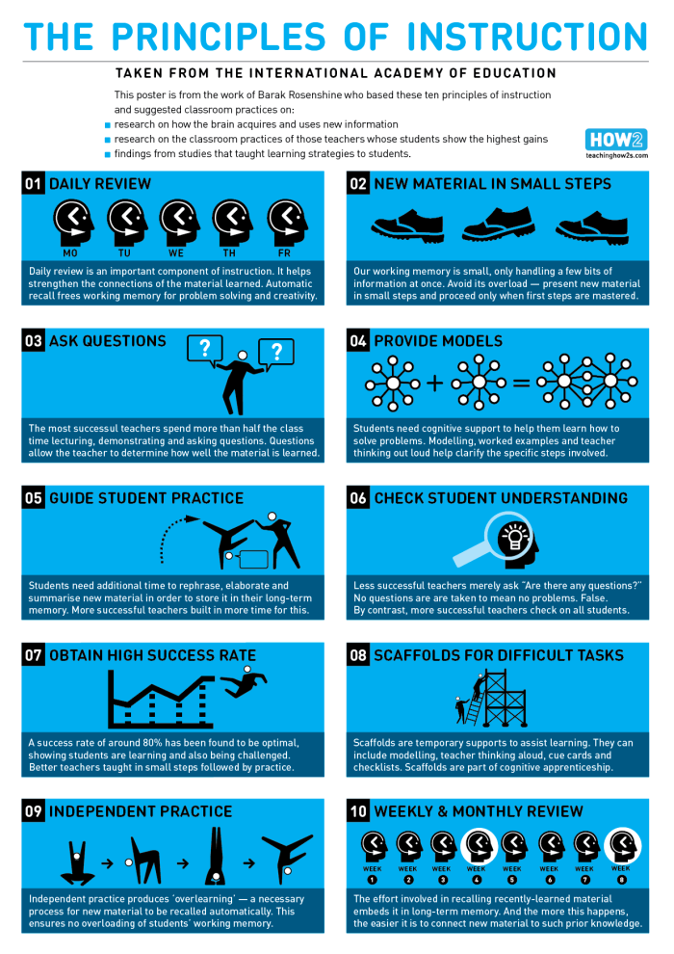
Using as a Guide – Not a Checklist
Two short films…
https://youtu.be/ZO8abw3DHxs
https://youtu.be/Pjrqc6UMDKM
www.retrievalpractice.org
https://lovetoteach87.com/2019/11/24/retrieval-practice-the-myths-versus-reality/

Slide 74
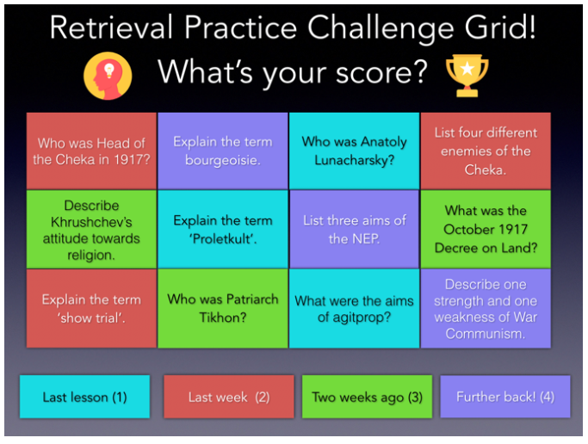
Kate Jones – @KateJones_teach
https://lovetoteach87.com/2018/01/12/retrieval-practice-challenge-grids-for-the-classroom/

Slide 75
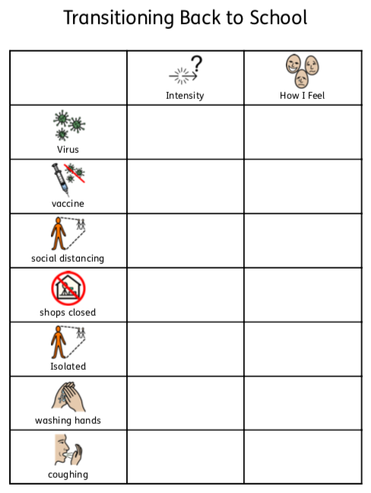
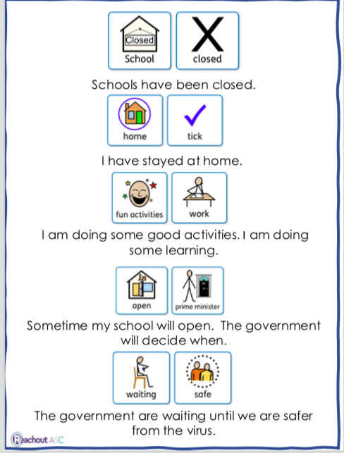
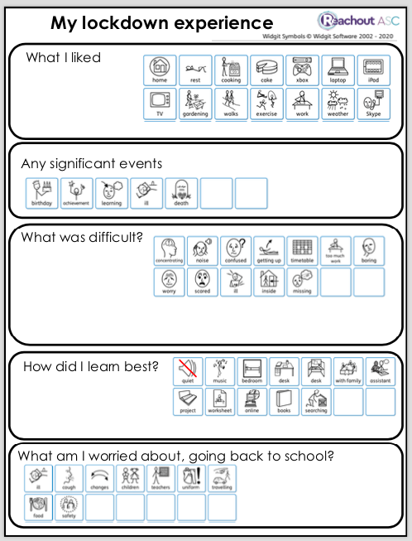

Visual Supports - Downloadable Resources - Reachout ASC - Lynn McCann

Slide 76
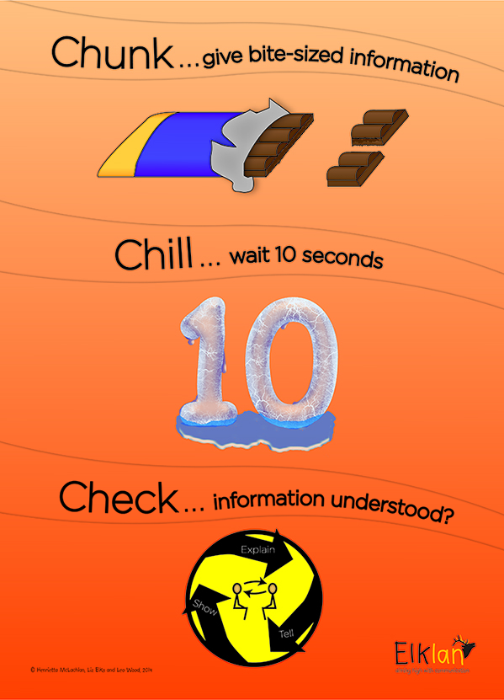
© Liz Elks and Henrietta McLachlan 2015

Slide 77
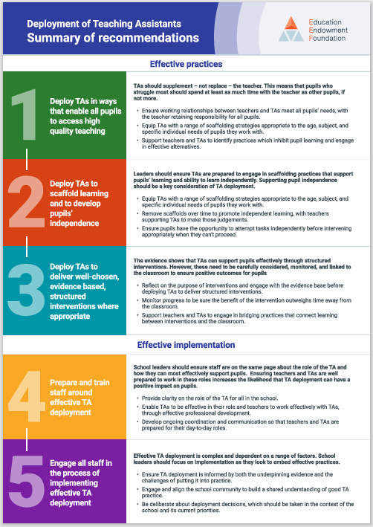

Slide 78
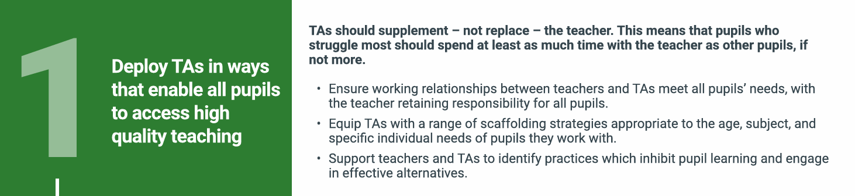
TAs should supplement – not replace – the teacher. This means that pupils who
struggle most should spend at least as much time with the teacher as other pupils, if
not more:
Ensure working relationships between teachers and TAs meet all pupils’ needs, with the teacher retaining responsibility for all pupils
Equip TAs with a range of scaffolding strategies appropriate to the age, subject, and specific individual needs of pupils they work with
Support teachers and TAs to identify practices which inhibit pupil learning and engage in effective alternatives.

Slide 79
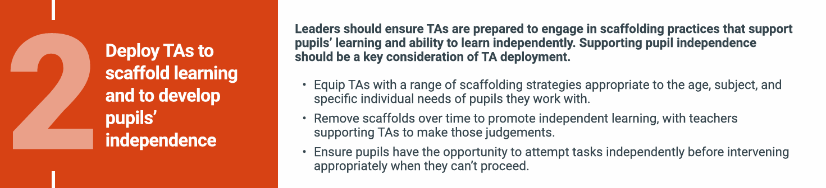
Leaders should ensure TAs are prepared to engage in scaffolding practices that support pupils’ learning and ability to learn independently. Supporting pupil independence should be a key consideration of TA deployment
Equip TAs with a range of scaffolding strategies appropriate to the age, subject, and specific individual needs of pupils they work with
Remove scaffolds over time to promote independent learning, with teachers supporting TAs to make those judgements
Ensure pupils have the opportunity to attempt tasks independently before intervening appropriately when they can’t proceed.

Slide 80
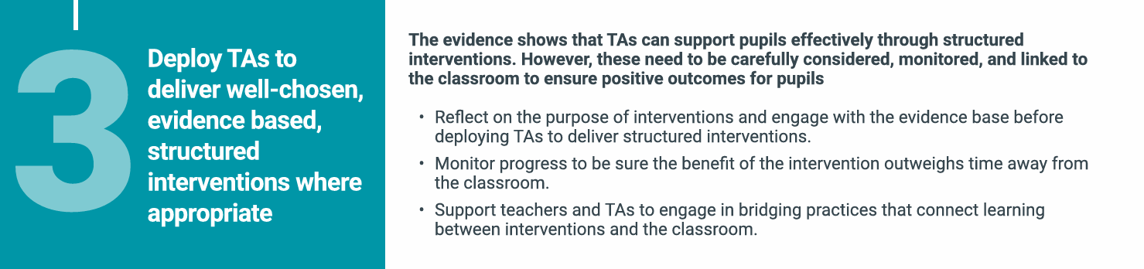
The evidence shows that TAs can support pupils effectively through structured interventions. However, these need to be carefully considered, monitored, and linked to the classroom to ensure positive outcomes for pupil
Reflect on the purpose of interventions and engage with the evidence base before deploying TAs to deliver structured interventions
Monitor progress to be sure the benefit of the intervention outweighs time away from the classroom
Support teachers and TAs to engage in bridging practices that connect learning between interventions and the classroom.

Slide 81
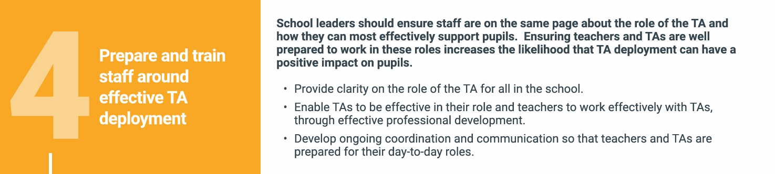
School leaders should ensure staff are on the same page about the role of the TA and how they can most effectively support pupils. Ensuring teachers and TAs are well prepared to work in these roles increases the likelihood that TA deployment can have a positive impact on pupils
Provide clarity on the role of the TA for all in the school
Enable TAs to be effective in their role and teachers to work effectively with TAs, through effective professional development
Develop ongoing coordination and communication so that teachers and TAs are prepared for their day-to-day roles.

Slide 82
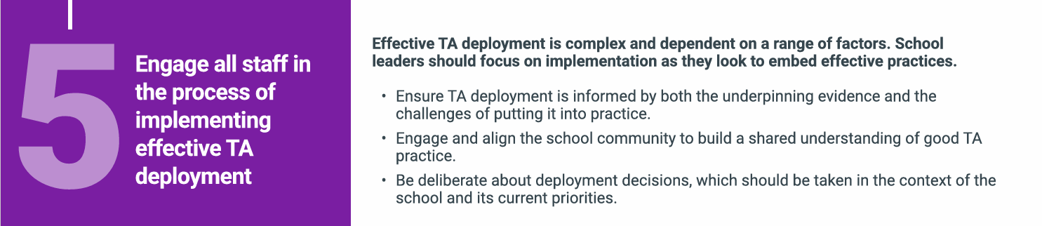
Effective TA deployment is complex and dependent on a range of factors. School leaders should focus on implementation as they look to embed effective practices
Ensure TA deployment is informed by both the underpinning evidence and the challenges of putting it into practice
Engage and align the school community to build a shared understanding of good TA practice
Be deliberate about deployment decisions, which should be taken in the context of the school and its current priorities.

Slide 83
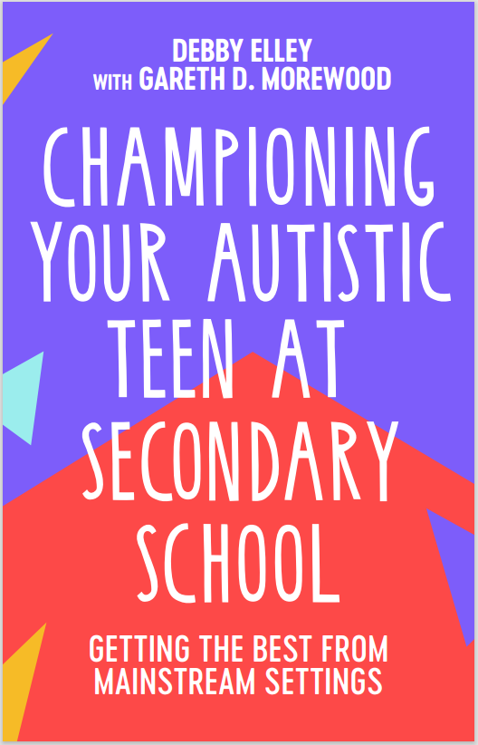
New Book - Available for £10 today
‘I’d recommend this to all parents looking to support their child in school and to all teachers who want to build a collaborative approach with pupils and parents.’
Richard Nurse, parent and founder of Picturepath.
‘This book’s grounded, compassionate and practical approach will be a boon for all involved in the education of autistic teenagers. I highly recommend it.’
Mary Myatt, education writer and curator of Myatt and Co.
‘This should be essential reading for parents of autistic children who attend a mainstream secondary school. A remarkable achievement.’
Neil Humphrey, Sarah Fielden Chair: Psychology of Education, University of Manchester.
‘Drenched in lived experience, this is a superb guide. You’ll learn something new in every chapter.’
Matt Keer, parent contributor to Special Needs Jungle website.

Slide 84
Spot What Is Going Well & Develop
‘If you were the boss managing a team, and you only ever spoke to them when there was something to criticise, the chances are you’d not have a very motivated team. The same psychology works here…’
‘Tell them what they did right and why! There’s nothing in the word ‘no’ that tells a school what it should be doing instead.’
Championing Your Teen at Secondary School

Slide 85
Links
FREE webinars - www.studio3.org/free-webinars
LASER Prog - www.studio3.org/laser-online
Low Arousal Training - www.studio3.org/low-arousal-online
Films - Videos Archives - Gareth D Morewood (gdmorewood.com)
SENCology Blog - SENCology | Optimus Education Blog (optimus-education.com)

Slide 86
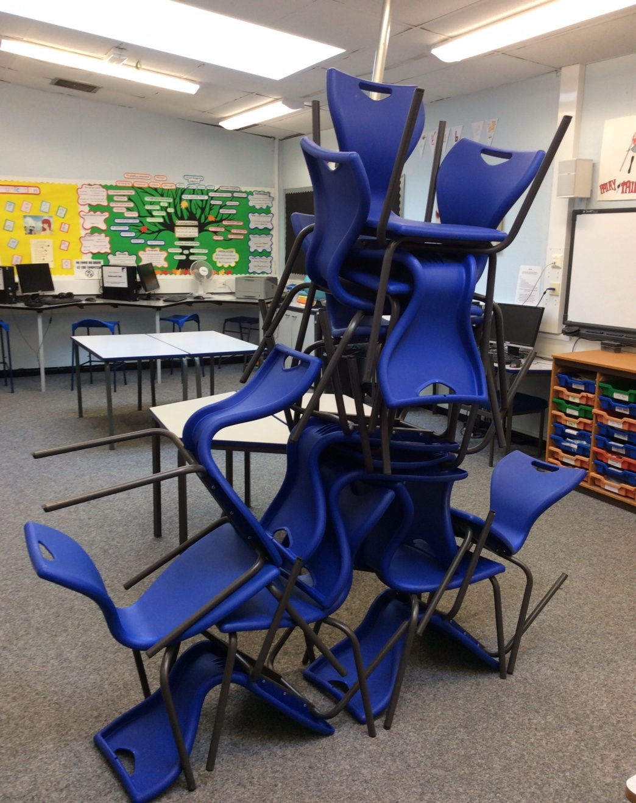

Slide 87


Slide 88
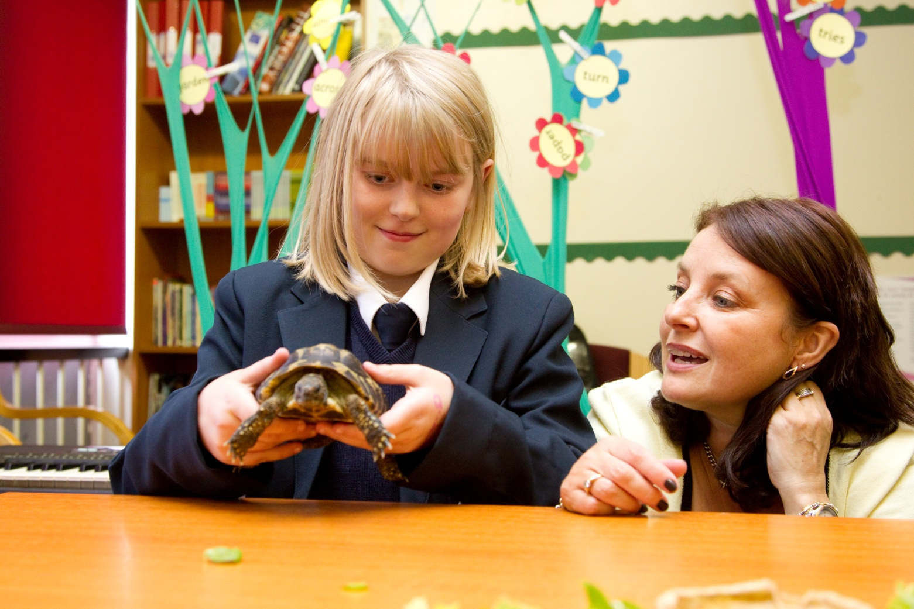
Learning isn’t always the same ...

Slide 89

The ‘Bananarama’ Principle…
It ain’t what you do it’s the way that you do it…
So how do you spend to ‘get results’?
Or, what does the evidence say is a good investment or a poor investment for your students/child?
It ain’t what you spend but the way that you spend it… what works for one, may not for others!
Personalisation in the key!
Quoted from Prof Steve Higgins

Slide 90
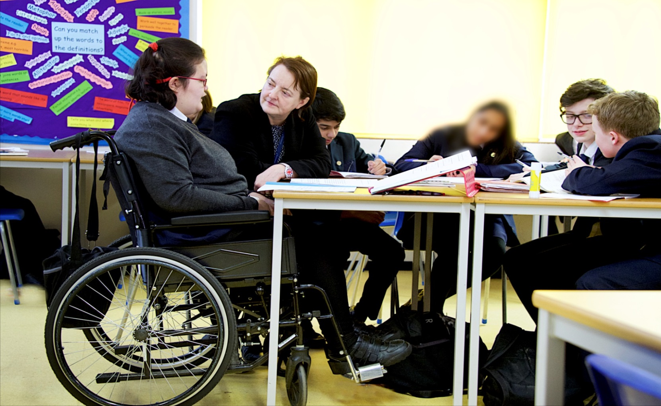
“I get to do everything my friends do, just that sometimes I have things changed a little so I can join in properly.” Lisa, aged 15

Slide 91


Slide 92
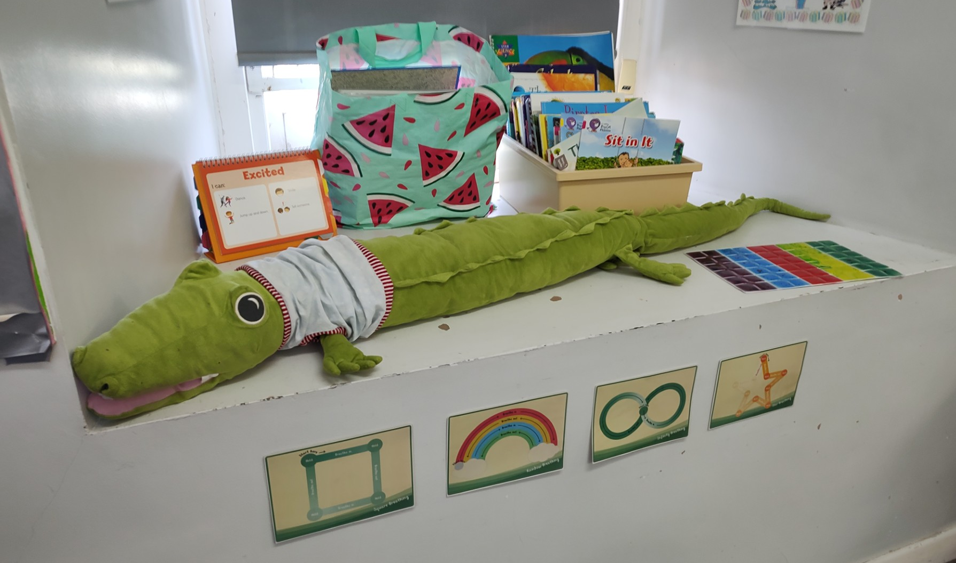
Don’t Worry!

Slide 93


www.studio3.org @studioIII www.gdmorewood.com @gdmorewood
Practical Ideas For Inclusive Classrooms

