Slide 1

Gibraltar DoE Education Conference 2025
Practical Self-Care and Personal Wellbing Strategies for Staff
Gareth D Morewood

Slide 2
The Importance of Context
Life takes place within a social setting, reading social situations, deciphering the unwritten rules
We live in a complex language environment (often) with limited visual support (& lots of verbal instructions)
Understanding and communicating with other young people and adults
Coping with change, transitions and unexpected breaks in routine
Day to day organisation
Generalising learning beyond the setting in which it took place

Slide 3
Understanding Stress
‘In essence, stable wellbeing is when individuals have the psychological, social and physical resources they need to meet a particular psychological, social and/or physical challenge. When individuals have more challenges than resources, the see-saw dips, along with their wellbeing, and vice-versa.’
(Dodge et al, 2012, p 230)

Slide 4
“Psychological stress is a relationship between the person and the environment that is appraised by the person as taxing or exceeding his or her resources and endangering his or her well being. The judgment that a particular person-environment relationship is stressful hinges on the cognitive appraisal of that situation.”
“The outcome of the impact of stress depends on how well we cope. What our coping styles are like and how effective they are.”
Lazarus and Folkman (1984)

Slide 5
Stress
Time

Slide 6
"When a person is drowning that is not the best time to teach them how to swim."
(David Pitonyak)

Slide 7
A Stress and Well-being Framework
Do you & your young people engage at least weekly with any of the following:
Light cardiac activity (2-3 hours of walking per week)?
Intensive cardiac exercise (1-2 hours a week)?
Participate in a physical sport?
10-15 minutes per day of some form of Mindfulness or meditation?
Drink more than 2 litres of fluid per day?
Have any absorbing hobbies or interests?
Regularly eat 3 meals (of whatever size) per day?

Slide 8
Achieving and Encouraging Flow States
Achieving a sense of flow is an important component of wellbeing and good stress management.
Flow experiences require complete immersion in an activity, whether playing a musical instrument, completing a complex technical task, or reading a book (Nakamura and Csikszentmihalyi, 2009).
Athletes can often refer to such states as ‘being in the zone’.

Slide 9
Achieving and Encouraging Flow States
Flow can also happen within social interactions.
For example: when one is talking to a good friend or playing with a young child (Csikszentmihalyi, 1990).
A flow state can also be achieved when the skills and resources available to an individual are fully engaged in managing an activity.

Slide 10
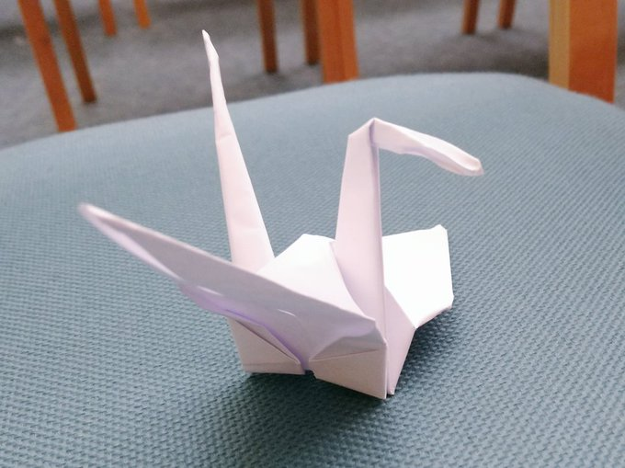
Achieving and Encouraging Flow States

Slide 11
What Is the "Spoons Theory" of Autism?
Autistic people often experience burnout and fatigue.
"Spoons theory" encourages autistic people to think of their energy in terms of a limited number of spoons.
Conceiving of energy in this way can help autistic people stop themselves from taking on too much.
Being realistic about their energy and deliberate in how they use it can help autistic people avoid fatigue.

Slide 12
Positive Psychology - Three Good Things Exercise
Participants were asked to write down three things that went well each day and their causes every night for one week (Seligman, 2005).
In addition they were asked to provide a causal explanation for each good thing.
You can see how Seligman’s ideas can be translated to school/home environments.
For 1 week at the end of each day, staff could write about 3 positive things that occurred in their day.
You can also ask them to describe 3 things that made them smile.

Slide 13
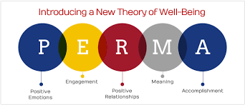
Positive Psychology – The PERMA Model
Seligman’s PERMA model of positive psychology is a useful tool for frontline staff to employ
Focus on positive recording, moments of happiness and building meaningful relationships with the young people we support

Slide 14
“Masking Is Life”: Experiences of Masking in Autistic and Nonautistic Adults. Autism in Adulthood
www.liebertpub.com/doi/10.1089/aut.2020.0083
Double Empathy: Why Autistic People Are Often Misunderstood
Double Empathy: Why Autistic People Are Often Misunderstood · Frontiers for Young Minds (frontiersin.org)

Slide 15
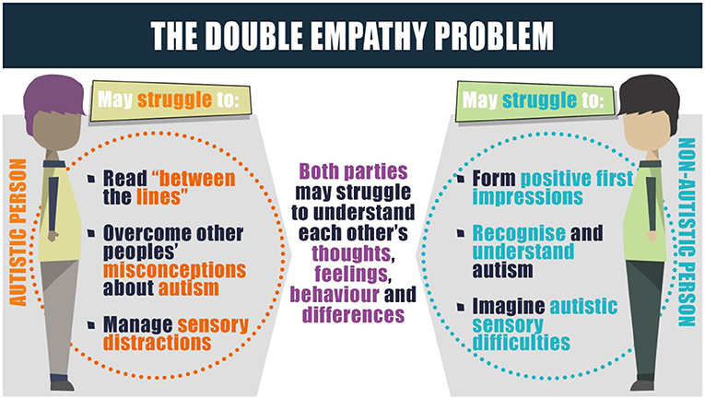

Slide 16
We Must Be Careful Where We Locate The ‘Problem’
The vast a majority of challenging situations are inadvertently triggered by supporters.
We are often unaware that we can trigger situations.
Reflective practice is a cornerstone of low arousal approaches.

Slide 17
Movement / Exercise
There are many studies which demonstrate that regular cardiac exercise is positive for our physical health, being associated with a lower risk of heart failure and increased well-being.
Aerobic exercise can also have a positive impact on cognitive functioning for children in classrooms.
Bidzan-Bluma, I. & Lipowska, M. (2018). Physical Activity and Cognitive Functioning of Children: A Systematic Review. International Journal of Environmental Research and Public Health, 15(4), 800.

Slide 18
Movement / Exercise
Cardiac exercise can produce positive physiological changes in relatively short periods of time, such as reducing levels of the stress hormone cortisol.
Alghadir, A. H., Gabr, S. A. & Aly, F. A. (2015). The Effects of Four Weeks of Aerobic Training on Saliva Cortisol and Testosterone in Young Healthy Persons. Journal of Physical Therapy Science, 27(7), 2029-2033.

Slide 19

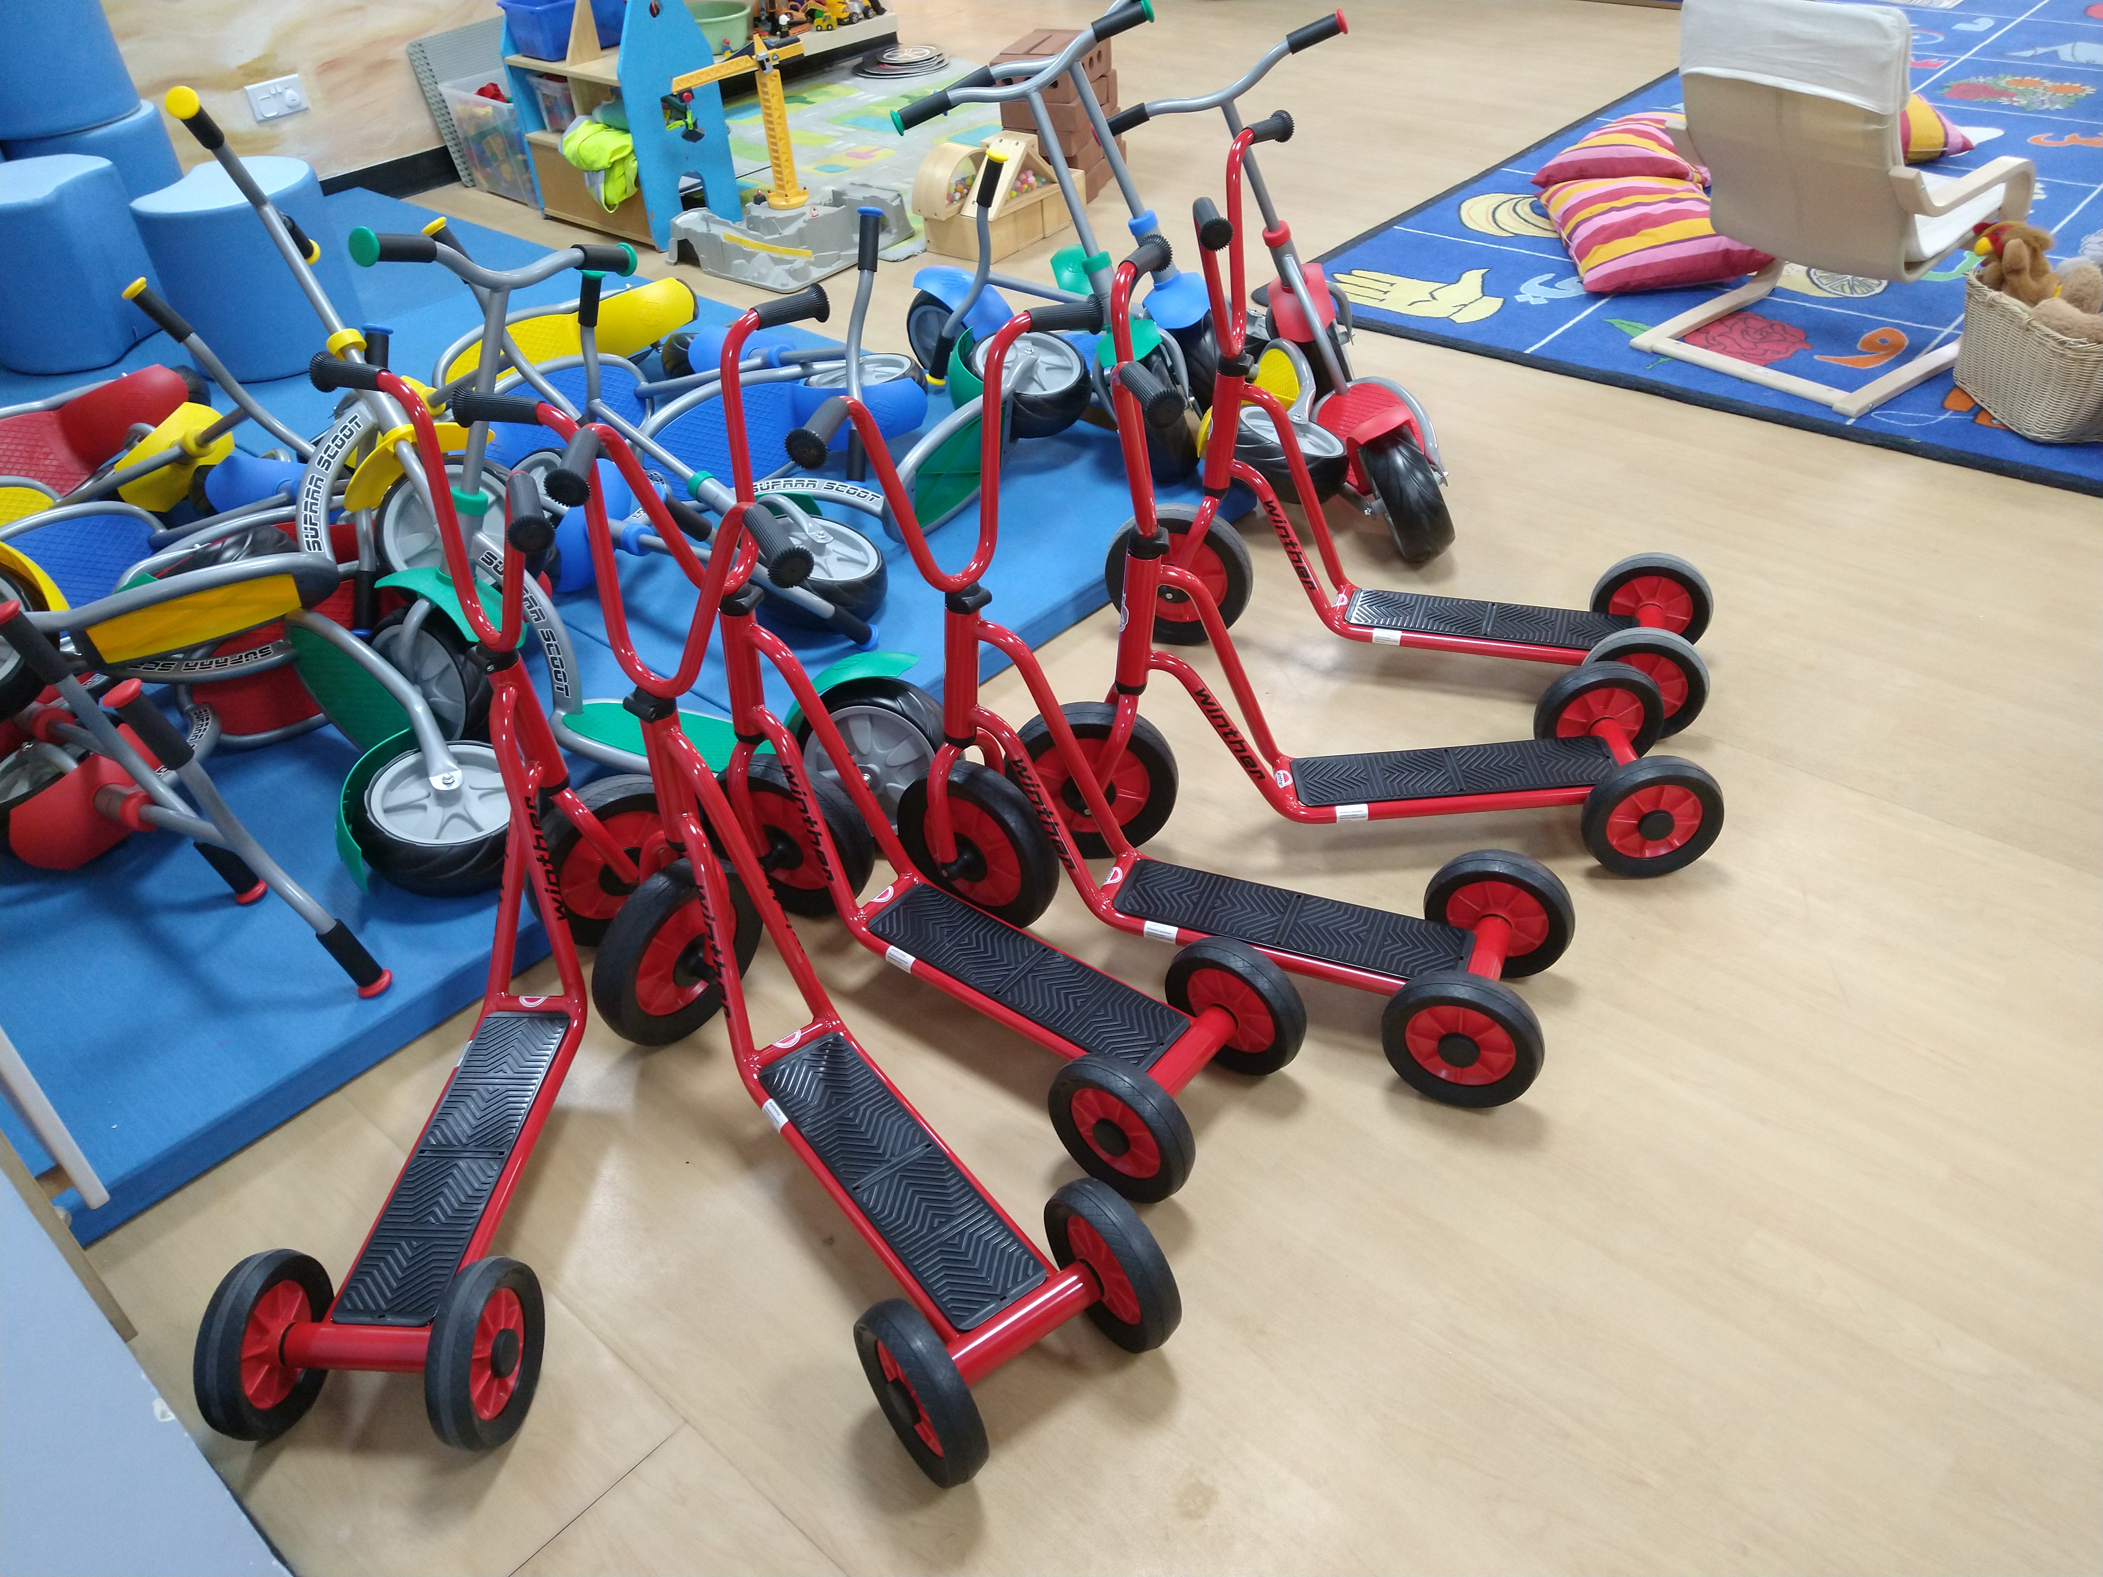


Slide 20
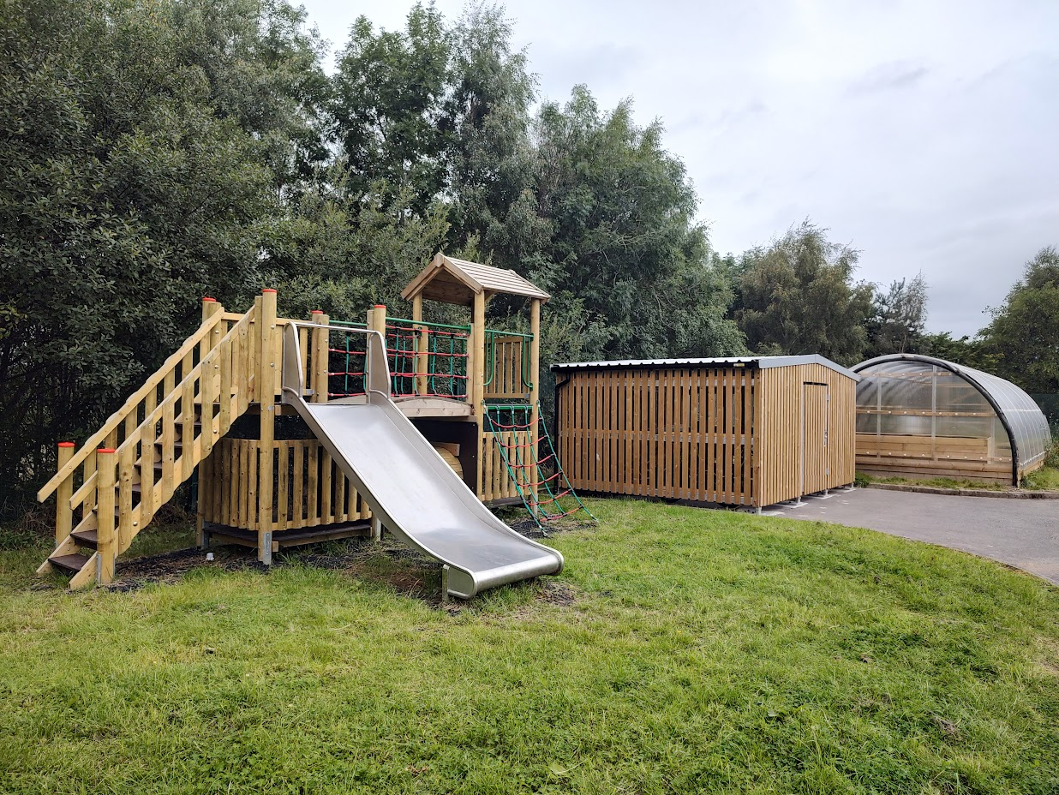
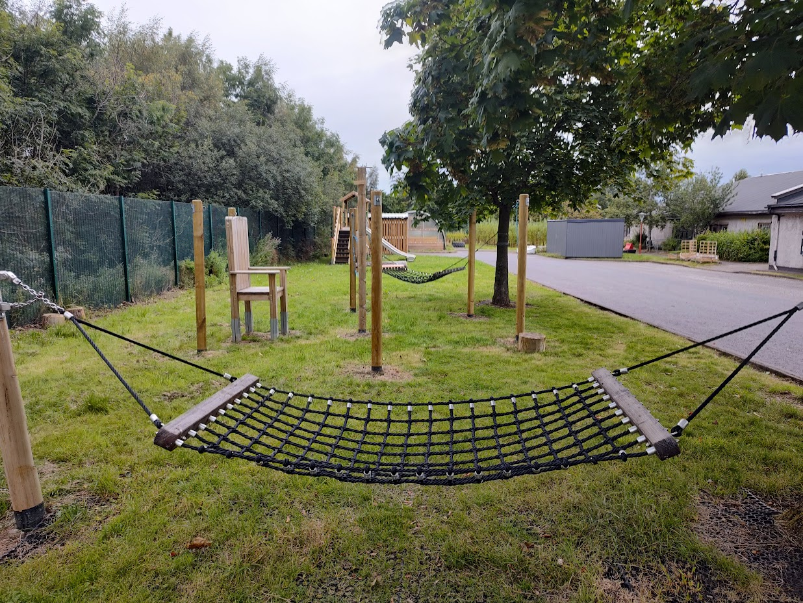
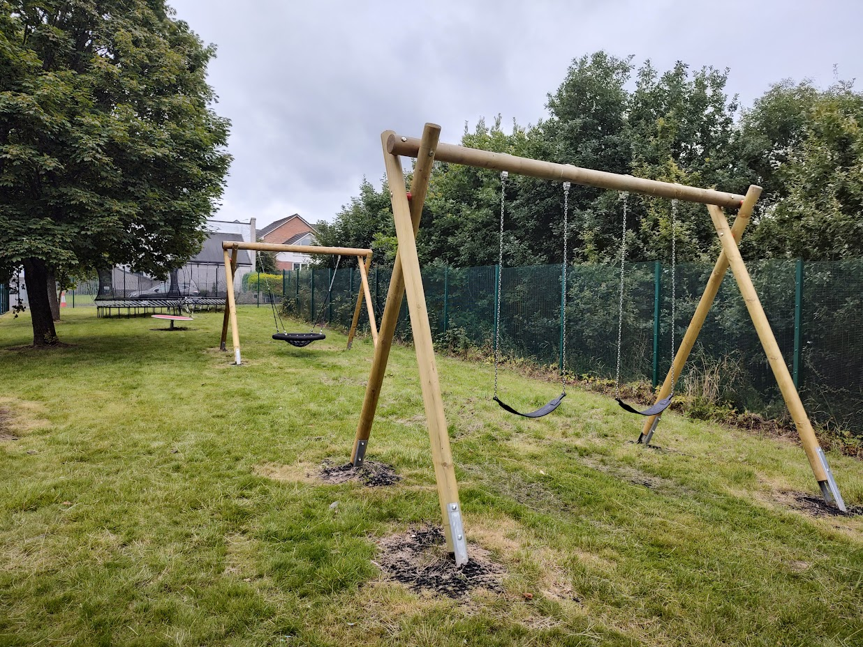
Self-Reg in Glasgow

Slide 21
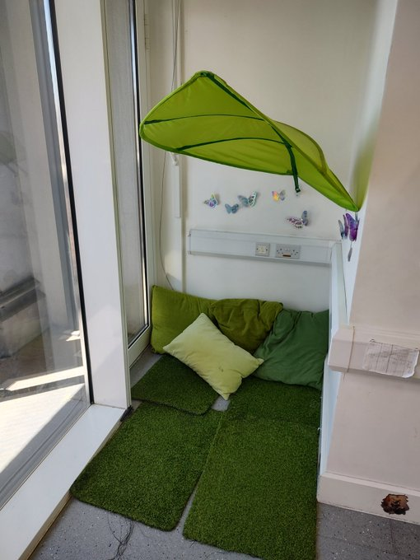
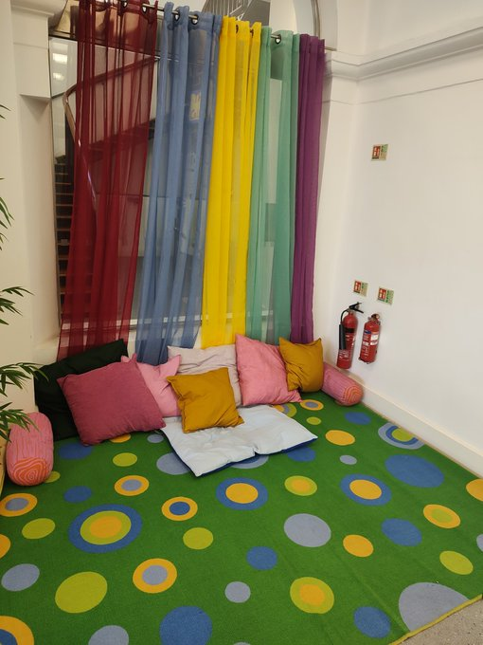
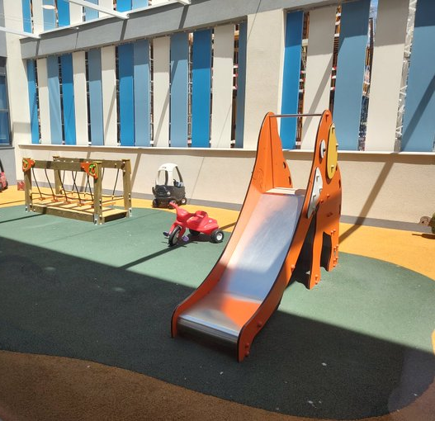
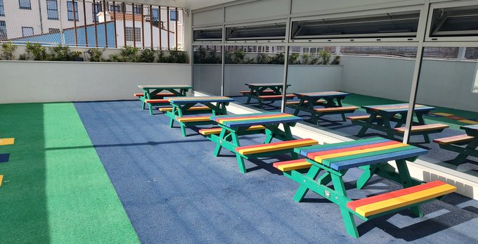
Self-Reg in
Gibraltar

Slide 22
    Self-Regulation / Use of Space
Key questions:
How do we understand and support Planned Escape / Self-Regulation in our settings?
What systems / policies can be develop and adopt to support human responses to stress and coping?

Slide 23
Judgements Under Uncertainty
The Nobel Laureate and psychologist Daniel Kahneman identified that human judgements under uncertainty can be full of biases that have an impact on our everyday behaviour.
The perceived unpredictability of the world is a constant source of stress.
Understanding this stress response is critical to surviving in a world that can appear to be so unpredictable and chaotic.

Slide 24
Chaos
David Pitonyak has often remarked that supporting people who are distressed can feel like you are ‘jumping into the chaos of things’
This session will focus on how we support people who are experiencing high levels of emotional distress and are in a state of panic
Making sense of chaos starts with making US less of a threat

Slide 25
The Saturation Model
The whole-school saturation model (Morewood, Humphrey, & Symes, 2011) was originally developed to illustrate the principles of effective inclusion of autistic learners in a secondary mainstream school
Applicable to all educational phases and contexts
Focuses on what we as practitioners can do to improve outcomes for young people
Aligned with Bronfenbrenner’s (2005) bioecosystemic theory
Morewood, G. D., Humphrey, N. & Symes, W. (2011) Mainstreaming autism: making it work. Good Autism Practice Journal 02.12.11, 62-68.

Slide 26
The Saturation Model
Agent of change
Developing the school environment
Flexible provision
Direct support and intervention
Policy development and embedding practice
Training and development of staff
Peer education and awareness
Creating a positive ethos
Morewood, G. D., Humphrey, N. & Symes, W. (2011) Mainstreaming autism: making it work. Good Autism Practice Journal 02.12.11, 62-68.

Slide 27
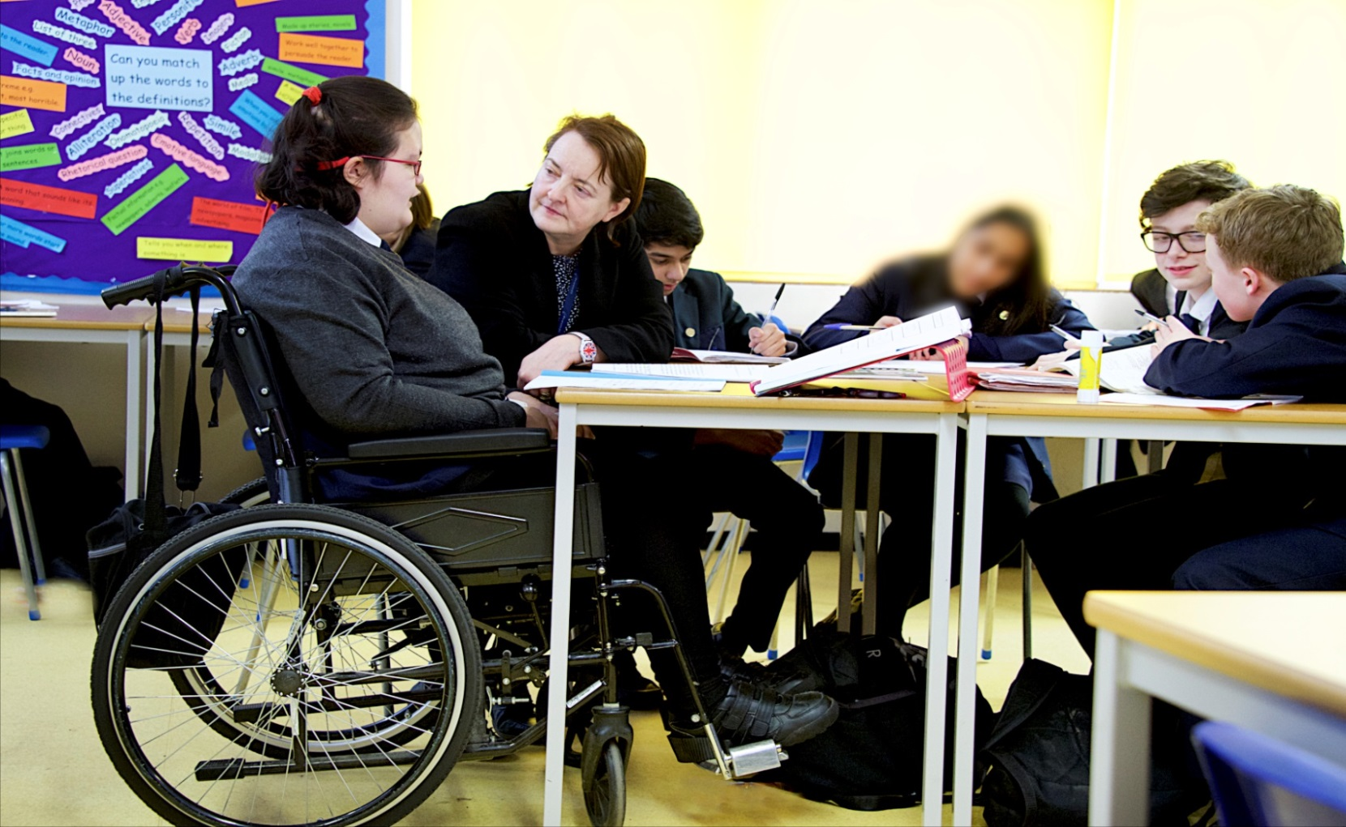
Creating a Positive Ethos & Environment
This is vital!
If we don’t believe that together we can improve the outcomes of the young people – who will?
“I get to do everything my friends do, just that sometimes I have things changed a little so I can join in properly.”
Lisa, aged 15

Slide 28

The Saturation Model
Autism and inclusion: the saturation model explained http://ow.ly/QcST30qe7YG
Two short films
http://ow.ly/CRUF30qe7Xm & http://ow.ly/VFfP30qe7Xl
The original paper
http://ow.ly/WJEc30qe80H

Slide 29
Prof Mark Wetherall
www.youtube.com/watch?v=sINE8WO6BLc

Slide 30
‘We need schools where difference is valued and where there is less emphasis on conformity and greater focus on harnessing strengths in order to enable all, staff and students alike….to be the best they can become’
Professor Rita Jordan
‘Personalisation NOT Normalisation’
Dr Damian Milton

Slide 31
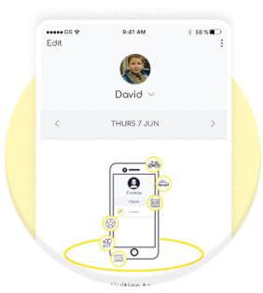
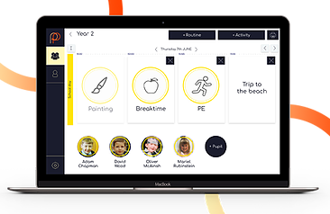
Digital Visual Timetable
www.mypicturepath.com
https://www.studio3.org/post/app-review-picturepath

Slide 32
What is the Low Arousal Approach?
A recent framework (McDonnell, 2012) suggests four key areas of Low Arousal:
  The reduction of staff demands and requests in a crisis
  The adoption of verbal and non verbal strategies that avoids potentially arousing triggers (e.g. direct eye contact)
  The exploration of staff beliefs about the short-term management of challenging behaviours
  The provision of emotional support to staff

Slide 33
The Notion of Low Arousal…(1)
The Low Arousal Approach is based on the notion that people with challenging behaviour often have trouble regulating affect.
They often react to other´s affects by experiencing and expressing the same affect. Affect is always contagious, but most people learn to differentiate between own and other´s affects early in life. Some people don´t.
They don´t know if an affect they feel is their own or somebody else's. That can result in anger if somebody else is angry and telling off the one who tells you off.

Slide 34
The Notion of Low Arousal…(2)
We also know that challenging behaviour often occurs when someone experiences a high intensity of affect.
Nobody fights when they are relaxed and easy-going.
Calm and self-control is connected, and we want the service-user or child to be in control of him- or herself, so that they can cooperate and work with us, in partnership.
Physiological arousal can be strongly linked to the construct of stress (McDonnell et al, 2014).
Arousal and stress are considered to be important in the regulation of emotion (Reich & Zautra, 2002).

Slide 35
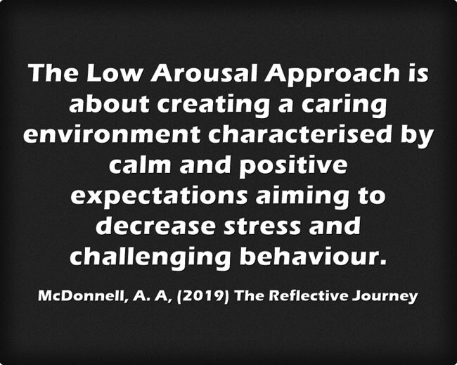
The Notion of Low Arousal…(3)

Slide 36
Assumptions about Behaviour
Viewing a person as always a) in control & b) aware of their behaviour is a dangerous combination.
Seeing people as distressed and traumatised can #flipthenarrative on how we interact with these individuals in crisis situations – but also how we ‘set up’ learning – being pro-active is key!

Slide 37
Potential Causes & Challenges
Communication difficulties
Confusion
Unexpected change – breaking a routine
Environmental factors – heat, overcrowding, noise, etc.
Sensory differences i.e. hyper and hyposensitivity
Pain or medical problems
Medication changes
Inactivity/boredom
Demands and requests
Emotional problems and mental illness
Too many rules and restrictions
Being denied a need or getting something that they don’t want
Staff/Adults/Others
And many more…

Slide 38
Less Reactive – More Pro-active
The more pro-active we are the less reactive we need to be…

Slide 39
The Power of ‘Giving In’
Better to give in and adopt a low arousal strategy than to get involved with physical interventions.
Always ask the question ‘Can we stop what we are doing?
Can we reduce confusion?
Why am I doing this?

Slide 40
Give Options, Not Ultimatums
What can we do to reduce stress in the moment?
In a crisis or 'meltdown' choices can empower people.
'Give people choices rather than adding boundaries and rules'
Getting rid of unnecessary boundaries and rules is also important.

Slide 41
Make Fewer Requests
A request does not have to be unpleasant.
Sometimes consider making a request visual rather than verbal.
Allow people time to process requests.
As a rule the more stressed people become the longer their delays in processing.

Slide 42
Demand Reduction
Reduce demands and requests in a crisis – verbally and non-verbally.
People who are in a state of hyperarousal may not always process these requests.
Remember 'it is OK to give in’.
This can be called tactical/strategic capitulation.

Slide 43
Control
It is easier to take control than to give control away.
Low arousal approaches encourage people to avoid controlling measures.
Taking a step back and allowing a person to calm down will ultimately teach a person to self regulate.

Slide 44
Relationships
Relationships with the young people we support are incredibly important, and it can be extremely difficult to re-engage with a person after a physical restraint has taken place

Slide 45
Alternatives to Restraint
Avoidance
Distraction
Distance
Movement
Removing self and others from situation (remember, removing the individual themselves means increasing demands during a period of crisis)
Planned Escape – see short films
Allow property destruction

Slide 46
Planned Escape
When we are in a heightened state of a arousal, it is natural to want to escape from environments that may have become distressing.
Teaching people ways of communicating their need to ‘STOP’ is essential, and encourages them to be aware of their own levels of arousal.

Slide 47
Planned Escape
Planned Escape
From the original interview almost a decade ago
http://ow.ly/h4h030qe7H1
Hear more about establishing a Planned Escape strategy, that worked!
http://ow.ly/ojdf30qe7H2 & http://ow.ly/zAZ330qe7H0

Slide 48
Stay Calm
The most important thing in a crisis situation is to appear calm
‘Don’t add fuel to the fire’
It is essential that we consider ourselves as active agents in this process
Do not add your own arousal to the situation

Slide 49
Slow Movements Down
The more aroused people become the more they become aware of signals of threat.
A support staff needs to slow their movements down as this may reduce perceived threat.

Slide 50
Avoid Direct Eye Contact
Direct eye contact increases physiological arousal
Body language often communicates fear and distress, and can be physiologically arousing
Be aware of the non-verbal cues you are communicating with your eye contact, expression, posture, physical proximity etc.

Slide 51
Tactical Withdrawal
Keep your distance
Research has shown that close proximity to individuals who are angry or highly aroused may increase the likelihood of interpersonal violence
This also applies to backing down from the situation and taking a step back mentally

Slide 52
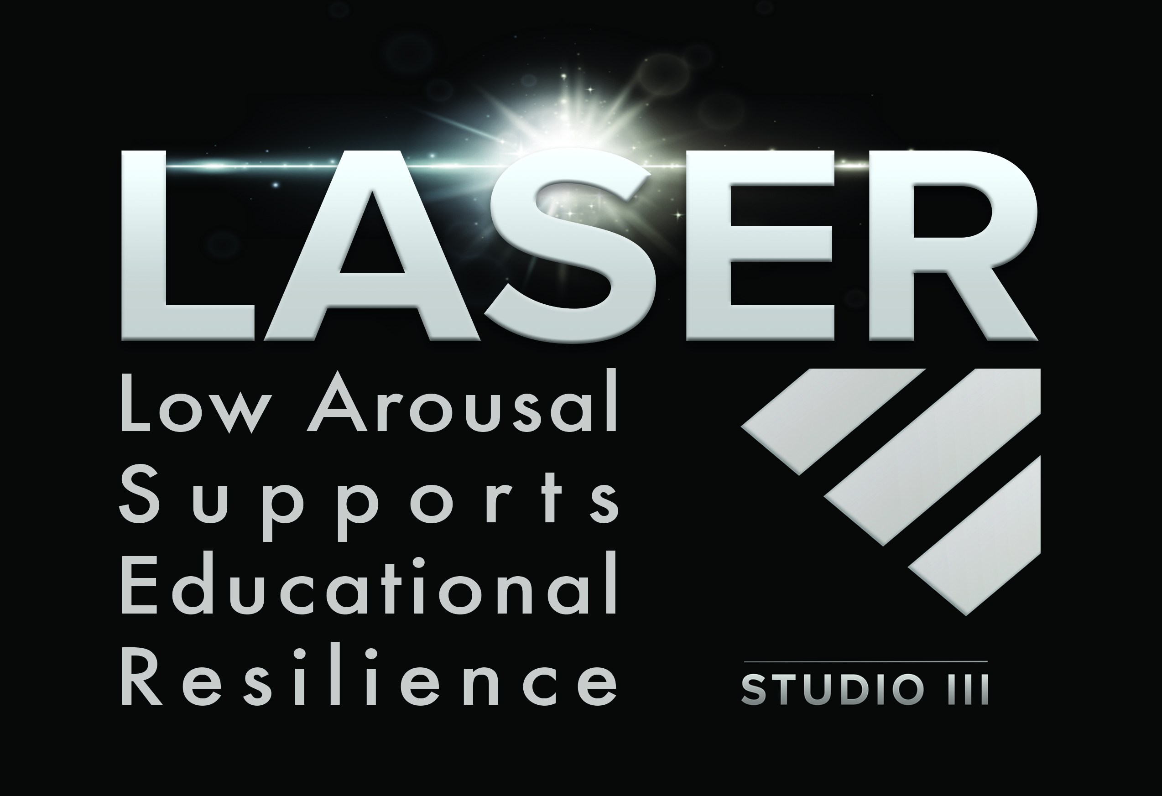
The LASER Approach from Studio III

Slide 53
Key Aims
The LASER Project is a systemic approach to creating calm, safe and thriving school environments with a focus on coproduction and positive outcomes.
The Key Goals include:
A focus on stress reduction
Reducing restrictive practices (with the aim of elimination)
Excellence in the prevention of dysregulation
Creating an ethos and culture of low arousal approaches
Developing inclusive pedagogy and culture through training, support and reflective practice

Slide 54
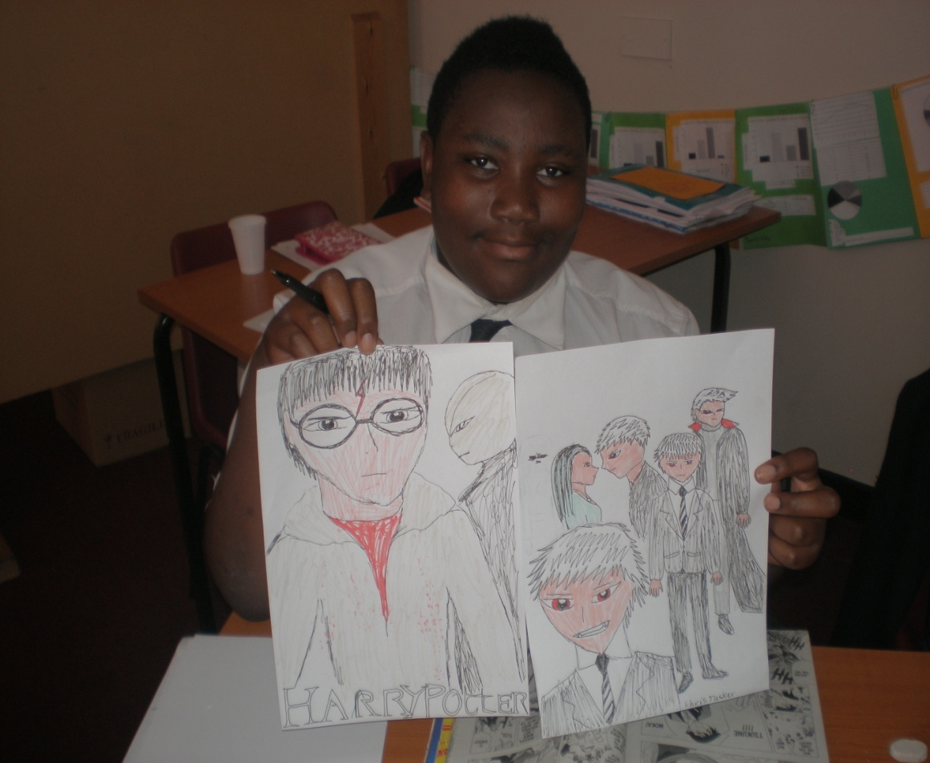
Chris’ Story
Chris, now aged 21
(pictured aged 13)

Slide 55
Important Research and Links
Moyse, R. (2021). Missing: The autistic girls absent from mainstream secondary schools. PhD thesis. University of Reading.
Available at: http://centaur.reading.ac.uk/97405/
Autism and Girls – Webinar
https://www.youtube.com/watch?v=LZE6XGOvdJo&feature=youtu.be
Autism, Anorexia & Me – Gareth D Morewood Interviews Dr Pooky Knightsmith
https://youtu.be/PqrAgjV8OnA?si=si0gXvWN8uM3TrHh

Slide 56
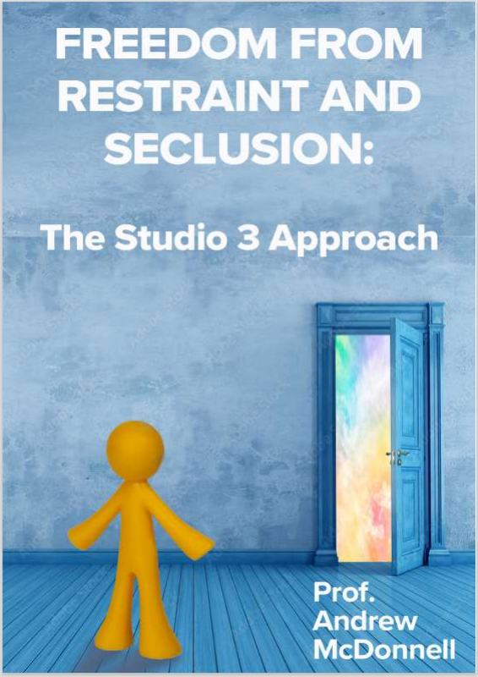
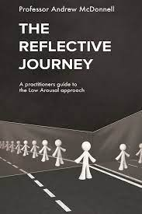
Available Now

Slide 57
Two Other Great Autism Books (1)

Slide 58

Two Other Great Autism Books (2)
Morewood, G., Tomlinson, C. & Bond, C. (2019) Meeting the needs of autistic girls at secondary school.
In Hebron, J. & Bond, C (Eds). Educating girls on the autism spectrum: developing an integrated approach. London. Jessica Kingsley.

Slide 59
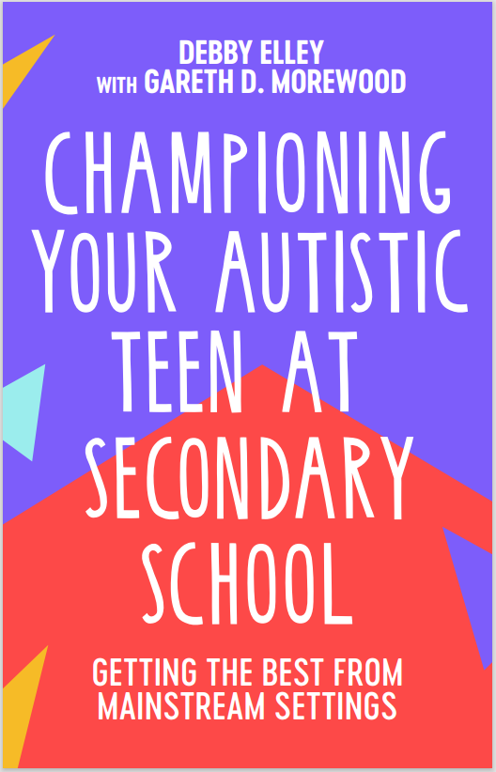
New Book
‘I’d recommend this to all parents looking to support their child in school and to all teachers who want to build a collaborative approach with pupils and parents.’
Richard Nurse, parent and founder of Picturepath.
‘This book’s grounded, compassionate and practical approach will be a boon for all involved in the education of autistic teenagers. I highly recommend it.’
Mary Myatt, education writer and curator of Myatt and Co.
‘This should be essential reading for parents of autistic children who attend a mainstream secondary school. A remarkable achievement.’
Neil Humphrey, Sarah Fielden Chair: Psychology of Education, University of Manchester.
‘Drenched in lived experience, this is a superb guide. You’ll learn something new in every chapter.’
Matt Keer, parent contributor to Special Needs Jungle website.

Slide 60
Links
FREE webinars - www.studio3.org/free-webinars
FREE Newsletter - www.studio3.org/so/d5OUpnBWt?languageTag=en
LASER Prog - www.studio3.org/laser-online
Low Arousal Training - www.studio3.org/low-arousal-online
Films - Videos Archives - Gareth D Morewood (gdmorewood.com)
SENCology Blog - SENCology | Optimus Education Blog (optimus-education.com)

Slide 61
About Studio 3
At Studio 3 we also offer bespoke training in managing distressed behaviour. There are several training options including:
Low Arousal Training – Introductory and Advanced courses in applying Low Arousal Approaches
Managing Signs of Stress 3-day training in stress reduction, coping, Low Arousal Approaches and gentle physical skills
The Atlass Masterclass in Stress and Coping for families, staff and carers who support vulnerable people
Trauma-Informed Care Training for residential and foster carers
Train the Trainer Programme for future Studio 3 trainers
We also offer a range of clinical services including assessments and advice for families, individuals and organisations.

Slide 62

Low Arousal Training
Available online and in person for professionals, families and staff teams
Introduction to Low Arousal Approaches
Going beyond crisis management towards proactive de-escalation
Practical methods for creating Low Arousal environments
Focus on staff/supporters’ behaviour
Online training every Friday

Slide 63
Managing Signs of Stress
3-day course run on a bespoke basis within your organisation
Promotes a person-centred approach to crisis management
Gentle physical skills taught with a goal to reduce restrictive practices and physical interventions
De-escalation training focused on the prevention of re-occurrence
Understanding causes of behaviour
Low Arousal Approaches

Slide 64
Atlass Masterclass
This is a 3-day course with two, 2-day follow-ups over the following 6 months
Masterclass in managing your own stress, and recognising stress in the people you work with and support
Framework of positive psychology, well-being and Low Arousal Approaches
A focus on autism, but applicable to a wide range of settings
For parents, families, individuals, staff teams and organisations
Coping mechanisms for you and the people you support

Slide 65
Train the Trainer
For individuals who wish to deliver Studio 3 training and become a member of the training team
We currently have trainers throughout the UK, Ireland, Canada and Denmark
Goes beyond teaching physical interventions and in-the-moment crisis management
Limited number of spaces

Slide 66
Clinical Services
We provide clinical inputs to a wide range of sectors
Offer a range of supports including ‘one to one’ therapies, specialist psychological supervision, coaching support, assessments, psychological reports and many more
Our clinicians work within a person-centred framework
Trauma-informed approaches

Slide 67
Assessments
Detailed, individualised autism diagnostic assessments, including for people who may also have demand avoidant profiles, ADHD, trauma, or other multiple diagnoses
Holistic ‘360°’ assessments for neurodivergent people who may require highly specialised, bespoke services to meet their needs in the community

Slide 68
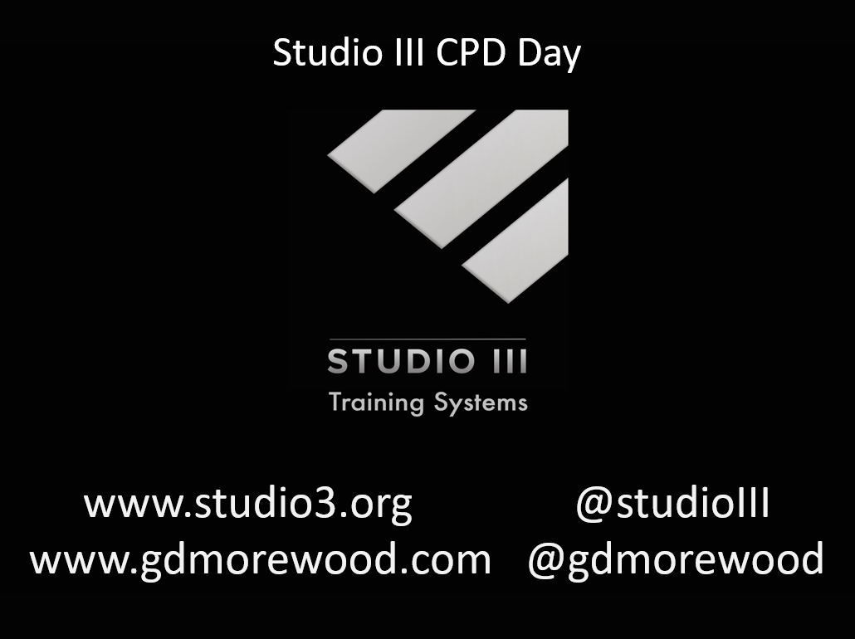
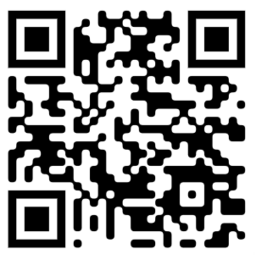
www.studio3.org @studioIII www.gdmorewood.com @gdmorewood
Practical Ideas For Inclusive Classrooms

