Slide 1

Gibraltar DoE Education Conference 2025
Creating an Inclusive Curriculum – including peer understanding an awareness
Gareth D Morewood

Slide 2

Key Areas To Consider
    Movement / Exercise
    Self-Regulation / Use of Space
    Low Arousal – understanding things through the lens of stress and coping
    Inclusive Pedagogy and Curriculum

Slide 3
Movement / Exercise
There are many studies which demonstrate that regular cardiac exercise is positive for our physical health, being associated with a lower risk of heart failure and increased well-being.
Aerobic exercise can also have a positive impact on cognitive functioning for children in classrooms.
Bidzan-Bluma, I. & Lipowska, M. (2018). Physical Activity and Cognitive Functioning of Children: A Systematic Review. International Journal of Environmental Research and Public Health, 15(4), 800.

Slide 4
Movement / Exercise
Cardiac exercise can produce positive physiological changes in relatively short periods of time, such as reducing levels of the stress hormone cortisol.
Alghadir, A. H., Gabr, S. A. & Aly, F. A. (2015). The Effects of Four Weeks of Aerobic Training on Saliva Cortisol and Testosterone in Young Healthy Persons. Journal of Physical Therapy Science, 27(7), 2029-2033.

Slide 5

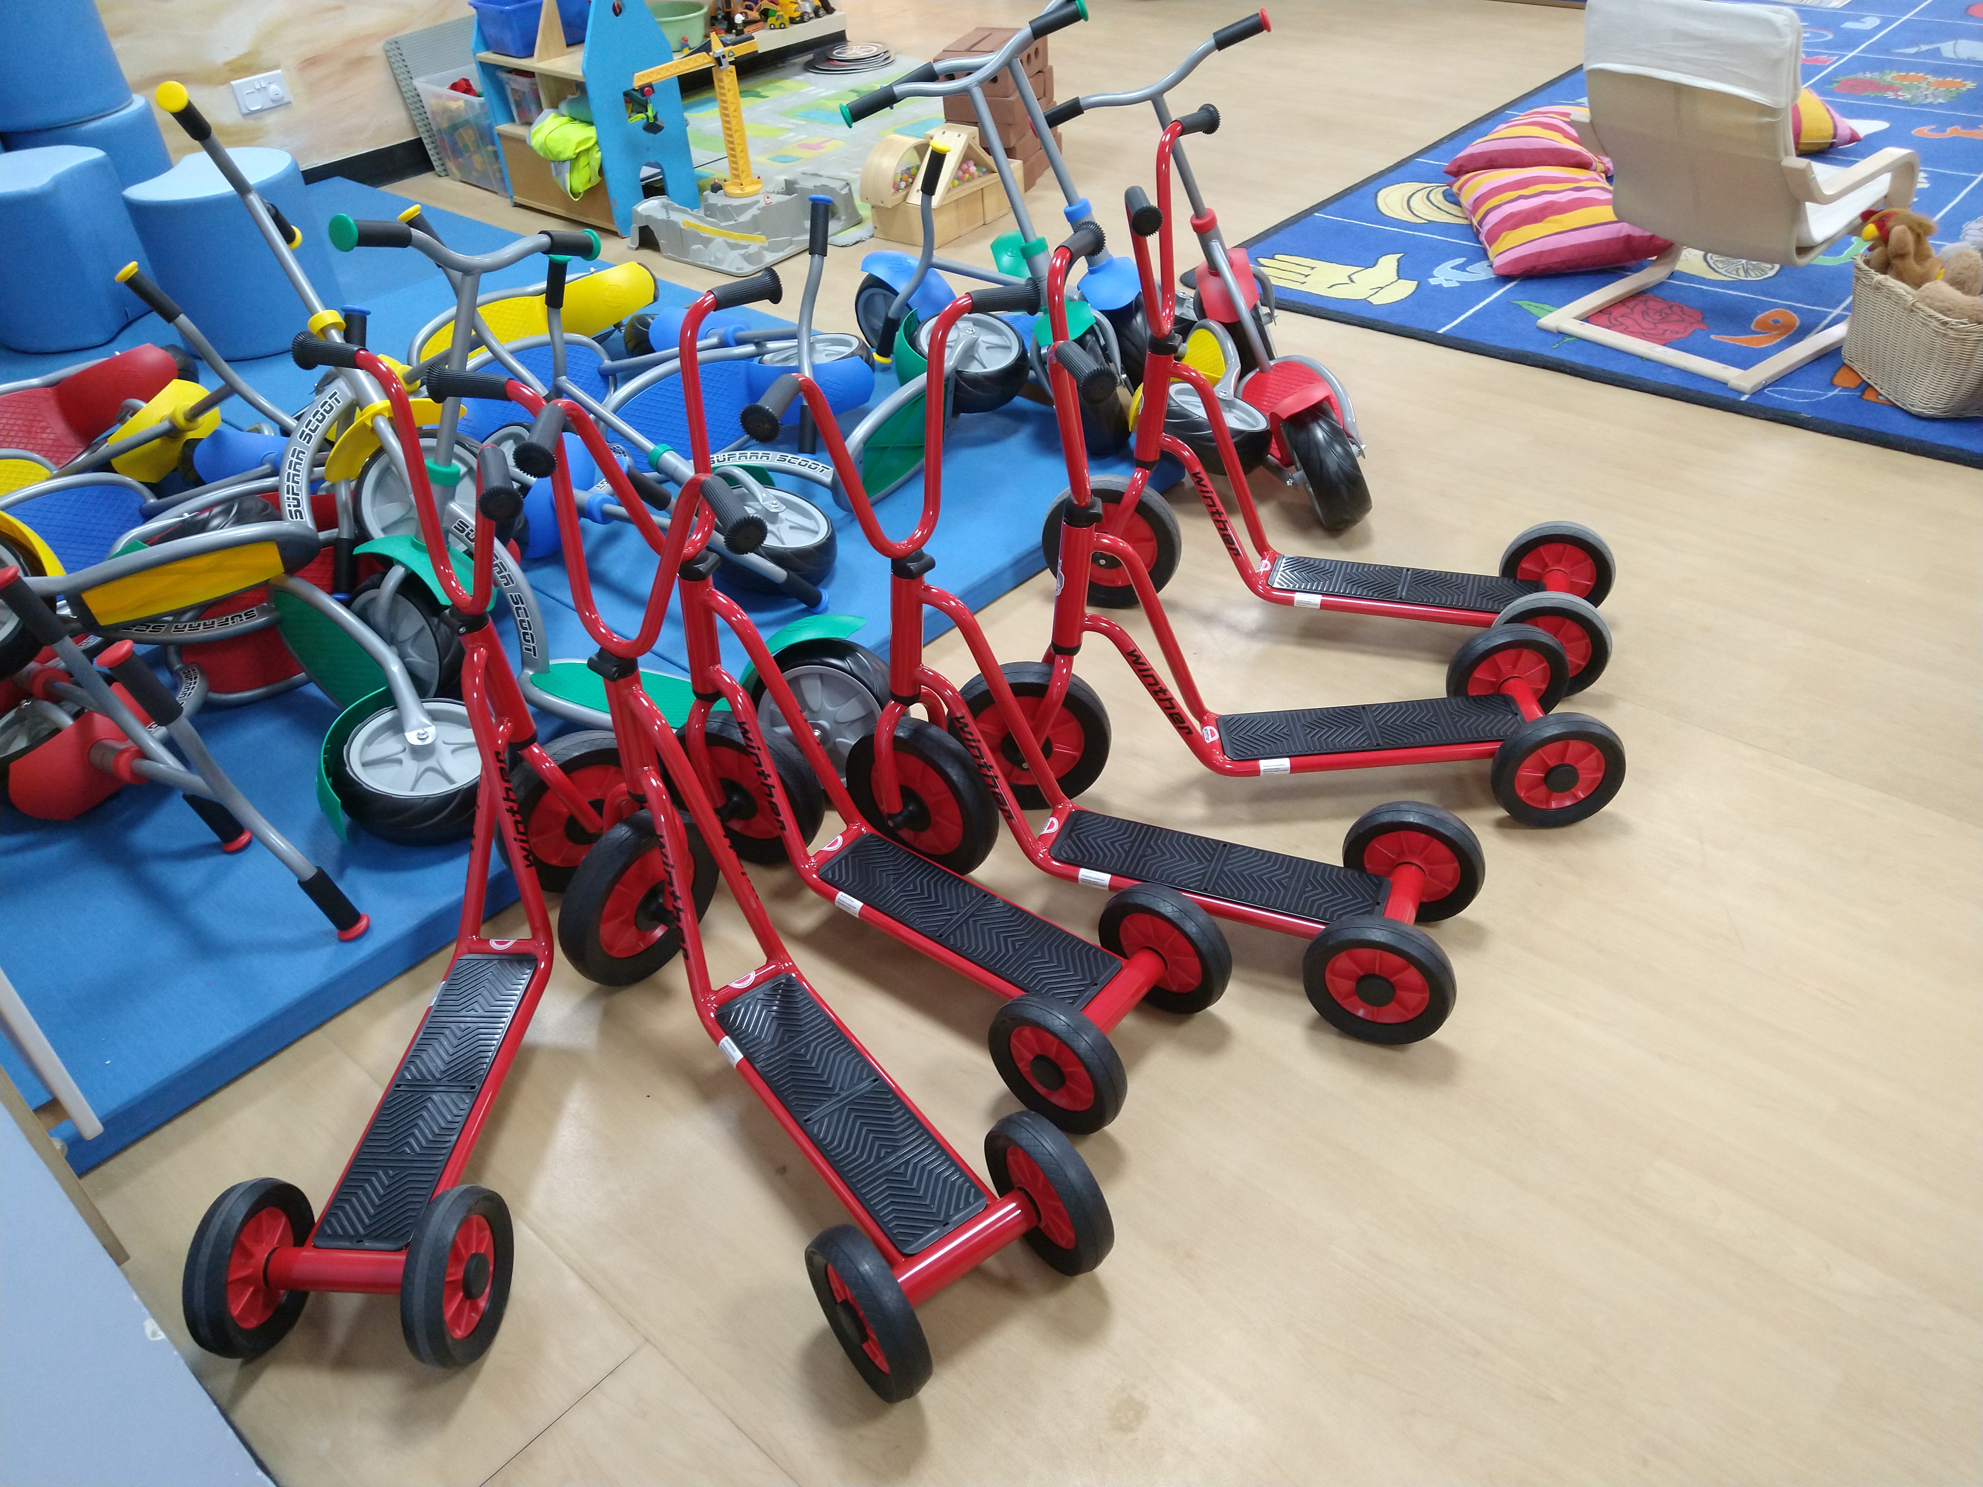

Slide 6
Increased Cardiac exercise
Exercise can have powerful effects on learning and evidence
suggests that the hour after exercise is an optimum time for
learning.
Three key questions:
How much cardiac exercise do you partake in in average week?
How much cardiac exercise do your students/children partake in in the average week?
How much short-term exercise is in your daily curriculum/home life?

Slide 7
    Self-Regulation / Use of Space
Thinks can be very challenging because:
    Learning in a social setting, reading social situations, deciphering the unwritten rules
    Learning in a complex language environment with limited visual support
    Understanding and communicating with other students and adults
    Coping with change, transitions and unexpected breaks in routine
    Day to day organisation
    Generalising learning beyond the setting in which it took place

Slide 8
    Self-Regulation / Use of Space
For the peer group
  Lack of understanding
  Resenting extra attention
  Social advances that are ignored or rejected
  Distraction or disruption
  Feeling that double standards are applied (‘getting away’ with things)
  Being nervous or fearful
  Ignoring, teasing, winding up, bullying (Morewood, Humphrey & Symes, 2011)
For staff and parents
    Gaining, maintaining and refocusing attention
    Motivation
    Differentiation of language and/or curriculum
    Managing behaviour ***WARNING***
    Accommodating special interests

Slide 9
We Must Be Careful Where We Locate The ‘Problem’
The vast a majority of challenging situations are inadvertently triggered by supporters.
We are often unaware that we can trigger situations.
Reflective practice is a cornerstone of low arousal approaches.

Slide 10
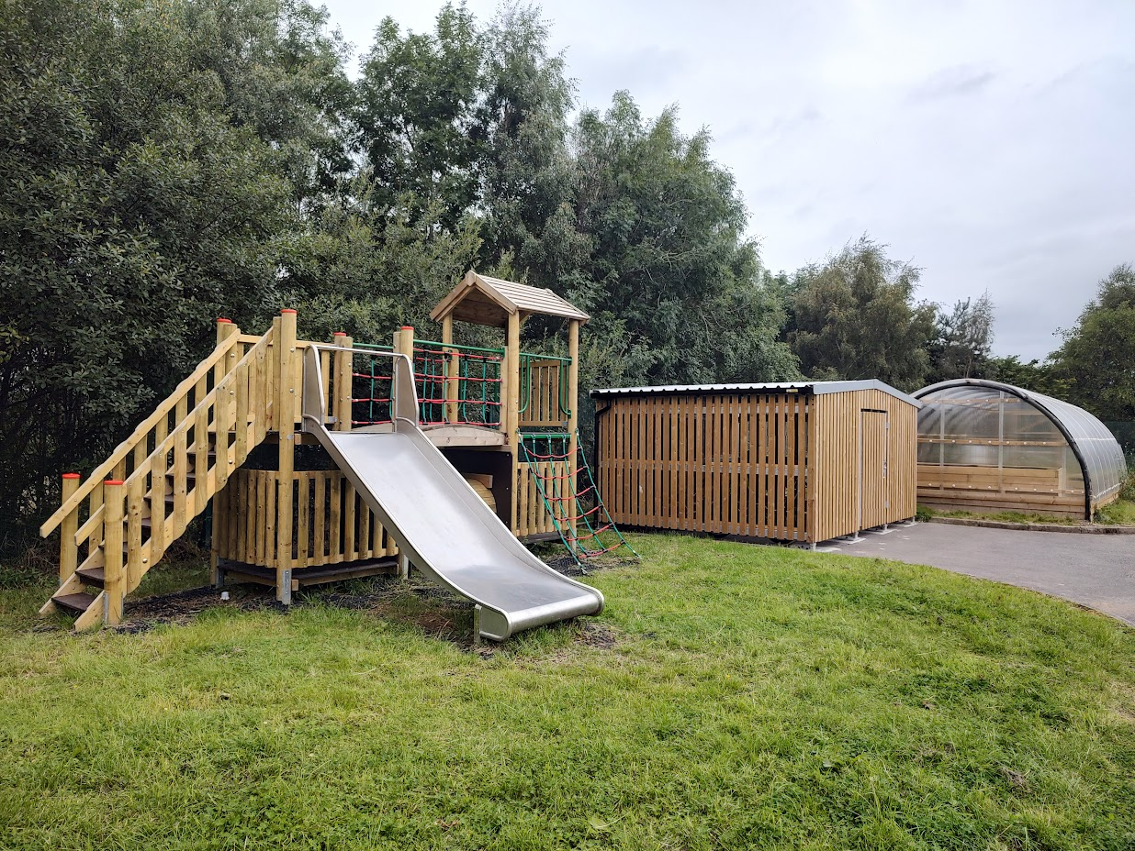
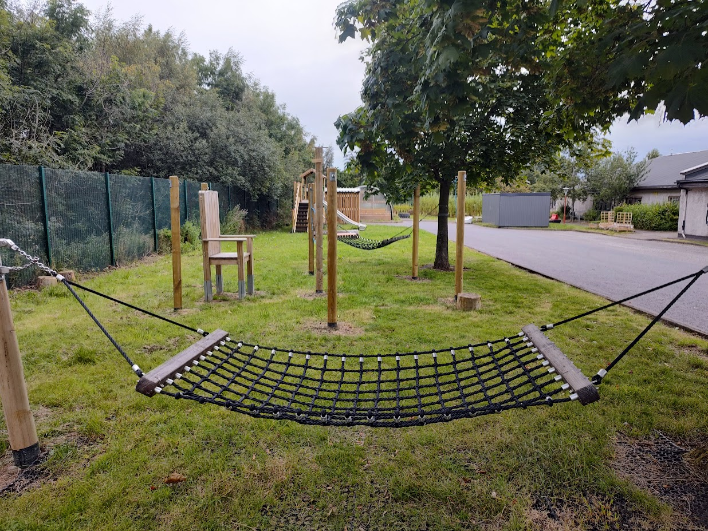
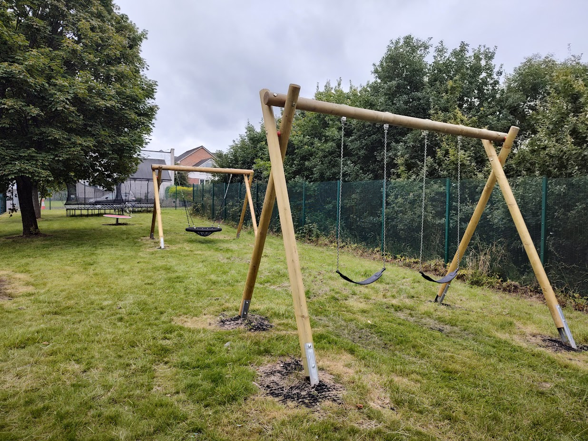
Self-Reg in Glasgow

Slide 11
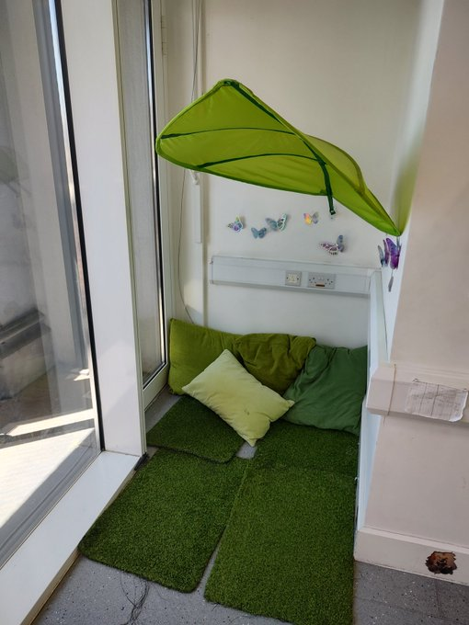
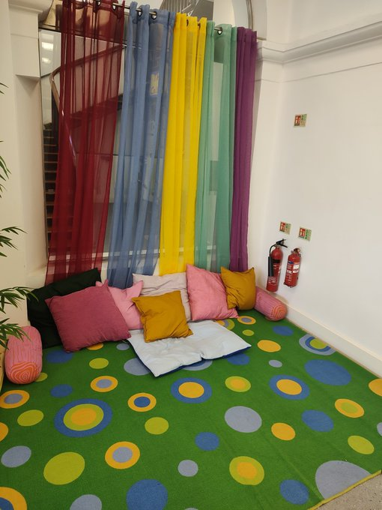
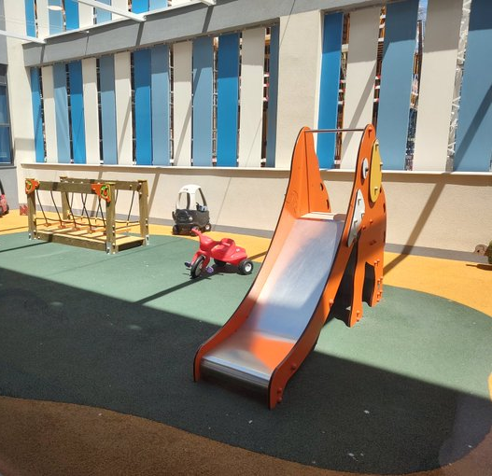
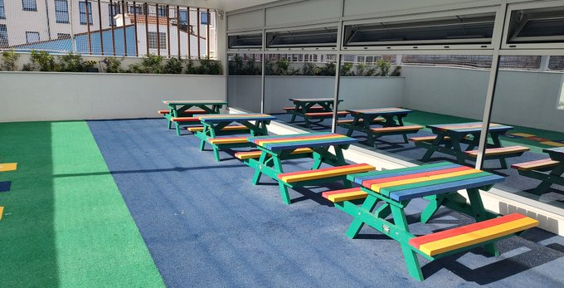
Self-Reg in
Gibraltar

Slide 12
    Self-Regulation / Use of Space
Key questions:
How do we understand and support Planned Escape / Self-Regulation in our settings?
What systems / policies can be developed and adopt to support human responses to stress and coping?

Slide 13
Planned Escape
Planned Escape
From the original interview almost a decade ago
http://ow.ly/h4h030qe7H1
Hear more about establishing a Planned Escape strategy, that worked!
http://ow.ly/ojdf30qe7H2 & http://ow.ly/zAZ330qe7H0

Slide 14
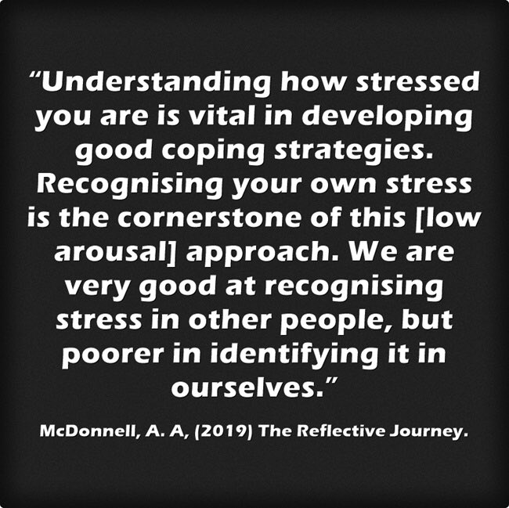
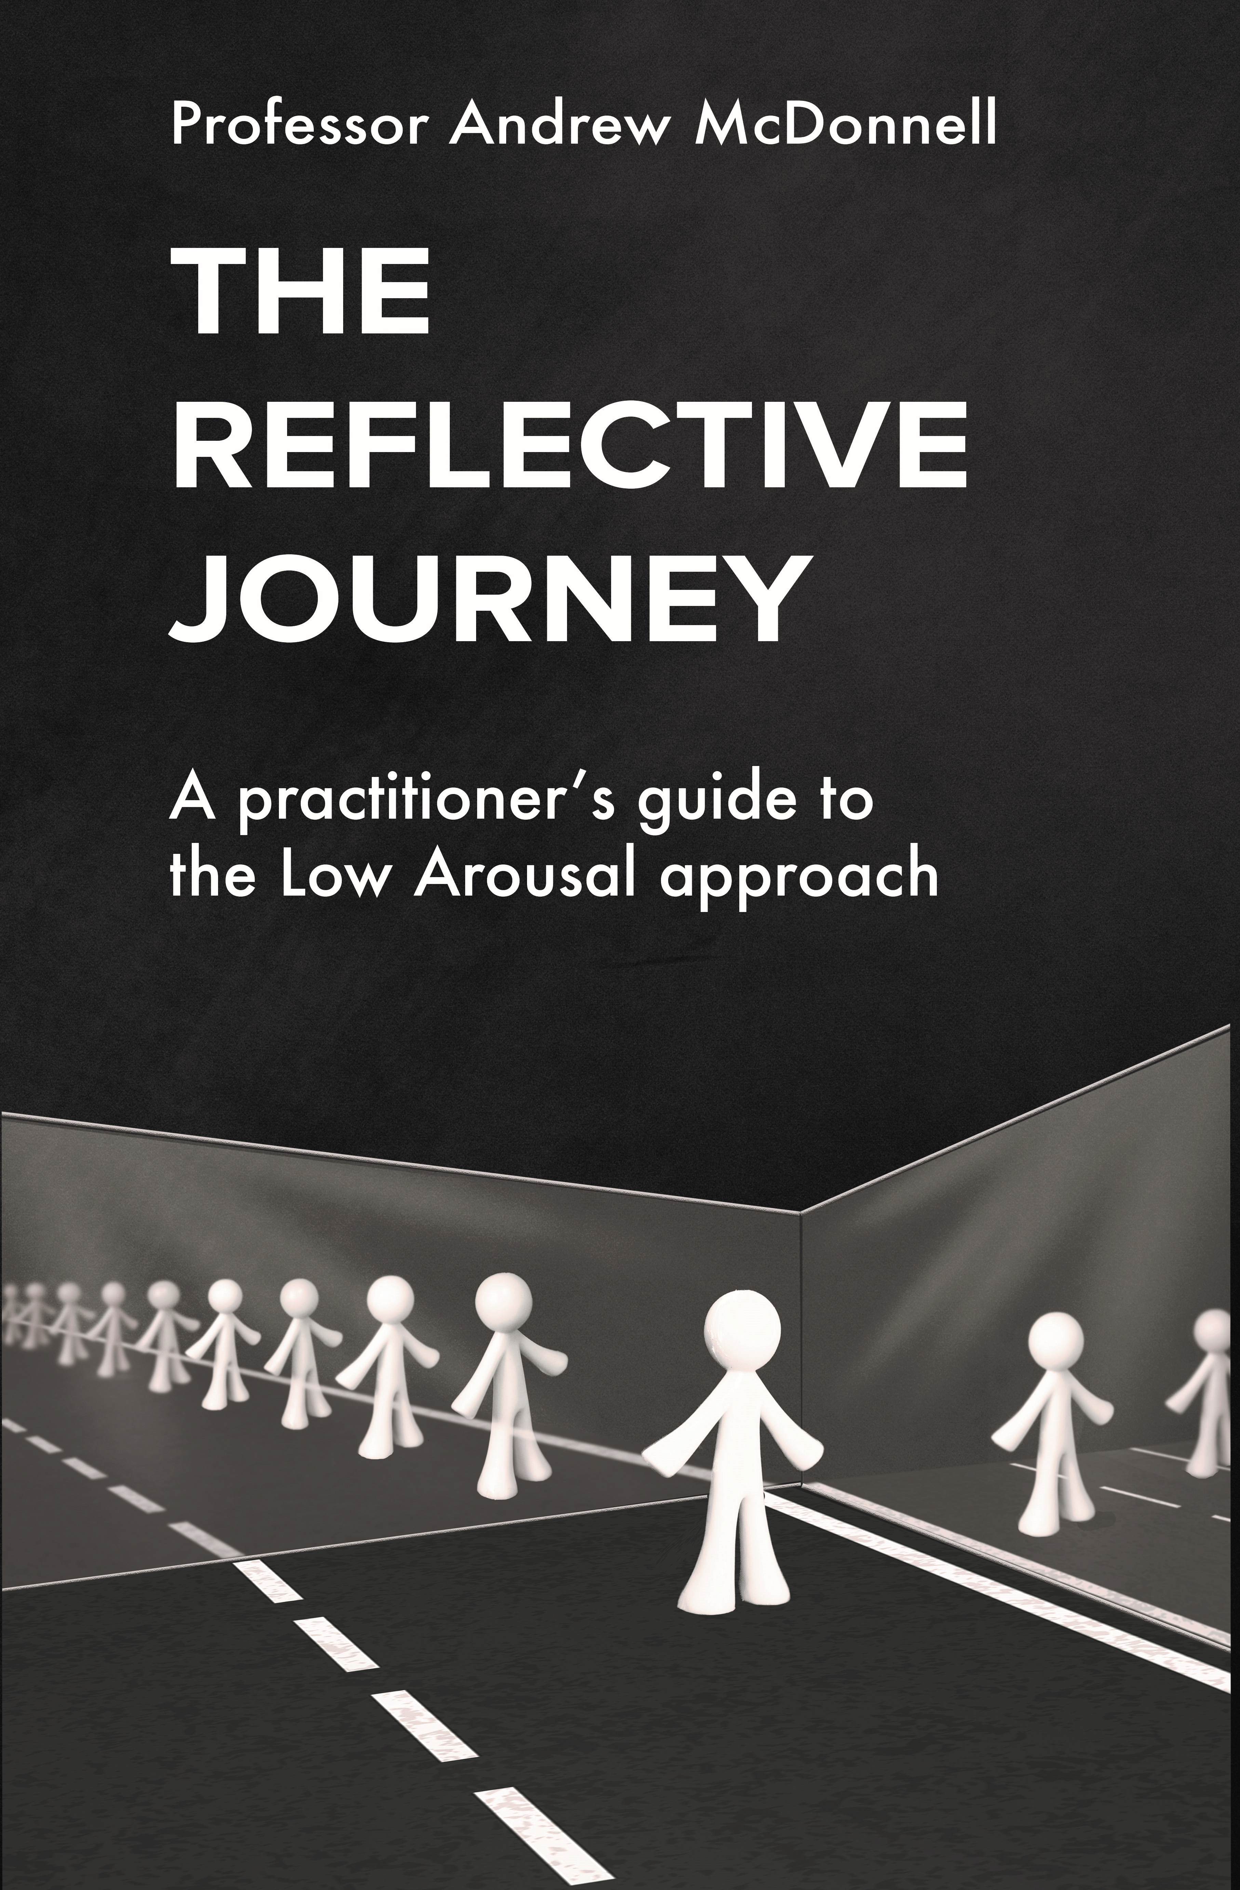
    Low Arousal through a Stress/Coping lens
‘The Reflective Journey: A Practitioner’s Guide to the Low Arousal Approach’ is available from www.studio3.org/product-page

Slide 15
Understanding Stress
It is our coping responses that determine how we adapt to stress.
Many young people have very few 'coping tools’.
Some restricted or repetitive behaviours may have very real and vital coping functions.
For example, a person may engage in stereotyped movements which help them to regulate their arousal (McDonnell and Gayson, 2014).

Slide 16
Understanding Stress
We therefore need to consider carefully our own perspectives.
We wouldn’t remove a wheelchair or hearing aid from a student, yet we often deny young people their own coping mechanisms through unintended consequences of wider systems and policies.

Slide 17
Combating Stress Pro-actively
Individual Exercise
Individually, consider the following three things:
What coping strategies do you use in your own life?
Identify some coping strategies you have seen pupils use.
How could your setting implement these coping strategies as an inclusive part of the curriculum?

Slide 18
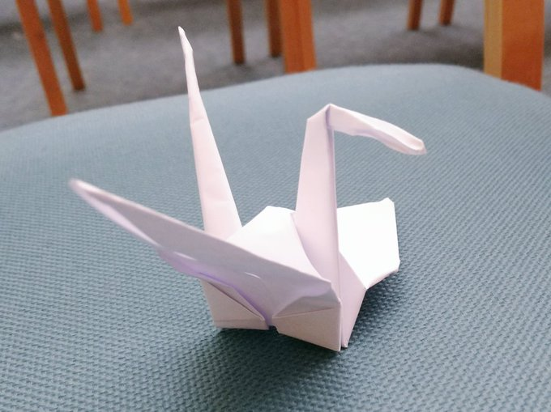
Achieving and Encouraging Flow States

Slide 19
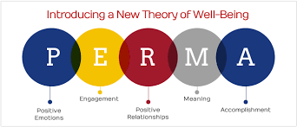
Positive Psychology – The PERMA Model
Seligman’s PERMA model of positive psychology is a useful tool for frontline staff to employ
Focus on positive recording, moments of happiness and building meaningful relationships with the young people we support

Slide 20
21st Century Children…A Key Message!
The young people in our schools are very different now, than 15 years ago...
Neo-natal survival rates and advances in medicine mean more children are surviving with complex needs and are now in our classes...
Learning & Teaching is different now; it has to be ... so we have to evolve too…
Schools need to respond to meet ‘modern need’…

Slide 21
“Masking Is Life”: Experiences of Masking in Autistic and Nonautistic Adults. Autism in Adulthood
www.liebertpub.com/doi/10.1089/aut.2020.0083
Double Empathy: Why Autistic People Are Often Misunderstood
Double Empathy: Why Autistic People Are Often Misunderstood · Frontiers for Young Minds (frontiersin.org)

Slide 22
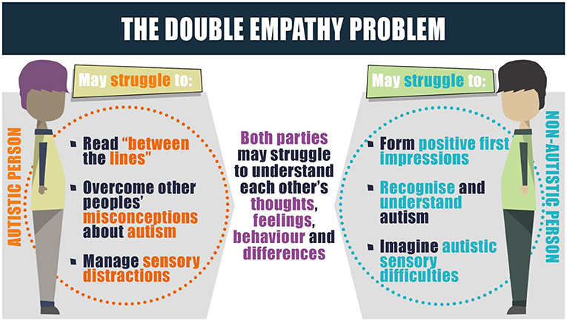

Slide 23
Have High Aspirations for Every Young Person
Ensure that all analysis/impact measures/data is done inclusively…
Change cultures of segregation in your settings – start with analysis…
Ensure that the highest aspirations are for all…
Be clear about how targets will help students develop and prepare for the next stage of their education, or for adulthood…
Engage in metacognative approaches with students – see Student Passports (for example)

Slide 24
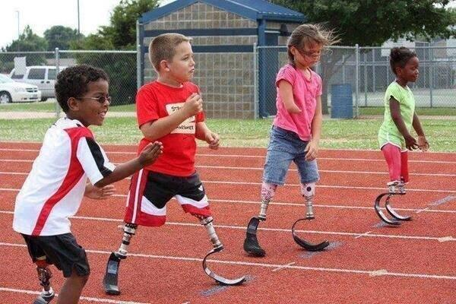

Slide 25


Slide 26
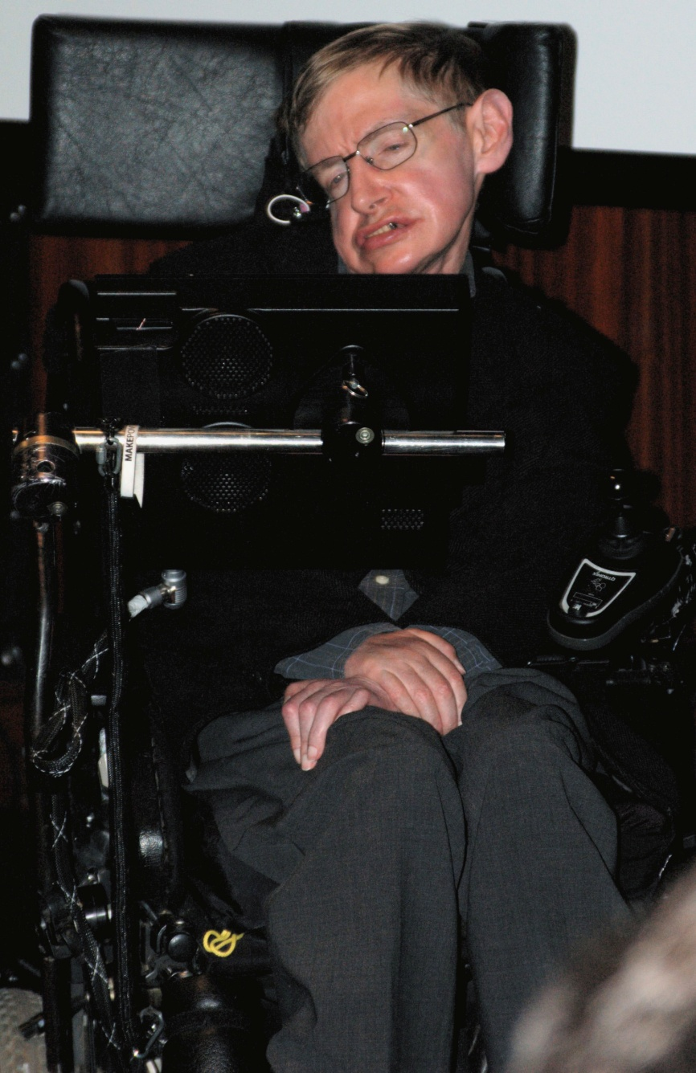
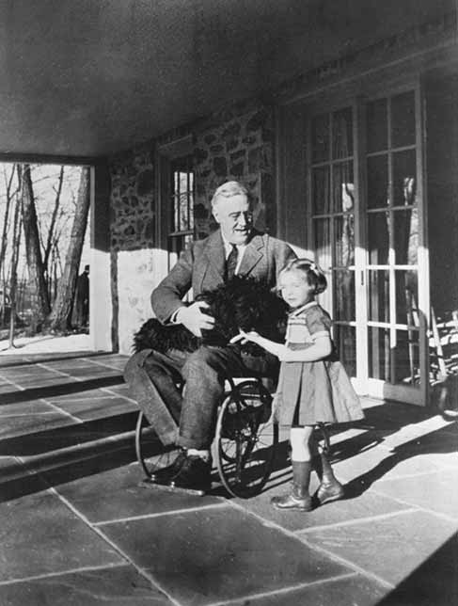

Slide 27
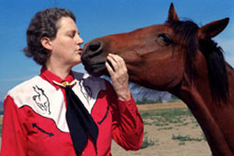

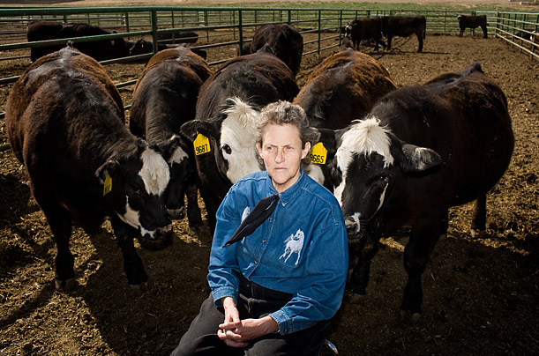

Slide 28
Temple Grandin
Born on August 29, 1947, in Boston, Massachusetts
Temple Grandin was diagnosed with autism as a child and went on to pursue work in psychology and animal science
She has become a leading advocate for autistic communities and has also written numerous books and provided consultation on the humane treatment of animals
In 2010, HBO released an Emmy Award winning film on Grandin’s life – a MUST watch for all!

Slide 29
Bullying and Disability
Create a school culture that does not accept bullying - Respect
Monitor and record all incidents
Develop an understanding of oppression and its impact historically
Develop an understanding of what disabilist bullying leads to
If an incident occurs stop the lesson/activity and discuss it
Fully involve student-peer mediators, bully busters, Form and Year Councils
Staff to model the behaviour they expect
Share what you are doing with local community and parents/carers

Slide 30

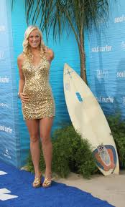
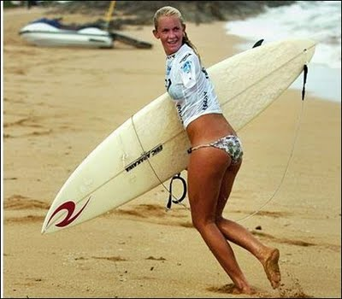
Bethany Hamilton – Pro Surfer
The inspirational Christian athlete from Hawaii who courageously returned to surfing after surviving the loss of her arm

Slide 31
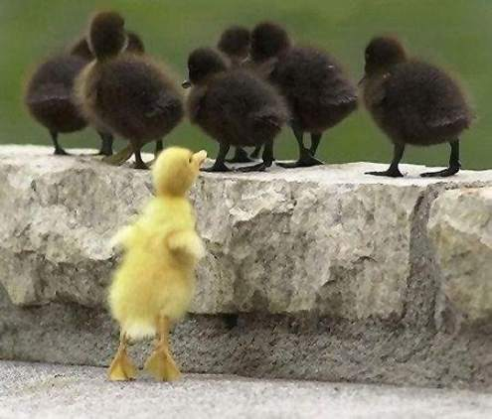

Slide 32

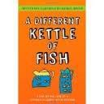


Must-Have Reads for Your Schools
Inclusive Book Store www.anewchapterbooks.com

Slide 33
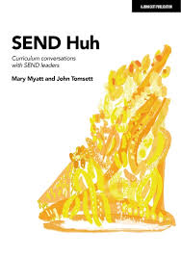
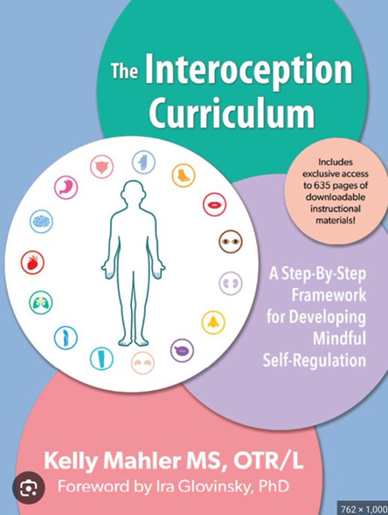

Curriculum Is Key
Myatt, M. and Tomsett, J. (2023). SEND Huh – curriculum conversations with SEND leaders. John Catt, Woodbridge.
The Interoceptive Curriculum
www.kelly-mahler.com
Motor Skills United
www.tts-group.co.uk/motor-skills-united-therapy-programme/1002394.html

Slide 34




Slide 35
Speech & Language
Listening to and recalling information
Processing information
Language Difficulties
Formulating and using language
Understanding
verbal information

Slide 36
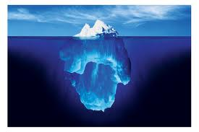
Speech sounds
Social skills
Expressions
Understanding
Memory
Attention
Listening

Slide 37
film doorzichtig lichtbron
foto zon kaarsen snelheid
Licht komt in onze ogen zodat wij kunnen zien.
Het licht komt van een _________ zoals de ______, gloeilamp, _______ en camera flits.
Het reist met hoge ________.
Licht kan door _________ materialen schijnen zoals de buitenkant van onze ogen of de lens voor een camera. Het licht dat de _______ raakt in een camera maakt een ______.
Het licht dat de achterkant van onze ogen raakt laat ons zien.

Slide 38
film zon doorzichtig lichtbron foto kaarsen snelheid
Licht komt in onze ogen zodat wij kunnen zien.
Het licht komt van een ________ zoals de _____, gloeilamp, ______ en camera flits.
Het reist met hoge _______.
Licht kan door _______ materialen schijnen zoals de buitenkant van onze ogen of de lens voor een camera. Het licht dat de ______ raakt in een camera maakt een _____.
Het licht dat de achterkant van onze ogen raakt laat ons zien.

Slide 39
Not understanding or being understood can be very frustrating and can lead to challenging behaviour.
Evidence suggests that students with a history of challenging behavioural difficulties can be experiencing underlying speech language & communication difficulties.

Slide 40
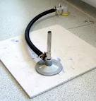
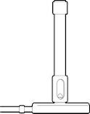

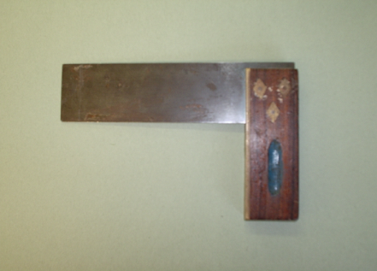
Strategies to Develop and Use
Use visual supports as much a possible:
BUNSEN BURNER
TRY
SQUARE

Slide 41
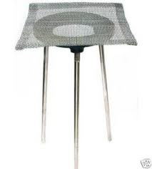

Reduce Uncertainty in Your Lessons
Tripod & Gauze
Pencil, Ruler & Rubber

Slide 42
Support the Vocabulary You Use
Key Words & Meanings

Slide 43
Evidence Based Learning Strategies
Spaced Practice
Retrieval Practice
Elaboration
Interleaving
Concrete Examples
Dual Coding
The Learning Scientists - www.learningscientists.org

Slide 44
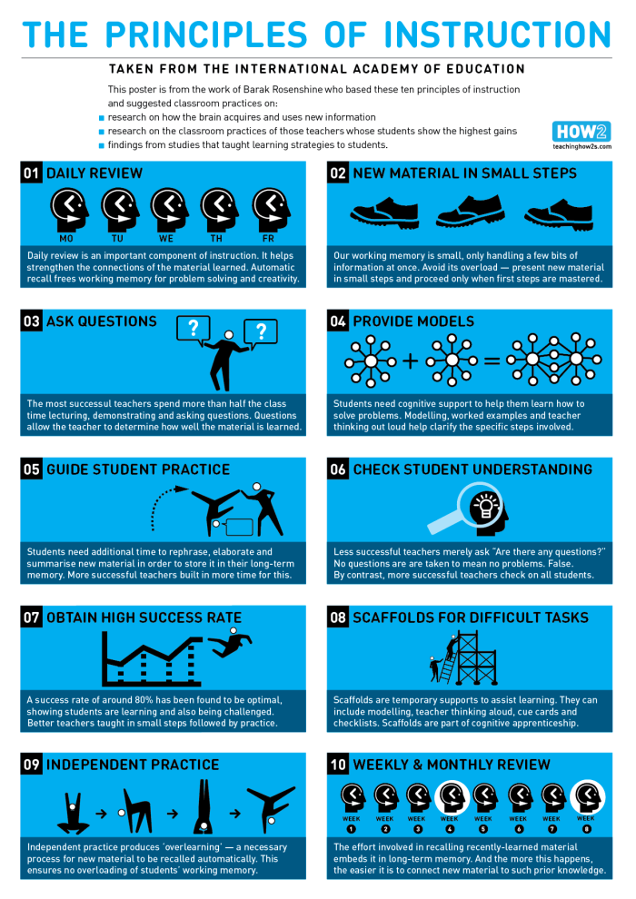
Using as a Guide – Not a Checklist
Two short films…
https://youtu.be/ZO8abw3DHxs
https://youtu.be/Pjrqc6UMDKM
www.retrievalpractice.org
https://lovetoteach87.com/2019/11/24/retrieval-practice-the-myths-versus-reality/

Slide 45
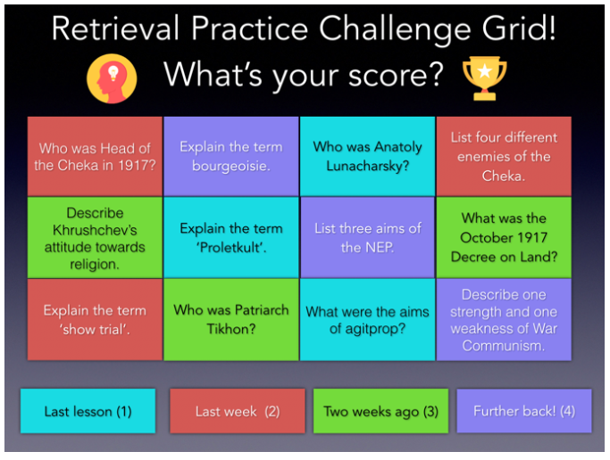
Kate Jones – @KateJones_teach
https://lovetoteach87.com/2018/01/12/retrieval-practice-challenge-grids-for-the-classroom/

Slide 46
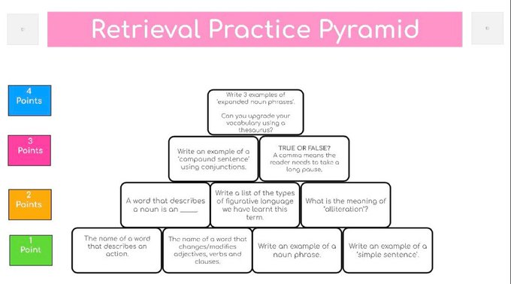
@mr_alfredb

Slide 47
https://www.learningscientists.org/videos

Slide 48
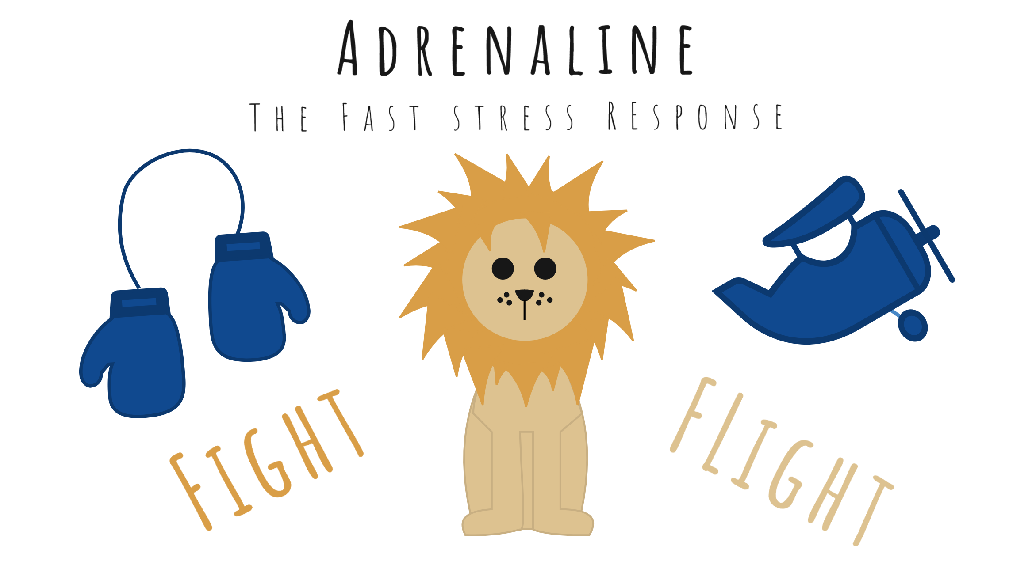
Fight or Flight: Stress Hormones

Slide 49

The Solution: Cortisol Management
You can control cortisol levels via:
Stress Management Techniques
Relaxation
Being mindful
Support systems
Coping styles
Exercise
Nutrition

Slide 50
Stress and Trauma
Viewing ‘behaviours’ from the perspective of stress and trauma is essential
This requires empathic understanding of why a person presents in the way they do
Stress and trauma are transactional and cumulative
Stressed people make poor decisions – everyone included

Slide 51
The Negative Behaviour Narrative
In a recent article on the Studio 3 website, Andy described himself as ‘A Behaviourist in Recovery’
Low Arousal Approaches are almost 80% reactive in nature – but need not *always* be
They are not ‘instead of’ other therapeutic approaches
Accepting that our role is to SUPPORT and not FIX people is an essential focus of the Low Arousal Approach (McDonnell, 2019)

Slide 52
Role Model Being a Calm and Reflective Individual
Good stress management focuses on calm and reflective individuals who actively avoid threatening cues
Remember, even moving towards an individual who is highly distressed can trigger a cocktail of fear, threat, and in some cases physical violence
Low Arousal practitioners are often attempting to ‘ride out the storm’

Slide 53

Stop Catastrophising
Are most behaviours we experience on the same level as knife crime?

Slide 54

Highly Stressed People Need More Control
As practitioners, we often try to over-control behaviours

Slide 55
The Battle for Control
He/she is trying to wind me up
He/she is doing it deliberately
He/she knows what they are doing
He/she could stop if they wanted
He/she can think through their actions
He/she means to make me feel bad
He/she knows the best time to challenge
*Adapted from the Controllability Beliefs Scale (Dagnan et al., 2013)

Slide 56
Recognise Panic and Avoid Emotional Contagion
Many people with additional needs, disabilities and distressed behaviours show signs of panic in specific situations
Panic reactions can often lead to people needing to escape from situations
Panic responses do not appear to habituate rapidly
Individuals are not always allowed by carers to escape from situations

Slide 57
Focus More on the Behaviour of Supporters
In our experience, there can be an overly mechanistic approach to supporting distressed behaviours
Changing the conversation or, as our colleague Elly Chapple says, ‘flipping the narrative,’ can be extremely positive
In therapeutic relationships, the supporters of clients/young people and their stress reduction should be a primary focus

Slide 58
It’s About ‘Us’ Not ‘Them’
If we are to change our approach to crises, the key is to change our own behaviour
Sometimes this means ‘giving in’ (McDonnell, 2019) – strategic capitulation
Often, it means saying nothing
Highly stressed people tend to focus more on body language than words
Ask yourself: ‘How can I manage that situation better next time?’

Slide 59
Choices Not Boundaries
David Pitonyak has always argued that we should give people choices rather than boundaries
Every boundary or rule is a point of confrontation
A Low Arousal Approach to crisis management means having fewer rules, not no rules
‘Give Options Not Ultimatums’

Slide 60
See the Person, Not the Behaviour
Always try to remind yourself that you are working with a highly distressed individual
Try to avoid focusing just on the person’s behaviour
There are always complex reasons why we behave in the way we do
Try and see the person as stressed and traumatised

Slide 61
Assumptions about ‘complexity’
Viewing a person as always a) in control & b) aware of their behaviour is a dangerous combination.
Seeing people as distressed and traumatised can #flipthenarrative on how we interact with these individuals in crisis situations – but also how we ‘set up’ learning – being pro-active is key!

Slide 62
Potential Causes & Challenges
Communication difficulties
Confusion
Unexpected change – breaking a routine
Environmental factors – heat, overcrowding, noise, etc.
Sensory differences i.e. hyper and hyposensitivity
Pain or medical problems
Medication changes
Inactivity/boredom
Demands and requests
Emotional problems and mental illness
Too many rules and restrictions
Being denied a need or getting something that they don’t want
Staff/Adults/Others
And many more…

Slide 63
Less Reactive – More Pro-active
The more pro-active we are the less reactive we need to be…

Slide 64
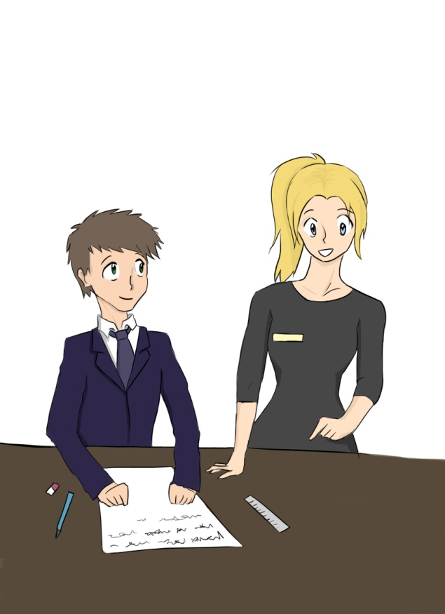
Helping students to self-regulate
Learning-to-learn

Slide 65
Metacognition & Self-Regulation
Metacognition - literally “beyond knowing”, knowing what one knows and doesn’t know - promoting a student’s ability to self-monitor levels of understanding and predict how well (s)he will do on a particular task
Self-regulation - students monitoring their own comprehension and assessing their own abilities without teacher help

Slide 66
Metacognition
Most closely associated with a teacher’s instructional practices
The teacher’s metacognitive practices, if done effectively, can lead to student self-regulation
We need to think carefully about language and communication to facilitate this

Slide 67
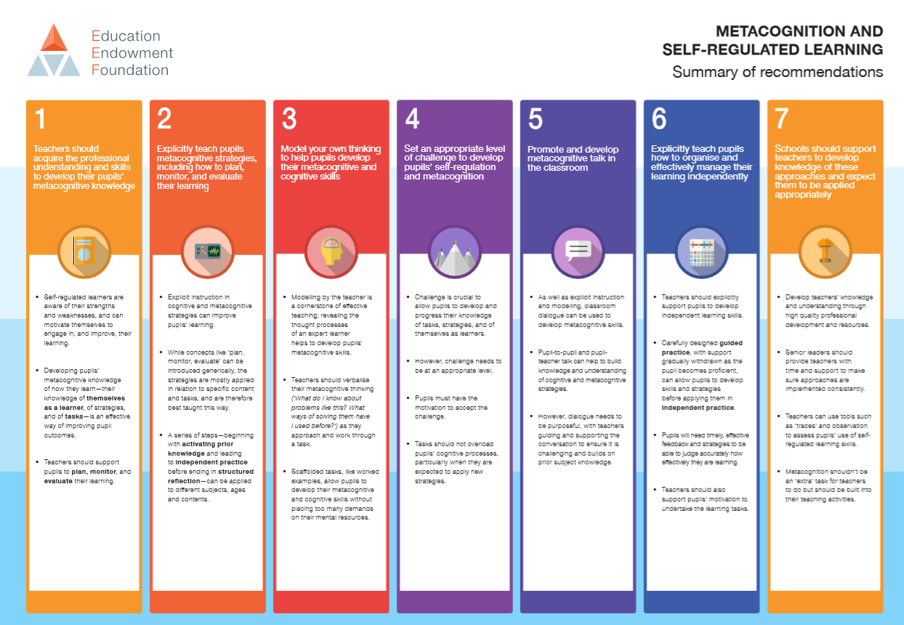
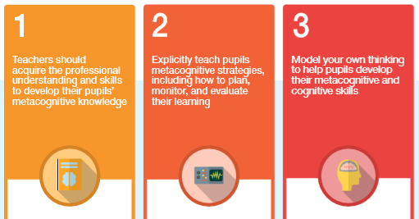
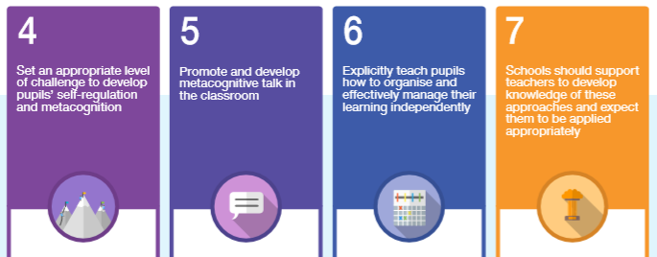
Metacognition & Self Regulation
https://educationendowmentfoundation.org.uk/tools/guidance-reports/metacognition-and-self-regulated-learning/

Slide 68
EEF Blog: What are effective Learning Behaviours - and how can we develop them in our pupils? | News | Education Endowment Foundation | EEF
Toolkit Talk: Meta Cognition - Bing video
https://youtu.be/V8jJPOxii6M

Slide 69
The Saturation Model
Agent of change
Developing the school environment
Flexible provision
Direct support and intervention
Policy development and embedding practice
Training and development of staff
Peer education and awareness
Creating a positive ethos
Morewood, G. D., Humphrey, N. & Symes, W. (2011) Mainstreaming autism: making it work. Good Autism Practice Journal 02.12.11, 62-68.

Slide 70
The Saturation Model – all the links
Morewood, G. D., Humphrey, N. & Symes, W. (2011) Mainstreaming autism: making it work. Good Autism Practice Journal 02.12.11, 62-68.
Download the original paper - http://ow.ly/WJEc30qe80H
The Saturation Model explained - http://ow.ly/QcST30qe7YG
Two short films - http://ow.ly/CRUF30qe7Xm & http://ow.ly/VFfP30qe7Xl
The Saturation Model and the Low Arousal Approach for Inclusion in Schools
Link - https://tinyurl.com/yc3j6yxv
Free Webinar: Using the Saturation Model as a Tool for School Improvement
Link - https://rb.gy/b2tfbt

Slide 71
Why constant consistency matters: emotional regulation as a foundation for learning
https://blog.optimus-education.com/why-constant-consistency-matters-emotional-regulation-foundation-learning
Applying Low Arousal approaches in education settings
https://blog.optimus-education.com/applying-low-arousal-approaches-education-settings

Slide 72


Slide 73
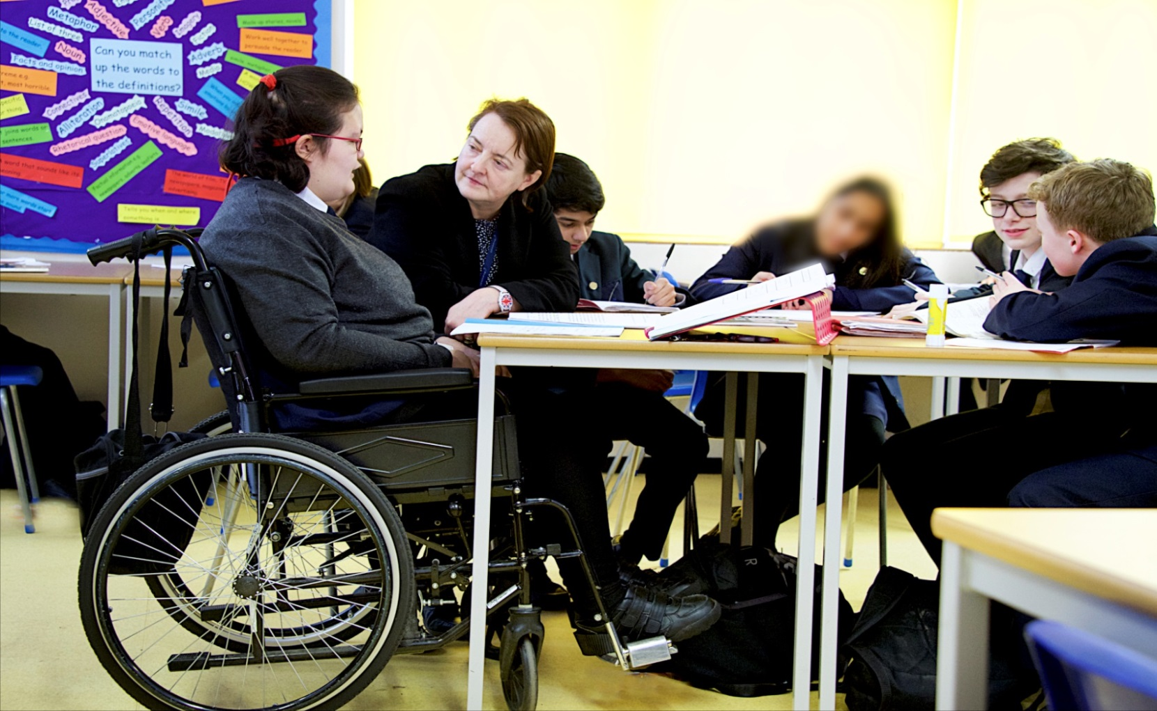
“I get to do everything my friends do, just that sometimes I have things changed a little so I can join in properly.” Lisa, aged 15

Slide 74
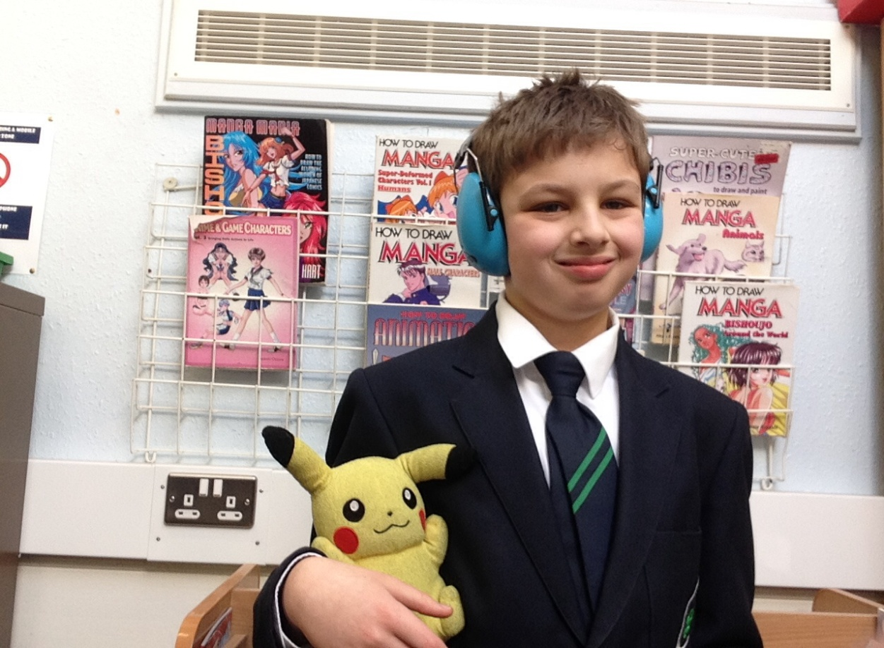
“School is really good because they have many autistic students and they understand us. I think I will have a great time at school because they know how to deal with me and support me. Social time is great as I get to hang out with other students who like to share my interests.”
Bobby, aged 11

Slide 75
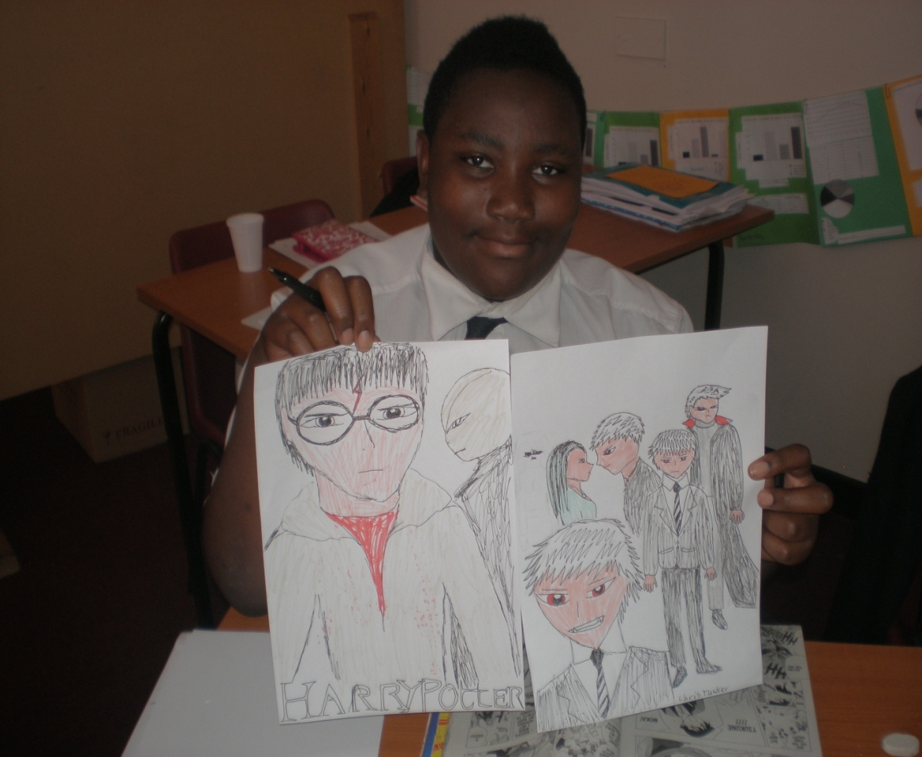
Chris, now aged 19
(pictured aged 13)

Slide 76
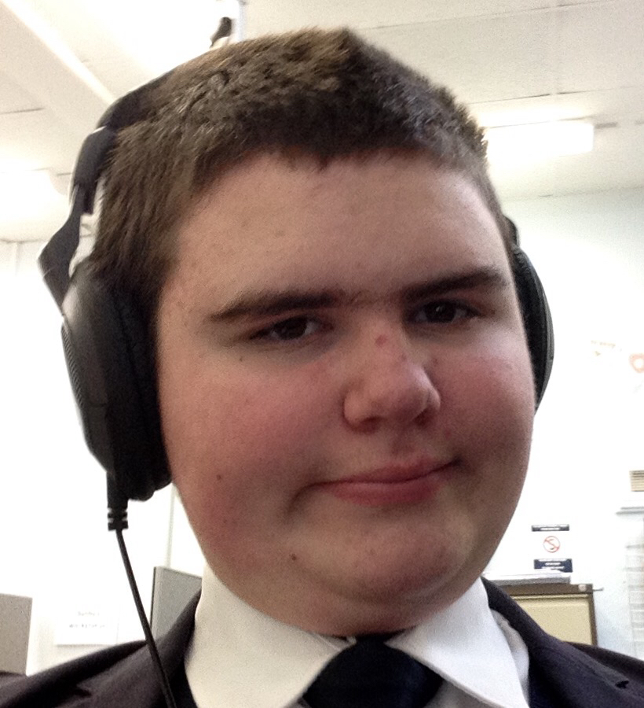
“At first it was very difficult for me at school but now I like to take on challenges and I like that here there are safe rooms for you to go to. I am good at maths.”
John, aged 14

Slide 77
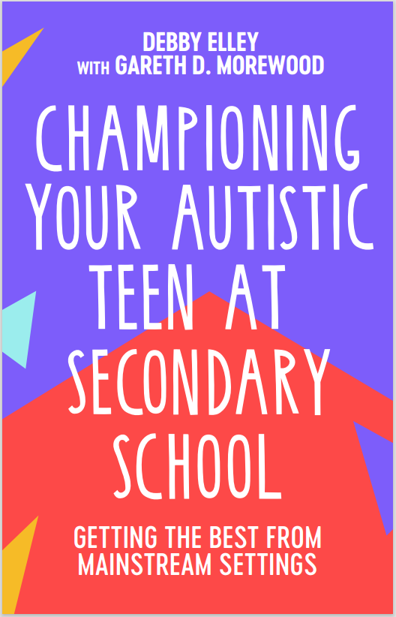
New Book
‘I’d recommend this to all parents looking to support their child in school and to all teachers who want to build a collaborative approach with pupils and parents.’
Richard Nurse, parent and founder of Picturepath.
‘This book’s grounded, compassionate and practical approach will be a boon for all involved in the education of autistic teenagers. I highly recommend it.’
Mary Myatt, education writer and curator of Myatt and Co.
‘This should be essential reading for parents of autistic children who attend a mainstream secondary school. A remarkable achievement.’
Neil Humphrey, Sarah Fielden Chair: Psychology of Education, University of Manchester.
‘Drenched in lived experience, this is a superb guide. You’ll learn something new in every chapter.’
Matt Keer, parent contributor to Special Needs Jungle website.

Slide 78
Links
FREE webinars - www.studio3.org/free-webinars
FREE Newsletter - www.studio3.org/so/d5OUpnBWt?languageTag=en
LASER Prog - www.studio3.org/laser-online
Low Arousal Training - www.studio3.org/low-arousal-online
Films - Videos Archives - Gareth D Morewood (gdmorewood.com)
SENCology Blog - SENCology | Optimus Education Blog (optimus-education.com)

Slide 79


Slide 80
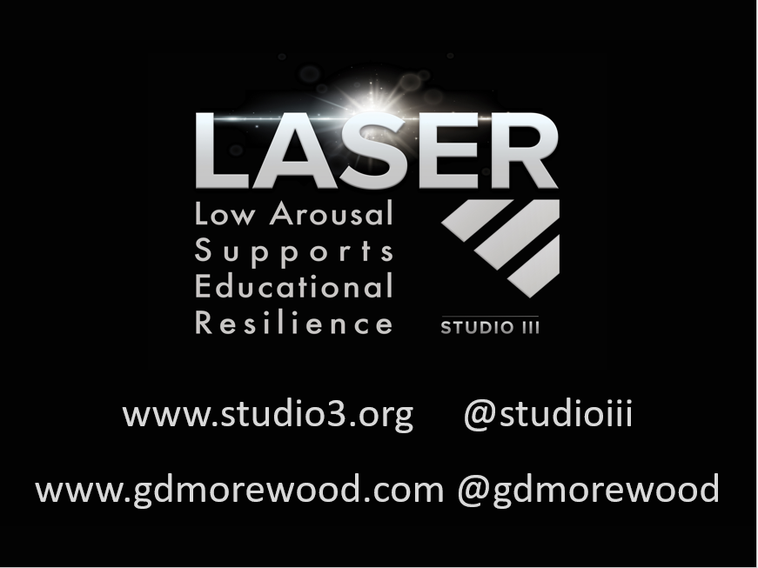
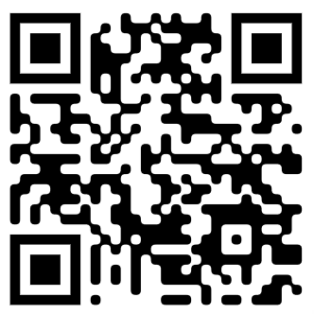
www.studio3.org @studioiii

