Slide 1

Are We Asking The Right Questions About Behaviour?
Gibraltar DoE Education Conference 2025
Gareth D Morewood

Slide 2
What is ‘behaviour’?
‘Behavior or behaviour is the actions and mannerisms made by individuals, organisms, systems or artificial entities in conjunction with themselves or their environment, which includes the other systems or organisms around as well as the physical environment.’
‘Manner of behaving or acting.’
‘Responses to external stimuli.’
‘The action or reaction under any given circumstances.’

Slide 3
Assumptions about Behaviour
Viewing a person as always a) in control & b) aware of their behaviour is a dangerous combination.
Seeing people as distressed and traumatised can #flipthenarrative on how we interact with these individuals in crisis situations – but also how we ‘set up’ learning – being pro-active is key!

Slide 4
Potential Causes & Challenges
Communication difficulties
Confusion
Unexpected change – breaking a routine
Environmental factors – heat, overcrowding, noise, etc.
Sensory differences i.e. hyper and hyposensitivity
Pain or medical problems
Medication changes
Inactivity/boredom
Demands and requests
Emotional problems and mental illness
Too many rules and restrictions
Being denied a need or getting something that they don’t want
Staff/Adults/Others
And many more…

Slide 5
Less Reactive – More Pro-active
The more pro-active we are the less reactive we need to be…

Slide 6
"When a person is drowning that is not the best time to teach them how to swim."
(David Pitonyak)

Slide 7
Why can school (education) be such a challenging place?
For young people:
    Learning in a social setting, reading social situations, deciphering the unwritten rules
    Learning in a complex language environment with limited visual support
    Understanding and communicating with other students and adults
    Coping with change, transitions and unexpected breaks in routine
    Day to day organisation
    Generalising learning beyond the setting in which it took place
For staff and families:
    Gaining, maintaining and refocusing attention
    Motivation
    Differentiation of language and/or curriculum
    Managing behaviour **WARNING**WARNING**WARNING**
    Accommodating special interests

Slide 8
Why can school (education) be such a challenging place?
For the peer group:
  Lack of understanding
  Resenting extra attention
  Social advances that are ignored or rejected
  Distraction or disruption
  Feeling that double standards are applied (‘getting away’ with things)
  Being nervous or fearful
  Ignoring, teasing, winding up, bullying (Morewood, Humphrey & Symes, 2011)

Slide 9
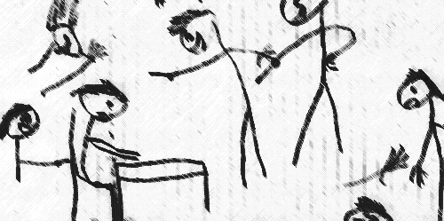
Why Can School Be Such a Challenging Place?
Taken from Humphrey & Lewis (2008)

Slide 10
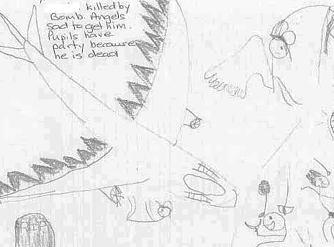
Why Can School Be Such a Challenging Place?
Taken from Humphrey & Lewis (2008)

Slide 11


Slide 12


Slide 13


Slide 14


Slide 15


Slide 16
“Masking Is Life”: Experiences of Masking in Autistic and Nonautistic Adults. Autism in Adulthood
www.liebertpub.com/doi/10.1089/aut.2020.0083
Double Empathy: Why Autistic People Are Often Misunderstood
Double Empathy: Why Autistic People Are Often Misunderstood · Frontiers for Young Minds (frontiersin.org)

Slide 17
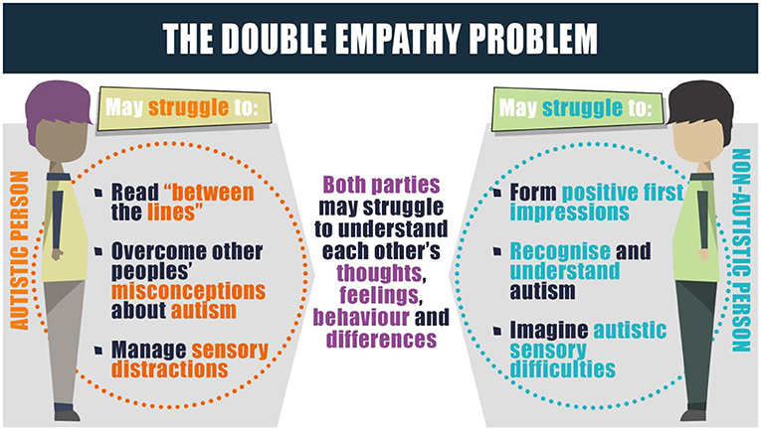

Slide 18
Understanding Stress
It is our coping responses that determine how we adapt to stress.
Many young people have very few 'coping tools’.
Some restricted or repetitive behaviours may have very real and vital coping functions.
For example, a person may engage in stereotyped movements which help them to regulate their arousal (McDonnell and Gayson, 2014).

Slide 19
What is the Low Arousal approach
A recent framework (McDonnell, 2012) suggests four key areas
of Low Arousal:
  The reduction of staff demands and requests in a crisis
  The adoption of verbal and non verbal strategies that avoids potentially arousing triggers (e.g. direct eye contact)
  The exploration of staff beliefs about the short-term management of challenging behaviours
  The provision of emotional support to staff

Slide 20
The Notion of Low Arousal
We also know that challenging behaviour often occurs when someone experiences a high intensity of affect.
Nobody fights when they are relaxed and easy-going.
Calm and self-control is connected, and we want the service-user or child to be in control of him- or herself, so that they can cooperate and work *with* - in partnership.
Physiological arousal can be strongly linked to the construct of stress (McDonnell et al, 2014).
Arousal and stress are considered to be important in the regulation of emotion (Reich & Zautra, 2002).

Slide 21
Key messages
Some of the key messages for consideration in developing an
approach schools and communities are:
    an evidence base isn’t always vital; something that works with only 5% of the population can still be incredibly useful – personalisation
    organisational changes cannot be affected in a zero tolerance policy – a need for flexibility and reasonable adjustments
    you need the appropriate tools to do the job – training and development is essential

Slide 22
Constant Consistency
Problems can arise for schools and other settings when there isn’t a joined up ‘whole-school approach’ that is supportive of plans and individuals.
Fragmented practice and provision can fuel dysregulation and increase stress; consistent, calm approaches are hugely effective.
We need to ensure that pockets of ‘good practice’ are not undone by inconsistent whole-school provision and/or wider systems.

Slide 23
Constant Consistency
It isn’t good having a really calm, consistent, purposeful learning environment in one classroom, if when the bell goes for break or lunch there’s a stampede down the corridor.
This just creates a very dysregulated experience and environment and adds significant stress for students who find these less structured times extremely challenging.
It’s also stressful for the staff who end up in reactive mode, trying to calm students and get them to stop running or shouting etc.

Slide 24
Constant Consistency
Consistency has to be constant for learning to take place.
This is one of my biggest learning experiences from my work with many schools in both the UK and internationally.
One of the key elements of the Saturation Model is ensuring a clear link between policy and practice; a disconnect creates opportunities for fragmentation with regard to provision and structure.
No-one is harmed by calm, consistent, positive approaches

Slide 25
Constant Consistency
Key to this is talking to students & families about their experience of the whole day – not school and home separately, or lessons and break/lunch as different times, but considering the whole day or week and how they engage with it.
Having pockets of calm and consistency (certain lessons, before school, in the taxi home etc.) can simply give a moment of relief from other, more chaotic times of the day.
Creating a continuous, positive experience is the key to unlocking success for all: no-one is harmed by calm, consistent, positive approaches, whereas many can experience significant distress from noisy, hectic and dysregulated ones.

Slide 26
Constant Consistency
If I am in a peaceful lesson before lunch, but I’m worried about the stampede afterwards and the noise in the canteen, for example; I will be less well placed to do my best in that lesson, even if it is a really well established and accordant environment.
Furthermore, the effort required to address these concerns personally can be exhausting. This might mean fewer coping mechanisms at my disposal later in the day, or when I arrive home.
This often fuels the ‘they’re all right in school, no idea why they’re so difficult at home’ narrative or negative language and a fundamental failure to understand the core issues of emotional regulation and stress.

Slide 27
Constant Consistency
Three things we can do…(that are within our gift):
Firstly, the key to successfully improving the experiences of young people throughout their day is effective co-production (see SENCology blogs).
This has to involve the young people and families in jointly identifying areas of challenge and finding solutions together.
Working collaboratively to understand a young person’s route through their whole day is a vital foundation for this approach.

Slide 28
Constant Consistency
Rather than adults or professionals assuming what is needed, we need to gather robust information and use this to inform our plans and provision.
We can then then build school systems and approaches that are based on an analysis and understanding of the community rather than assumptions and our perceptions of others.
Sometimes a small change in a school system can make a big difference to an individual and enable them to thrive.
But you won’t necessarily know that if you don’t gather information collaboratively.

Slide 29
Constant Consistency
Secondly, ensuring high quality teaching and learning for all – providing calm, consistent and robust learning environments is important.
I think there is now a growing body of evidence now as to what is considered a good investment in learning (which is something I’ll address in more detail shortly).
Great teaching for *all* has to be a core element of education.

Slide 30
Constant Consistency
Thirdly, make sure that whole-school policy and systems are also calm, consistent and in keeping with good classroom practice.
Getting rid of bells; promoting orderly transitions (for some students at slightly different times may also be beneficial); staff eating lunch with students and modelling expectations – all of this feeds into this corporate responsibility model of shared expectations and consistent, inclusive ideals.

Slide 31
Constant Consistency
From some recent experiences in international settings particularly, I know there are some very simple things that can be changed that have massive impact; the key here is listening to the voices of young people and families, finding out what is challenging for them and designing solutions together.
Approaches that assume what the challenges are often leave some falling behind or even unable to attend school as a result – this need not be the case.

Slide 32
Constant Consistency
Personalisation is key!
Remember that every environment and community is unique.
While there may be some things that have good utility, developing provision and thinking around your specific context is the key to success, based on my experiences.
A small rural primary school, specialist setting, large comprehensive secondary school, international school, home-learning environments – all have unique and different challenges, even before we consider locality and other factors.

Slide 33


Leadership & Corporate Responsibility
Morewood, G. D. (2018) in Bartram, D. Great Expectations: leading an effective SEND strategy in school. John Catt Publications.

Slide 34
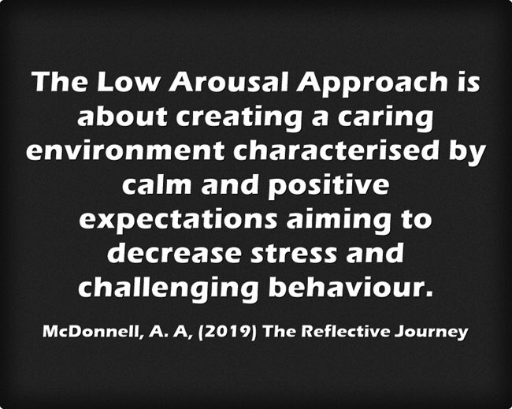

Slide 35
Applying Low Arousal Approaches
Calm and self-control are connected.
In applying the Low Arousal approach to teaching and learning it is all about the culture within the classroom; founded on a good understanding of stress and consistent proactive approaches.
Maintaining a calm, consistent environment, applying what the evidence would suggest is a good investment in learning, creates a purposeful environment that allows everyone the opportunity to thrive.

Slide 36
Applying Low Arousal Approaches
Creating a calm, consistent, positive learning environment benefits everyone – a good strategy for young people with additional needs, rarely, if ever, harms or hinders peers.

Slide 37
Low Arousal
What makes a Low Arousal practitioner?
What supports a Low Arousal culture/ethos?

Slide 38
Applying Low Arousal Approaches
I have been very fortunate to have the opportunity to develop these ideas in conjunction with the Saturation Model as part of the new LASER Programme.
The ideas centre around looking at how we set up whole-school systems and structures coupled with consistent, calm approaches to learning drawing on what the evidence suggests is a good investment.

Slide 39
What can we do to improve the educational experiences and outcomes of autistic young people?
Agent of change
Developing the school environment
Flexible provision
Direct support and intervention
Policy development and embedding practice
Training and development of staff
Peer education and awareness
Creating a positive ethos
Morewood, G. D., Humphrey, N. & Symes, W. (2011) Mainstreaming autism: making it work. Good Autism Practice Journal 02.12.11, 62-68.

Slide 40
The Saturation Model – all the links
Morewood, G. D., Humphrey, N. & Symes, W. (2011) Mainstreaming autism: making it work. Good Autism Practice Journal 02.12.11, 62-68.
Download the original paper - http://ow.ly/WJEc30qe80H
The Saturation Model explained - http://ow.ly/QcST30qe7YG
Two short films - http://ow.ly/CRUF30qe7Xm & http://ow.ly/VFfP30qe7Xl
The Saturation Model and the Low Arousal Approach for Inclusion in Schools
Link - https://tinyurl.com/yc3j6yxv
Free Webinar: Using the Saturation Model as a Tool for School Improvement
Link - https://rb.gy/b2tfbt

Slide 41
“We need schools where difference is valued and where there is less emphasis on conformity and greater focus on harnessing strengths in order to enable all, staff and students alike….to be the best they can become”
Professor Rita Jordan
‘Personalisation NOT Normalisation’
Dr Damian Milton

Slide 42
MEDICAL MODEL THINKING | SOCIAL MODEL THINKING
Person is faulty | Person is valued
Diagnosis | Strengths and needs defined by self and others
Labelling | Identify barriers and develop solutions
Impairment becomes the focus of attention | Outcome based programme designed
Assessment, monitoring, programmes of therapy imposed | Resources are made available to ordinary services
Segregation and alternative services | Disability Equality Training for All
Ordinary needs put on hold | Encourage social relationships
Re-entry if normal enough OR Permanent Exclusion | Diversity welcomed and disabled person is Included
Society remains unchanged | Society evolves
(Adapted from Micheline Mason 1994 & R. Rieser 2005)

Slide 43
Applying Low Arousal Approaches
The core principals are about:
  understanding the Low Arousal Approach and how it can improve outcomes for young people, staff and families
  understanding stress and how best to support yourself and others
  improving classroom pedagogy
  challenging and supporting positive whole-school systems.
A strong pillar throughout is co-production – working jointly on identifying challenges and finding solutions to improve the outcomes for young people.

Slide 44
Applying Low Arousal Approaches
Some of the key elements of this approach, from research and personal experience, are listed below:
  The Saturation Model
  Low Arousal approaches
  The PERMA model of positive psychology
  Co-production
  Stress and arousal
  Metacognition and self-regulation
  Reflective practice

Slide 45
Positive Psychology - Three Good Things Exercise
Participants were asked to write down three things that went well each day and their causes every night for one week (Seligman, 2005).
In addition they were asked to provide a causal explanation for each good thing.
You can see how Seligman’s ideas can be translated to school/home environments.
For 1 week at the end of each day, staff could write about 3 positive things that occurred in their day.
You can also ask them to describe 3 things that made them smile.

Slide 46
Applying Low Arousal Approaches
For me, the vital thing about this way of working is the ability to truly personalise responses to the individual setting/establishment.
This happens through:
  drawing on the core themes outlined previously and applying them with those who know the setting best
  working with individual families who educate in the home
  working with specialist and secure settings and mainstream schools and colleges.
Personalisation isn’t just about individuals; it’s about communities and families as well.

Slide 47
Classroom Structure & Routine
Positive examples regarding classroom routines and structure are numerous, but from my experience creating that calm and consistent learning environment starts with knowing your students and how to arrange and set-up the classroom for optimal learning.
For example:
  knowing students individually and being aware of those with sensory, language, cognition, emotional regulation needs etc.
  greeting students at the door and establishing positive, consistent routines for the start and end to each session
  sharing an explicit plan, with timings
  reducing stress by consistently following positive structures for learning.

Slide 48
Planned Escape
Planned Escape
From the original interview almost a decade ago
http://ow.ly/h4h030qe7H1
Hear more about establishing a Planned Escape strategy, that worked!
http://ow.ly/ojdf30qe7H2 & http://ow.ly/zAZ330qe7H0

Slide 49
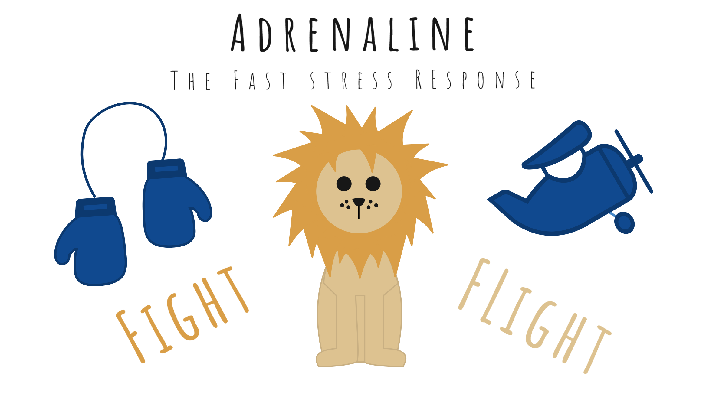
Fight or Flight: Stress Hormones

Slide 50

The Solution: Cortisol Management
You can control cortisol levels via:
Stress Management Techniques
Relaxation
Being mindful
Support systems
Coping styles
Exercise
Nutrition

Slide 51
Stress and Trauma
Viewing ‘behaviours’ from the perspective of stress and trauma is essential
This requires empathic understanding of why a person presents in the way they do
Stress and trauma are transactional and cumulative
Stressed people make poor decisions – everyone included

Slide 52
The Negative Behaviour Narrative
In a recent article on the Studio 3 website, Andy described himself as ‘A Behaviourist in Recovery’
Low Arousal Approaches are almost 80% reactive in nature – but need not *always* be
They are not ‘instead of’ other therapeutic approaches
Accepting that our role is to SUPPORT and not FIX people is an essential focus of the Low Arousal Approach (McDonnell, 2019)

Slide 53
Role Model Being a Calm and Reflective Individual
Good stress management focuses on calm and reflective individuals who actively avoid threatening cues
Remember, even moving towards an individual who is highly distressed can trigger a cocktail of fear, threat, and in some cases physical violence
Low Arousal practitioners are often attempting to ‘ride out the storm’

Slide 54

Stop Catastrophising
Are most behaviours we experience on the same level as knife crime?

Slide 55

Highly Stressed People Need More Control
As practitioners, we often try to over-control behaviours

Slide 56
The Battle for Control
He/she is trying to wind me up
He/she is doing it deliberately
He/she knows what they are doing
He/she could stop if they wanted
He/she can think through their actions
He/she means to make me feel bad
He/she knows the best time to challenge
*Adapted from the Controllability Beliefs Scale (Dagnan et al., 2013)

Slide 57
Recognise Panic and Avoid Emotional Contagion
Many people with additional needs, disabilities and distressed behaviours show signs of panic in specific situations
Panic reactions can often lead to people needing to escape from situations
Panic responses do not appear to habituate rapidly
Individuals are not always allowed by carers to escape from situations

Slide 58
Focus More on the Behaviour of Supporters
In our experience, there can be an overly mechanistic approach to supporting distressed behaviours
Changing the conversation or, as our colleague Elly Chapple says, ‘flipping the narrative,’ can be extremely positive
In therapeutic relationships, the supporters of clients/young people and their stress reduction should be a primary focus

Slide 59
It’s About ‘Us’ Not ‘Them’
If we are to change our approach to crises, the key is to change our own behaviour
Sometimes this means ‘giving in’ (McDonnell, 2019) – strategic capitulation
Often, it means saying nothing
Highly stressed people tend to focus more on body language than words
Ask yourself: ‘How can I manage that situation better next time?’

Slide 60
Choices Not Boundaries
David Pitonyak has always argued that we should give people choices rather than boundaries
Every boundary or rule is a point of confrontation
A Low Arousal Approach to crisis management means having fewer rules, not no rules
‘Give Options Not Ultimatums’

Slide 61
See the Person, Not the Behaviour
Always try to remind yourself that you are working with a highly distressed individual
Try to avoid focusing just on the person’s behaviour
There are always complex reasons why we behave in the way we do
Try and see the person as stressed and traumatised

Slide 62
Reflective practice
Reflective practice is considered to be the cornerstone of behaviour management strategies such as low arousal approaches (McDonnell, 2010).
There is a clear link with mindfulness (Singh et al 2013 & 2014).
People need to understand their own and wider environmental contributions to challenging behaviours.
Key to reflection, for me, is the acceptance of fallibility.

Slide 63
An important distinction
An important characteristic of Reflective Practice rather than reflection is the fact that it is captured and expressed in some form - usually written, spoken or pictorial - on a systematic basis.
This is because learning comes not only from the ‘in the head’ reflection but from the process of representing the reflection itself.
When the process of representation becomes a habitual activity, patterns and connections become visible.

Slide 64
Gibbs (1998) Reflection Cycle
Description - what happened?
Evaluation - what was good and bad about?
Analysis - what sense can you make of the situation?
Conclusion - what else could have been done?
Action - it is arose again what would you do?
Feelings - what were you thinking and feeling?

Slide 65
Reflective dialogues
Using Isaacs’ model of dialogue as a conversation tool with a group of fellow
learners is a powerful way of creating space for reflection.
The four principles of dialogue are:
    Listening to understand others rather than to plan what you’re going to say
    Suspending judgement and criticism
    Voicing, or speaking in the first person rather than abstractly
    Respecting the views of others and their right to hold them.
A dialogue can be used as a way of exploring experiences, planning future actions,
and enabling participants to benefit from others’ insights into their personal
challenges.

Slide 66
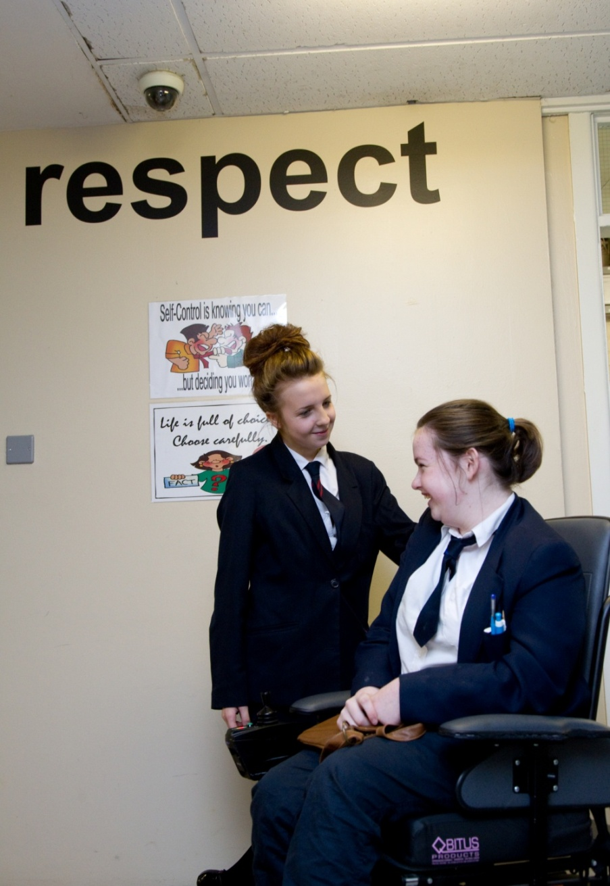
Peer education and support is essential
‘The education of the peer group is an essential part of moving towards a truly inclusive community’
Gareth D Morewood (2011)

Slide 67
Ensure clear communication with parents/carers
Keep parents/carers informed
Make sure they know who to contact and how
Provide honest communication – no long-term benefit in providing anything but the truth
Listen to parents/carers – give them time
Try to avoid uncertainty/misinterpretation
MOREWOOD, G. D., & BOND, C. (2012) Understanding Parental confidence in an inclusive high school: a pilot survey. Support for Learning, Vol. 27 No.2, p53-58 Wiley Blackwell Publishing.

Slide 68

The LASER Approach from Studio III

Slide 69
Key Aims
The LASER Project is a systemic approach to creating calm, safe and thriving school environments with a focus on coproduction and positive outcomes.
The Key Goals include:
A focus on stress reduction
Reducing restrictive practices (with the aim of elimination)
Excellence in the prevention of behaviours of concern
Creating an ethos and culture of low arousal approaches
Developing inclusive pedagogy and culture through training, support and reflective practice

Slide 70
On-Going Support & Supervision
As part of the commitment to developing outstanding practitioners, the LASER Project offers ongoing supervision and support for delegates, through a blend of coaching, reflective practice and additional support materials.
Our goal is to create sustainable systemic change within school organisations and educational settings through bespoke teaching and support.

Slide 71
On-Going Support & Supervision
Too often I’ve seen a singular input on a training day or session with the expectation that everyone can implement things equally as a result.
Adaptations may need to be made to systems before change can occur, and some colleagues will need further support.
Joint working and shared experiences can be so important, particularly during these challenging times.
To that end, there is much that can be adapted and implemented at no (or very low) cost – something which has always been part of my mantra of ‘high impact – low cost’ support and training.
We’ve very much kept all of this in mind when designing the LASER programme.
It’s all about supporting a personalised approach to learning, drawing on a range of systems and strategies, and forging an approach that’s suited to your community, setting and people.

Slide 72

Further Information
For further information and about personalising the training for your requirements please contact Gareth D Morewood, Educational Adviser for Studio 3 (garethm@studio3.org).

Slide 73
Why constant consistency matters: emotional regulation as a foundation for learning
https://blog.optimus-education.com/why-constant-consistency-matters-emotional-regulation-foundation-learning
Applying Low Arousal approaches in education settings
https://blog.optimus-education.com/applying-low-arousal-approaches-education-settings

Slide 74
AET Case Studies
In Year 7, Max said there were lots of changes to adjust to, the two main ones being new pupils and the new environment.
He described secondary school as a very friendly place and said that staff gave advice on how to calm down, rather than criticising you when you had a meltdown.
He said, “If staff see I am upset, they will ask me what’s wrong and what’s making you feel depressed – or say, Can I do anything to help you?”

Slide 75

AET Case Studies
Max’s advice to new students is to “be yourself and have a lot of fun and make new friends. He said, School is a place not only to learn but where you make friends. This school focuses on mental health, your life, your happiness – equally important as education.”

Slide 76
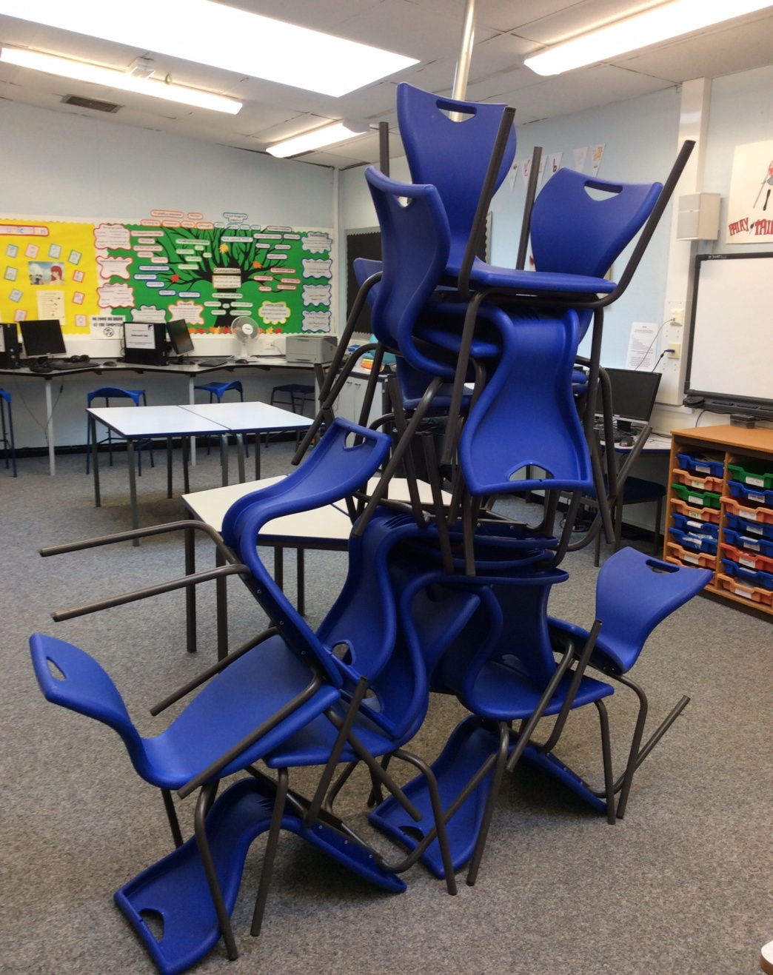

Slide 77


Slide 78

The ‘Bananarama’ Principle…
It ain’t what you do it’s the way that you do it…
So how do you spend to ‘get results’?
Or, what does the evidence say is a good investment or a poor investment for your students/child?
It ain’t what you spend but the way that you spend it… what works for one, may not for others!
Personalisation in the key!
Quoted from Prof Steve Higgins

Slide 79
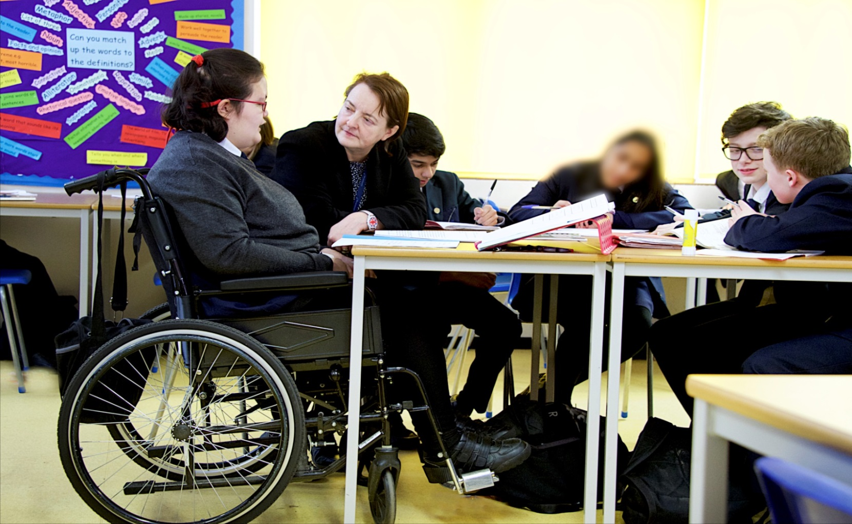
“I get to do everything my friends do, just that sometimes I have things changed a little so I can join in properly.” Lisa, aged 15

Slide 80
Links
FREE webinars - www.studio3.org/free-webinars
FREE Newsletter - www.studio3.org/so/d5OUpnBWt?languageTag=en
LASER Prog - www.studio3.org/laser-online
Low Arousal Training - www.studio3.org/low-arousal-online
Films - Videos Archives - Gareth D Morewood (gdmorewood.com)
SENCology Blog - SENCology | Optimus Education Blog (optimus-education.com)

Slide 81
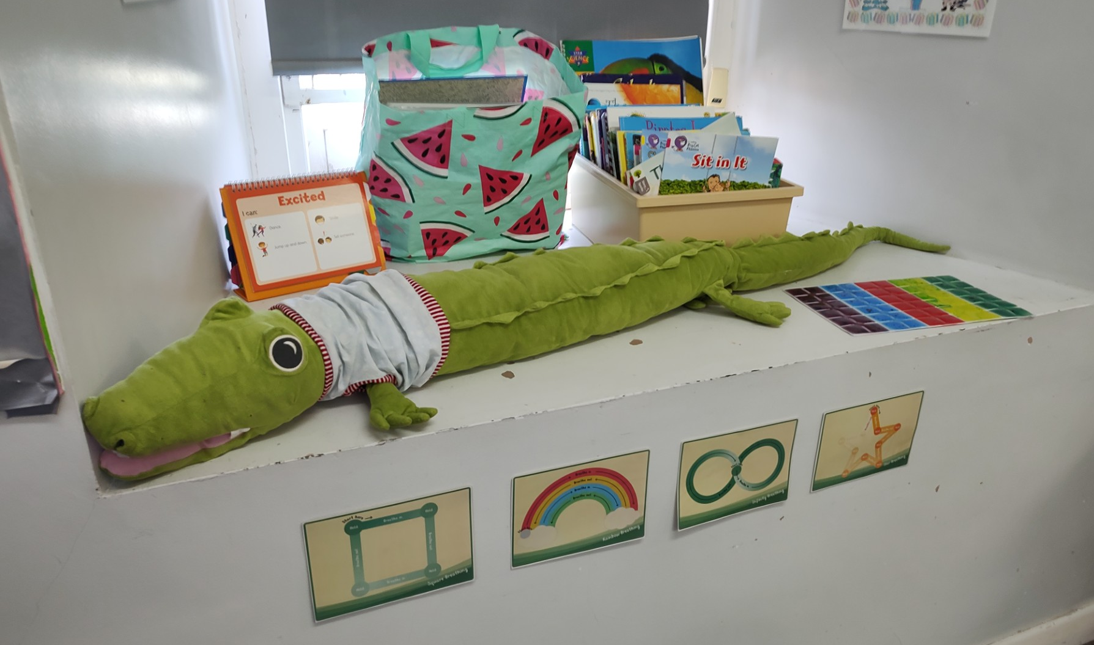
Don’t Worry!

Slide 82
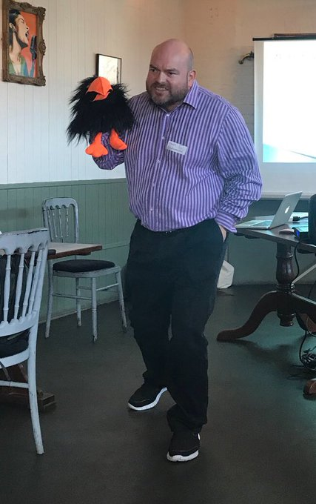

Slide 83
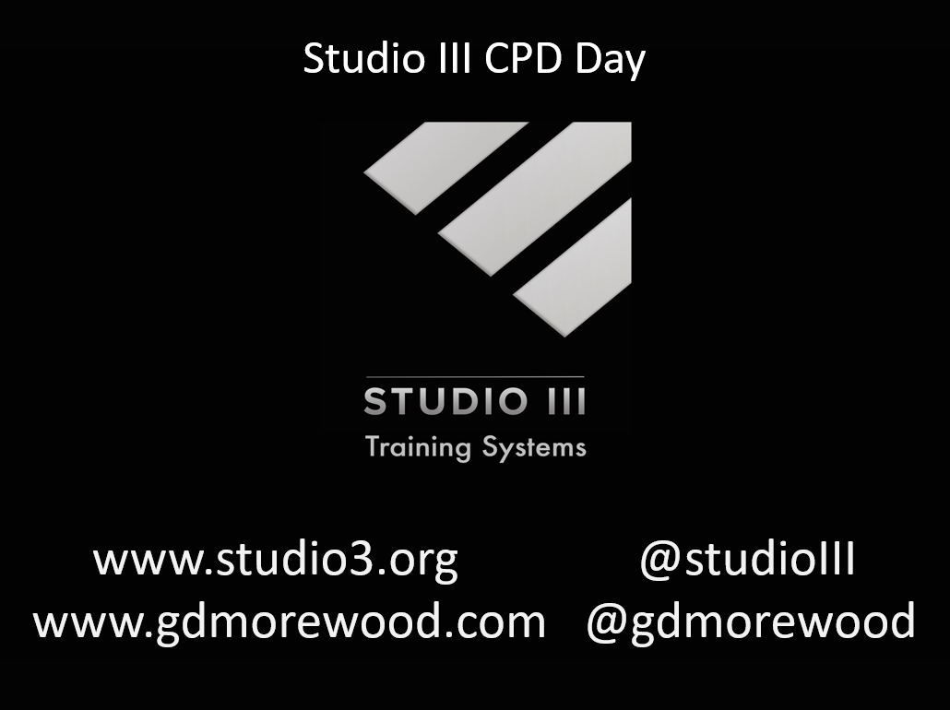
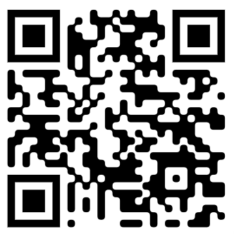
www.studio3.org @studioIII www.gdmorewood.com @gdmorewood
Practical Ideas For Inclusive Classrooms

