Slide 1
Stress, arousal and behaviour management
Andrew McDonnell, CEO Studio3,
Visiting Professor of Autism Studies,
Birmingham University,
Andym@studio3.org

Slide 2
Society focuses on extreme situations

Slide 3
Most behaviours we experience are like this?

Slide 4
Managing Behaviours
"When a person is drowning that is not the best to teach them how to swim. "
(David Pitonyak)

Slide 5
Good Behaviour Management
“It is a mistake to think that once an intervention is underway, you no longer need to worry about serious outbursts and the necessity for crisis management” (Carr et al. 1994, p.14).

Slide 6
What We believe??
“peoples’ levels of motivation, affective states and actions are based on what they believe, than in what is objectively true” (Bandura, 1997, p21).

Slide 7
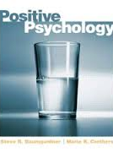
Positive Psychology
Positive psychology is concerned with the pleasant life, the engaged life and the meaningful life.
(Carr 2011, pp2)

Slide 8
Behaviours of Concern
The term challenging behaviours has been used quite extensively in the care sector since 1987.
However, this term has become almost a behaviour category in its own right.
The term Behaviours of Concern has been suggested as an alternative to highlight the ideal response of staff rather than a challenge that they must overcome (Chan et al, 2012)

Slide 9
Models of support and our thinking style
A variety of models and approaches are used to support people with behaviours of concern.
Behavioural models view behaviours and meaningful. The language used can be difficult for people to understand (Target behaviour, Functional assessment, operant, establishing operation etc).
Behaviour supports will be influenced by models of support. Grey, Lydon & Healy (2016) contrasted behaviour supports with the medical model, social model and a supports model. They argued that models have often been oversimplified, but, they placed PBS within a context of supports.

Slide 10
Models of support and our thinking style
Many behaviour support programmes can sometimes appear to be quite medicalised in approach and language. We use terms such as ‘referral’ or ‘cases’ and create medicalised pathways of behaviour supports.
Psychodynamic models focus much more on ‘internal conflicts’ and ‘unresolved issues’ (ie, attachment and loss).
Trauma models focus on the impact of trauma on the people we support and their families.
Medical models still focus on biological based interventions almost to the exclusion of other factors.

Slide 11
A culture of fixing and repairing behaviours
It can sometimes feel that we are inadvertently attempting to ‘fix’ or ‘repair’ people as if they are ‘broken versions of ourselves. ‘
It has been argued that the old psychological thinking was mostly focused on negatives. And that there is an overemphasis on ‘fixing and repairing (Seligman & Csikzentmihayli 2000)’.
Developing cultures of support where the social context of behaviours is acknowledged and understood is a major challenge.
Broader models and frameworks need to be adopted to help us engage in meaningful ways with people.

Slide 12
Stress is key

Slide 13
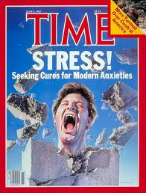

Slide 14
Lazarus & Folkman 1984
Lazarus & Folkman (1984) described a transactional model of stress emphasizing interaction between an individual and his/her environment.
Stress occurs when the demands of stressors outweigh coping responses and there is a clear interaction between environmental and physiological events. Implicit in this model is the cognitive appraisal of threat.
STRESS IS NOT VIEWED AS JUST A CHARACTERISTIC OF THE PERSON.
The use of the term stress rather than anxiety allows us to focus on a variety of support strategies.
We may provide better stress manage skills to parents and do much less with the children we support.
We may train people to manage crises in a calm manner using low arousal approaches (McDonnell, 2010).
Currently, working with my colleagues the University of Northumbria examining carer based stress.

Slide 15
Stress and Coping
Lazarus & Folkman (1991) linked stress and coping.
Coping strategies are a critical variable in this model.
In this model individuals with high levels of stress , but with high levels of coping responses do OK.

Slide 16
Stress as a transaction
Psychological—Perceived Threat
Demands exceed ability to cope
Experience of stress
Biological—CNS Activation
and/or Physiological response
e.g., BP, HR, Skin Conductance,
HR variability, Cortisol

Slide 17
What is Stress Appraisal?
Primary Appraisal– Is this a threat?
Threat (potential for harm)
Harm/loss (damage done)
Challenge (opportunity for growth, mastery, gain)
Secondary Appraisal-- Can I cope with it?
Problem-focused coping
Emotional-focused coping
Lazarus, R. S., & Folkman, S. (1984) Stress, appraisal & coping.

Slide 18
Stress Hormones are key in our Fight or Flight Response

Slide 20
The problem is: threat also causes cortisol secretion – and disturbs the 24 hour rhythm
Brain
Pituitary
Adrenal glands
Everywhere in body 15 minutes
Cortisol

Slide 21
In humans threat is usually psychological – not physical
Novelty
Lack of control
Cortisol
Lack of social support
Unpredictable events
Anticipation
Threat to self esteem
Physical illness

Slide 22
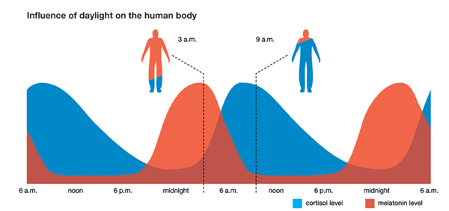
Melatonin/Cortisol Relationship

Slide 23
Cortisol tells the rest of our body when it is night and day

Slide 24
Stress

Slide 25
The Solution: Cortisol Management
You can control cortisol levels via:
Stress Management Techniques
Relaxation
being mindful
Support systems
Coping styles
Exercise
Nutrition
That is good news for us……what about those with autism we have been thinking about?

Slide 26
Stress and Arousal
A number of people with ASD who present with challenging behaviours may experience either constant or intermittent states of hyperarousal. Dunn (2001) in her model of sensory experiences argued that people often experience modulation of sensory input.
The mixed results of empirical studies on hyperarousal may be accounted for by individuals who’s arousal level fluctuates on a regular basis. This model suggests that there is a transaction between the persons internal state of arousal and the interaction with environmental stressors. (McDonnell et al, 2014)

Slide 27
Other mechanisms( Changing Perceived Control)
Changes in staff behaviour ma occur because they perceive the person with autism to be less in control of their behaviour.
Coping can include the ability to control ones own life.
The Whitehall studies of civil servants repeatedly found that mortality rates from diseases such as coronary heart disease were lower in individuals who were at the top of the work hierarchy. (Marmot et al, 1978: Marmot et al 1991).

Slide 28
Stress and Perceived Control
Stress alone is not the main variable but our ability to have control over our daily lives.
We have long advocated giving more choice and control and choice to people with intellectual disabilities (Wolfensberger, 1983, Chan et al, 2011).
Can we measure perceived control?

Slide 29
We often try to overcontrol behaviours

Slide 30
Controllability Beliefs Scale (Dagnan et al 2012)
They are trying to wind me up
They can’t help themselves
They are doing it deliberately
They know what they are doing
They have no control over their behaviour
They could stop if they wanted
They are trying to manipulate the situation
They can think through their actions
They don’t mean to upset people
They are in control of their behaviour
They mean to make me feel bad
They have chosen to behave in this way
They are not to blame for what they do
They know the best time to challenge
They don’t realise how it makes me feel

Slide 31
Challenging behaviours as panic reactions
Many people with intellectual disabilities and challenging behaviours show signs of panic in specific situations.
Behaviours may be interpreted as deliberate by carers in these situations
Similarities have been drawn between the symptoms of post traumatic stress disorder and some individuals who present with challenging behaviours (Pitonyak, 2004).
Panic reactions can often lead to people needing to escape from situations.
Panic responses do not appear to habituate rapidly.
Individuals are not always allowed by people to ESCAPE from situations.

Slide 32
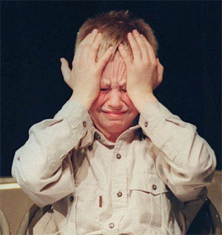
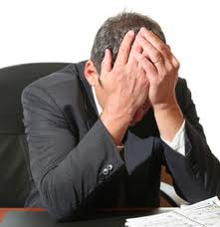
Manage my stress first?

Slide 33
Reflective Practitioners
By focussing on their own behaviour carers may make a connection to the fact that they are part of the problem and as such part of the solution.
A key variable in this may be reflective practice (Schon 1987).

Slide 34
Low Arousal approaches: Definition
" attempts to alter staff behaviour by avoiding confrontational situations and seeking the least line of resistance.“
(McDonnell, Reeves, Johnson & Lane, 1998, p164)

Slide 35
Key pre requisites of the low arousal approach
Understanding of stress and trauma.
Understanding of the complexity of behaviour.
Acceptance and forgiveness.
Empathy (with an emphasis on double empathy)
Understanding of fear and anger and how they drive our our behavioural responses.
Manage behaviours first and change them second.
Change our behaviour rather than that of the person.

Slide 36
Further Information
Training in low arousal approaches.
Autism, stress and wellbeing (ATLASS programme)
Individual consultation and coaching.
Contact Info@studio3.org for general enquiries.
Tel 01225 334111.
Website: www.studio3.org

