Slide 1
Progress 8 and SEND: the challenge of meeting the curriculum needs of young people with SEND
Friday 9th June 2017
Gareth D Morewood
Director of Curriculum Support & Specialist Leader of Education,
Priestnall School, Stockport; Honorary Research Fellow, University of Manchester; Associate Editor, Good Autism Practice Journal & Vice-Chair SENCo-Forum Advisory Group.

Slide 2
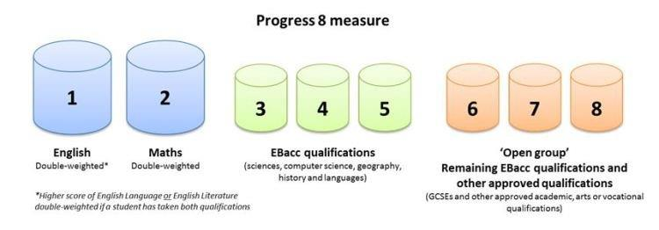

Slide 3
Showing Progress: Progress 8 and SEND
Progress 8 is calculated for each student by comparing their average grade across eight subjects at key stage 4 with the average grade of all students nationally who had similar prior attainment.
It is calculated using assessment results from the end of primary school, with individual scores then combined to achieve one score for a school.
In 2016, there was one point score allocated to each grade.
But in 2017, when the new grading scale kicks in, a student moving up a grade from A to A* receives a point score increment three times that of someone moving from a G to an F grade (see table).

Slide 4
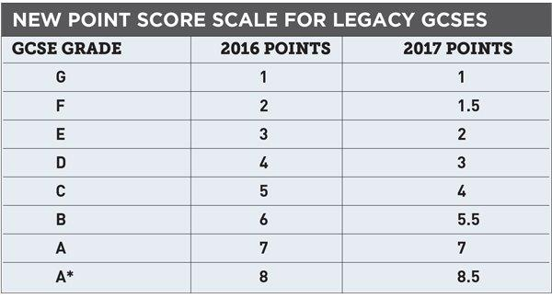

Slide 5
So what are the key points?
Crucially, there is a 1.5 point gain for a student who gets an A* rather than an A.
While a less able student moving from a G to an F grade would gain only half a point.
By 2018 most GCSEs will be new specifications.
By 2019 issues to do with weighting are expected to have ‘evened out’.
It is argued that this is better than the traditional ‘high stakes’ C/D borderline for reporting.

Slide 6
So what does this mean for us? (1)
Never has the curriculum offer been more important.
A limited curriculum offer will hamper individuals progression to adulthood and also potentially have significant impact on Progress 8 outcomes.
The curriculum should reflect the need of the individual cohort/school; not be driven by external measures.
The additional weighting for English and Maths mean that additional supported learning pathways are important to be maintained.

Slide 7
So what does this mean for us? (2)
The measure also allows students to study up to three high quality non-GCSE qualifications.
For example Catering BTEC Level 2 is a much more accessible and appropriate course, for some than Food & Nutrition GCSE and equally weighted.
Progress 8 does not make it mandatory for students to take eight qualifications or for all the qualifications they do take to be GCSEs.
However schools will be under pressure and should be wary of a ‘0’ in any component having a significant impact on the Progress 8 score.
Personalisation of pathways into adulthood is still important to keep at the forefront of thinking.

Slide 8
So what does this mean for us? (3)
The DfE explicitly state that they want every student to fulfil their potential, and take the qualifications that will allow them to achieve their goals and move on to their chosen next stage of education or training.
They recognise that for a small minority of students, 8 qualifications may not be appropriate.
They expect schools to help students to choose the right qualifications, and the right number of qualifications.
See more at: http://www.nasen.org.uk/newsviews/News/News.concerns-about-progress-8.html#sthash.i8aHdmZJ.dpuf

Slide 9
So what does this mean for us? (4)
The DfE are also very clear about the fact that there will be a small number of students that are unlikely to be recognised in the Progress 8 measure; because their particular needs mean that they cannot enter any GCSEs or high value vocational qualifications.
To support these students the DfE publish a range of additional information in the performance tables, for example, destination measures.
See more at: http://www.nasen.org.uk/newsviews/News/News.concerns-about-progress-8.html#sthash.i8aHdmZJ.dpuf

Slide 10
So what does this mean for us? (5)
This is why I see the NEETs figure are one of the most important measures of an inclusive school.
In preparation for adulthood the top priority for the small number of students who are not recognised in the Progress 8 measure has to be post-16 pathways.
Although we should never ‘do anything for Ofsted’; they always refer to the age and starting point of individuals, demonstrating a positive post-16 pathway is a vital part of personalising provision for the individual students concerned.

Slide 11
Quality First Inclusive Teaching…
Teachers have a renewed responsibility and accountability for the progress and development of all students in their class, including where students access support from TAs or other specialist staff.
The key to this is about developing an inclusive QFT model.
In schools where responsibility is ‘abdicated’ to ‘SEN teams’ there will be significant challenge; however our whole-school approach has developed over 10 years and works well – so it can be done!
No amount of intervention can make up for poor quality teaching.

Slide 12
21st Century Children…a key message!
The young people in our schools are very different now, than 15 years ago...
Neo-natal survival rates and advances in medicine mean more children are surviving with complex needs and are now in our classes...
Learning & Teaching is different now; it has to be ... so we have to evolve too…
Schools need to respond to meet ‘modern need’…with appropriate CPD and training to support the population.

Slide 13
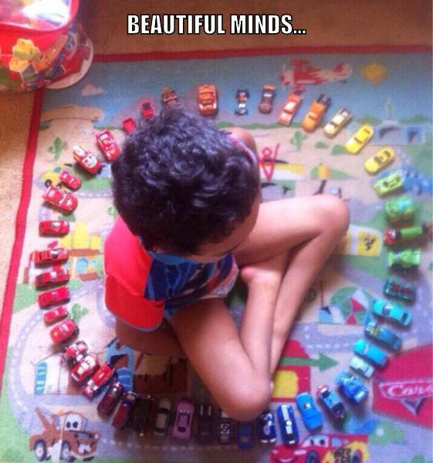

Slide 14
Have high aspirations for every young person…
Ensure that all analysis/impact measures/data is done inclusively…
Change cultures of segregation in your settings – start with analysis, as part of a whole-school approach…
Ensure that the highest aspirations are for all…
Be clear about how targets will help students develop and prepare for the next stage of their education and for adulthood…
Engage in metacognative approaches with students – see Student Passports (for example see www.gdmorewood.com)

Slide 15
Measuring Impact…
Why do you do certain interventions?
How do you know they are effective?
What is the impact?
Do they dovetail with whole-school provision?
How to you track progress?

Slide 16
Useful blog links…
SENCology Blog – Preparing young people for the road ahead
http://blog.optimus-education.com/preparing-young-people-road-ahead
SENCology Blog – Maintaining an inclusive curriculum offer is more important than ever
http://blog.optimus-education.com/maintaining-inclusive-curriculum-offer-more-important-ever
SENCology Blog – How do we define success
http://blog.optimus-education.com/how-do-we-define-success

Slide 18
‘The education of the peer group is an essential part of moving towards a truly inclusive community’ Gareth D Morewood (2011)

Slide 19
Ensure clear communication with parents/carers
Keep parents/carers informed
Make sure they know who to contact and how
Provide honest communication – no long-term benefit in providing anything but the truth
Listen to parents/carers – give them time
Try to avoid uncertainty/misinterpretation
MOREWOOD, G. D., & BOND, C. (2012) Understanding Parental confidence in an inclusive high school: a pilot survey. Support for Learning, Vol. 27 No.2, p53-58 Wiley Blackwell Publishing.

Slide 20
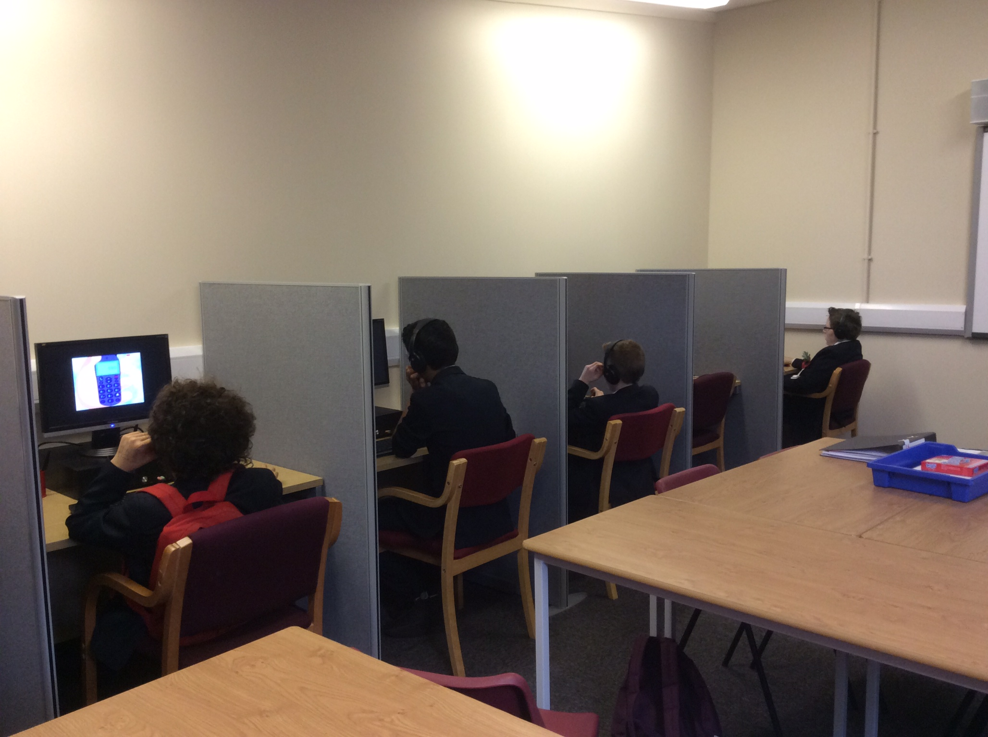

Slide 21
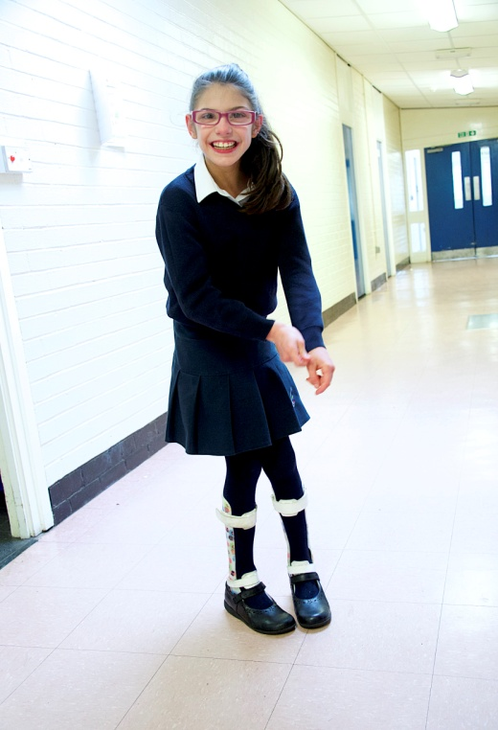
“At this school I’ve got to meet lots of new teachers and friends.”
Jessica, age 11

Slide 22
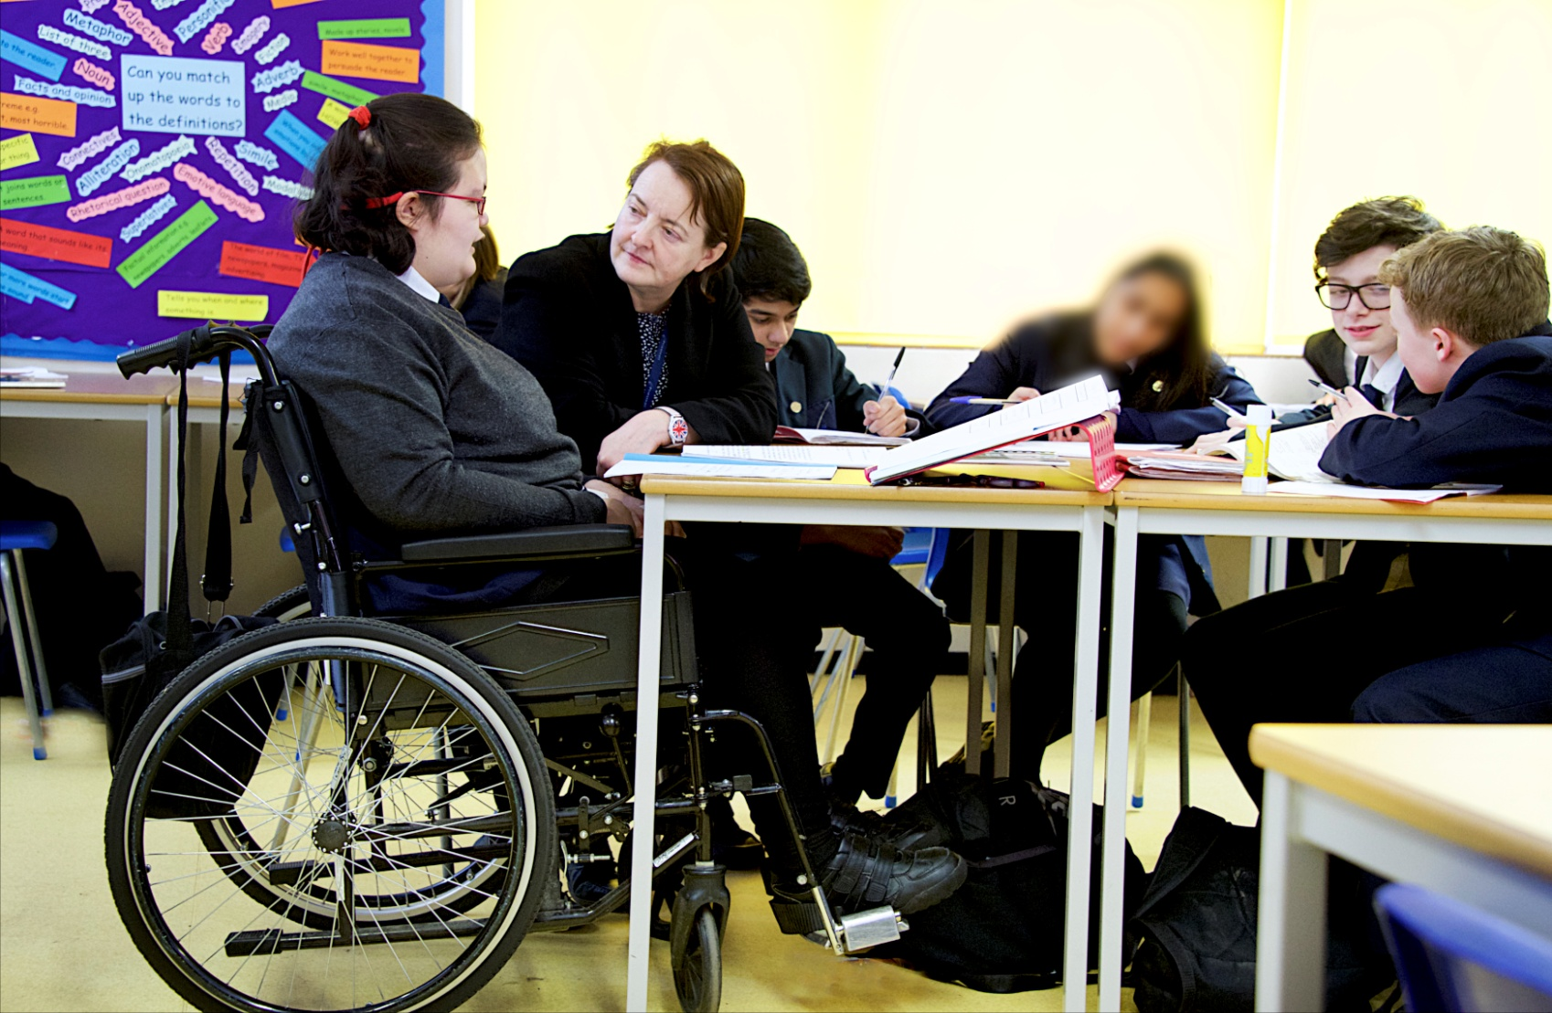
“I get to do everything my friends do, just that sometimes I have things changed a little so I can join in properly.”
Lola, aged 14

Slide 23
“I enjoy school. I get to do things I didn’t at primary. I do my exercises and physio as well as my lessons, it works well. People are nice.”
Sara, aged 12

Slide 24
“Going to Priestnall has helped me to gain confidence with my peers. I have developed my social skills and think this will help me at college.”
Josh, aged 16

Slide 25
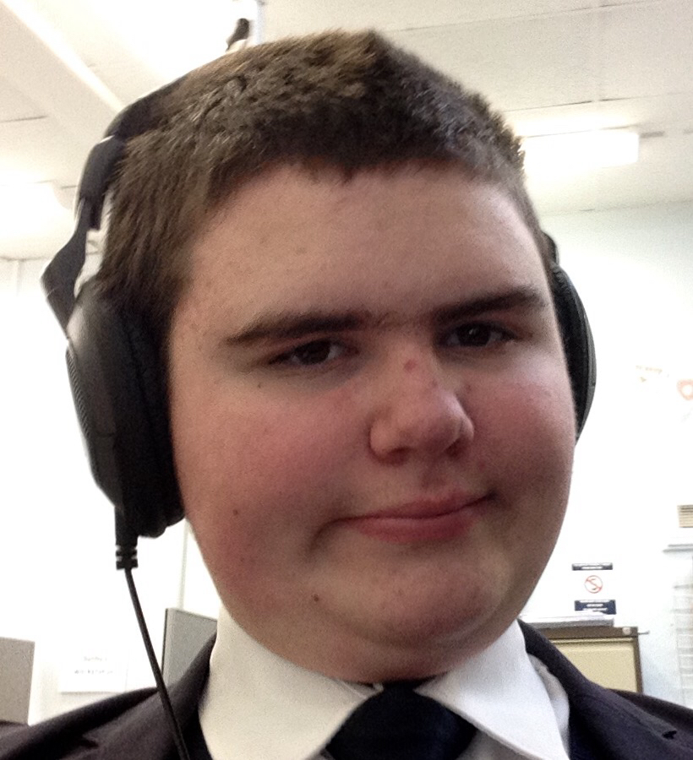
“At first it was very difficult for me at school but now I like to take on challenges and I like that here there are safe rooms for you to go to. I am good at maths.”
Jack, aged 14

Slide 26
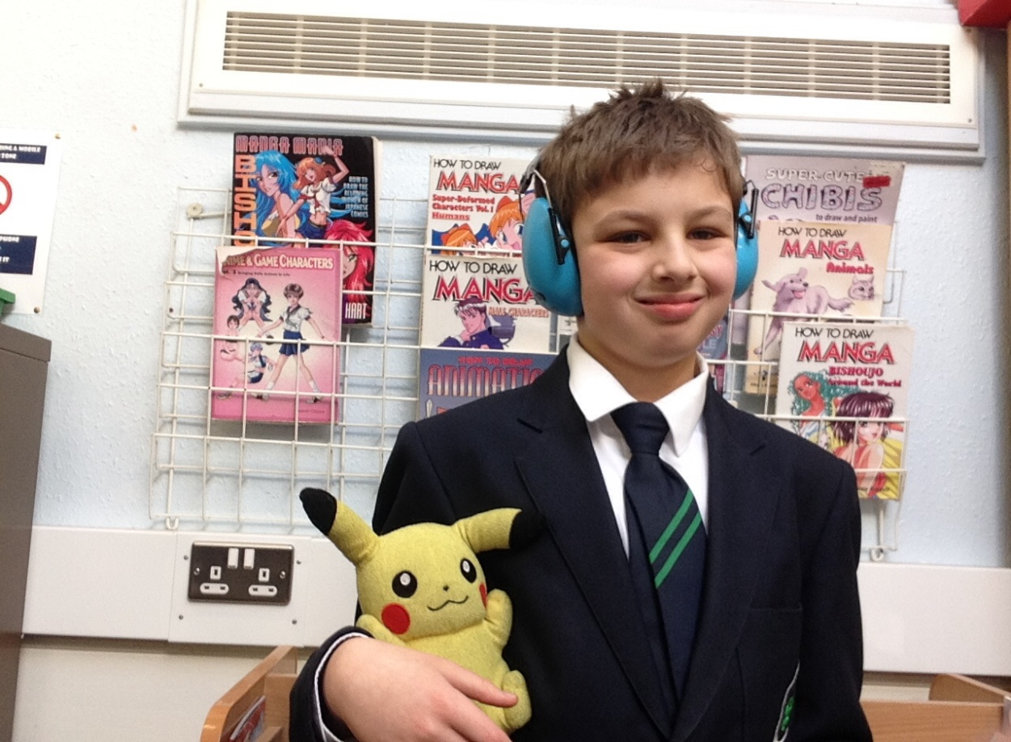
“Priestnall is really good because they have many autistic students and they understand us. I think I will have a great time at Priestnall because they know how to deal with me and support me. Social time is great as I get to hang out with other students who like to share my interests.”
Bobby, aged 11

Slide 27
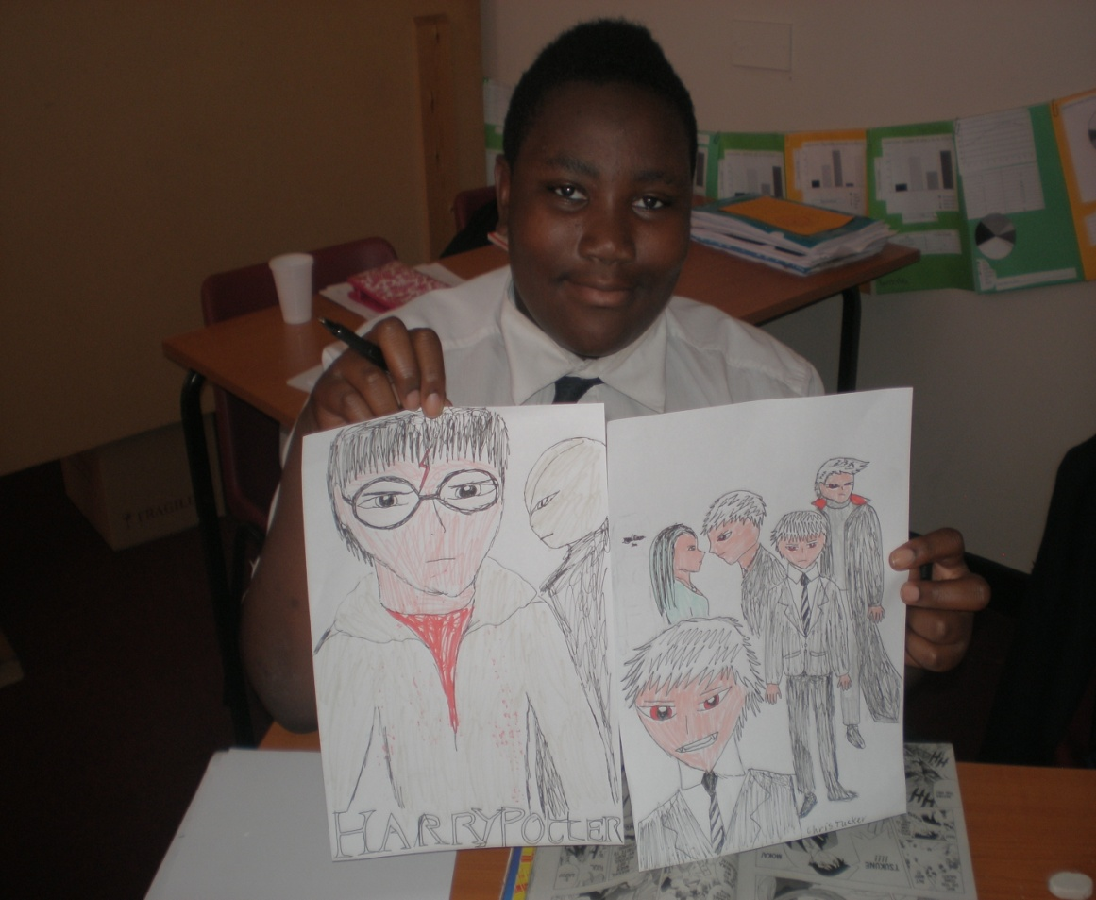
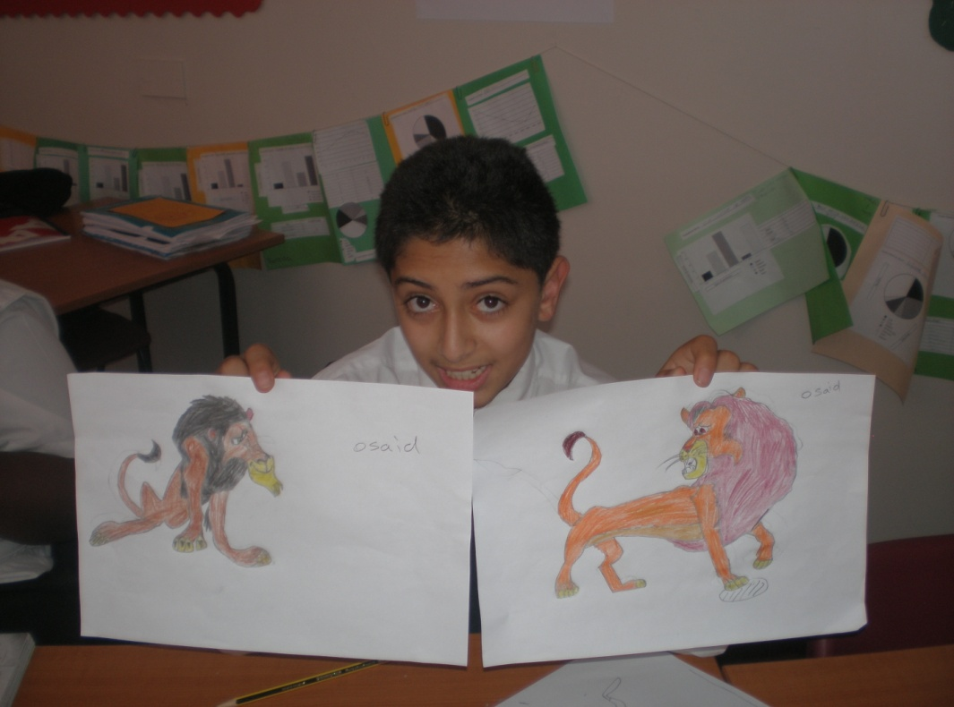
Chris, now aged 17
(pictured aged 13)
Osaid, now aged 19
(pictured aged 13)

Slide 28
SENCo skills are still the same…
A lead professional
An advocate and knowledge/information manager
A commissioner and broker
A resource manager
A partnership manager
A quality assurer
A facilitator
A solution assembler
Cheminais in Morewood, G. D (2008) the 21st Century SENCo
www.gdmorewood.com

Slide 29
Have we found the final piece?

Slide 30
Personalisation not normalisation…
Above all – remember to be…
adaptable,
innovative,
empathetic,
and ... open minded.
Remember that not one strategy fits all … but strategies for one may well benefit others … think about the individual as part of the whole picture.

Slide 31
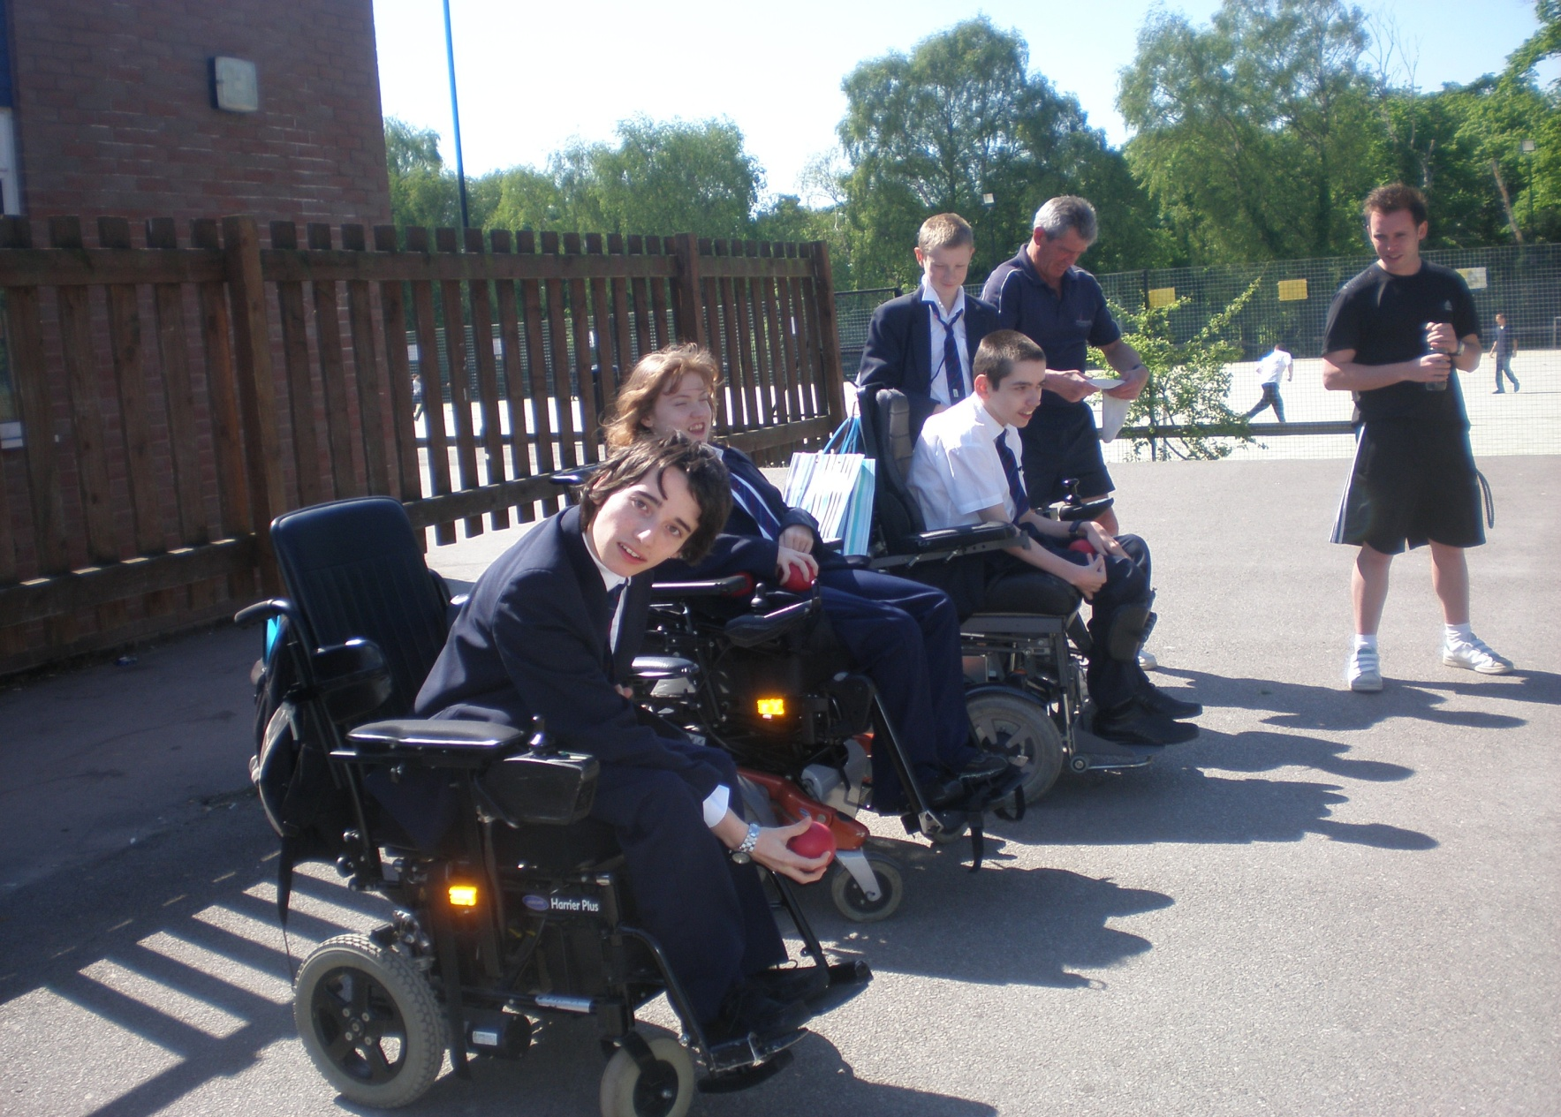

Slide 32
Four Essential Principles for Education Success
Remember that our goal is success, not process.
Reform and education innovation must be addressed in the context of universal principles of human nature.
Remember that education does not equal salvation.
We should always remember to whom we are accountable.
Thomas A. Hinton

Slide 33
Learning isn’t always the same ...

Slide 35
Gareth D Morewood
www.gdmorewood.com
@gdmorewood

