Slide 1
Educating persons with autistic spectrum conditions – from research to practice
Thursday 23rd June 2016
Presented by:
Neil Humphrey & Gareth D Morewood

Slide 2
Plan for the session…
Improving educational experiences for young people with autism – from research to practice
Autism interventions – what does the evidence say is a ‘good investment’?
Links, references and discussion

Slide 3
Improving educational experiences for young people with autism – from research to practice.

Slide 4
What we will talk about today
Autism education research at the University of Manchester
Why can school be such a challenging place for many young people with autism?
What do parents/carers and young people with autism want?
What can we do to improve the educational experiences and outcomes of young people with autism?
Conclusion

Slide 5
What we will talk about today
Autism education research at the University of Manchester
Why can school be such a challenging place for many young people with autism?
What do parents/carers and young people with autism want?
What can we do to improve the educational experiences and outcomes of young people with autism?
Conclusion

Slide 6
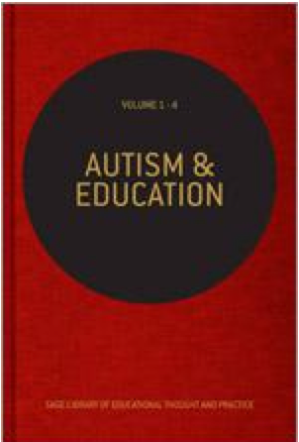
Autism education research at the University of Manchester
www.autism.manchester.ac.uk (also @autismUoM)
Inclusive education for students with autism in mainstream secondary schools (Humphrey & Symes)
Development of resource base provision for children with SLI/ASC (Bond & Hebron)
Risk factors for exposure to bullying among children with ASC (Hebron)
Transition from primary to secondary school for children with ASC (Hebron)
Educating persons with ASC: A systematic literature review (Bond, Symes, Hebron, Humphrey & Morewood)
Autism and education (Humphrey, Bond, Hebron, Symes & Morewood)

Slide 7
What we will talk about today
Autism education research at the University of Manchester
Why can school be such a challenging place for many young people with autism?
What do parents/carers and young people with autism want?
What can we do to improve the educational experiences and outcomes of young people with autism?
Conclusion

Slide 8
Why can school be such a challenging place for many young people with autism?
Only 23% of students with ASC achieved 5 or more A*-C grades (including English and Maths) at GCSE, compared to 54% among all students in the same year (DfE, 2010, 2011)
Students with ASC are more likely to receive both fixed-term and permanent exclusions from school than their peers (DfE, 2013a, 2013b)
A range of studies in different countries have also demonstrated that they are amongst the most likely to be bullied in the school population (Schroeder et al, 2014)
70% of parents report experiencing difficulties in getting the educational support their child needs, with 18% having to resort to the tribunal system to achieve this (NAS, 2011)
Prevalence rates of anxiety, depression and anger problems are significantly higher among young people with ASC than their peers (Hebron & Humphrey, 2014)

Slide 9
Why can school be such a challenging place for many young people with autism?
For the student
Learning in a social setting, reading social situations, deciphering the unwritten rules
Learning in a complex language environment with limited visual support
Understanding and communicating with other students and adults
Coping with change, transitions and unexpected breaks in routine
Day to day organisation
Generalising learning beyond the setting in which it took place
For staff and parents
Gaining, maintaining and refocusing attention
Motivation
Differentiation of language and/or curriculum
Managing behaviour
Accommodating special interests

Slide 10
Why can school be such a challenging place for many young people with autism?
For the peer group
Lack of understanding
Resenting extra attention
Social advances that are ignored or rejected
Distraction or disruption
Feeling that double standards are applied (‘getting away’ with things)
Being nervous or fearful
Ignoring, teasing, winding up, bullying (Morewood, Humphrey & Symes, 2011)

Slide 11
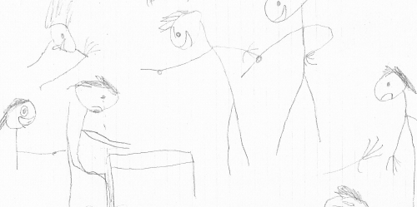
Why can school be such a challenging place for many young people with autism?
Taken from Humphrey & Lewis (2008)

Slide 12
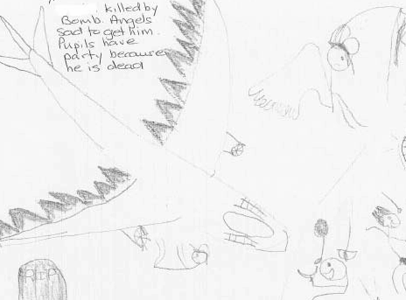
Why can school be such a challenging place for many young people with autism?
Taken from Humphrey & Lewis (2008)

Slide 13
What we will talk about today
Autism education research at the University of Manchester
Why can school be such a challenging place for many young people with autism?
What do parents/carers and young people with autism want?
What can we do to improve the educational experiences and outcomes of young people with autism?
Conclusion

Slide 14
What do parents/carers and young people with autism want?
Appropriate support, without a battle
“I found that if, as a parent, I had not been prepared to fight for my child, he would not have got where he is now, let alone got the specialised help that we needed. The sooner help is received, the quicker the child can begin to fulfil their potential” [parent] (National Autistic Society, 2011, p.7)
“It shouldn’t be like this, we shouldn’t have to battle for every crumb available” [parent] (National Autistic Society, 2011, p.12)
Choice and flexibility
“Special schools are vital to children such as mine. My son simply would not cope in a mainstream environment” [parent] (National Autistic Society, 2011. p.19)
“The teacher intuitively understood my child and how to teach him. She gave him work that was at his intellectual level, and let him choose what he wanted to do—all of it or some of it. This was a first grade teacher providing fourth grade materials. She was flexible and understanding and knew how to teach kids, depending on their learning styles” [parent] (Sciutto et al, 2012, p.184)
To feel listened to
“I have felt very able to challenge the school” [parent] (National Autistic Society, 2011, p.23)

Slide 15
What do parents/carers and young people with autism want?
Autism to be viewed as difference, not disorder
“My brain is different, but I’m not bad” [YP] (National Autistic Society, 2011, p.4)
“I’m fine with it… sometimes it upsets what I do but it’s a small compromise with friends that I’ve got and like the problems they’ve got… it gives me all those bonuses” [YP] (Humphrey & Lewis, 2008, p.32)
“[Autism] is not a disease that must be corrected. It is a different way of thinking that must be taught— differently” [parent] (Sciutto et al, 2012, p.181)
Support to negotiate their differences
“I did have a teacher that had us do a journaling exercise. In one entry, I was whining about all the things I that I tried to be “normal” and he told me that I should think about just not trying for once and being myself. I would feel more successful. It took me a lot of years to figure out what that meant, but I finally figured it out and I live by that. Don’t try to do what you think everyone else wants or need you to do, just be yourself” [YP] (Sciutto et al, 2012, p.182)
Better understanding of the challenges of school for students with autism
“Its really hard to go to school. People don’t understand how hard it is. They judge me for doing things I can’t help” [YP] (National Autistic Society, 2011, p.7)
“The noisier or more larger the group, the more difficult it is” [YP] (Connor, 2000, p.291)
“Because I am well-behaved in school, I get overlooked when I am requiring help” [YP] (National Autistic Society, 2011, p.27)

Slide 16
What do parents/carers and young people with autism want?
Teachers and school staff to set a positive example
“You, the teacher, can make a huge difference – positive or negative – in the way other students view a child with autism. As the leader of the classroom, you set the tone. Be careful not to give the others license to bully that child” [parent] (Sciutto et al, 2012, p.182)
“Her most recent teacher made a point of telling our child regularly, ‘I am not giving up’” (Sciutto et al, 2012, p.182)
Understanding of the individual student and their autism
“He is a CHILD first… Do not focus on the disability, but rather his tremendous abilities” [parent] (Sciutto et al, 2012, p.180)
“The more they learn about Asperger’s the more sympathetic they feel” [YP] (Humphrey & Lewis, 2008, p.40-41)
“I am leaving my present school as they do not understand autism at all. I get treated pretty much the same as other children although I don’t think I act like them. I am different but they don’t take much notice of me at my school” [YP] (National Autistic Society, 2011, p.18)
“You met another kid on the spectrum? That’s nice. Here’s another one. Not the same one. Another one” [parent] (Sciutto et al, 2012, p.180)

Slide 17
What do parents/carers and young people with autism want?
Make use of the differences associated with autism in a positive way
“His teacher realized that my son’s “obsessive interest” revolved around sprinklers, fire alarms and bells. He asked my son to bring in some of his collection and made it a point to design many of his Algebra classes around these items (e.g. ‘find the circumference of a fire bell’). My son not only got an A in that class but for the first time, actually looked forward to going to school in the morning. It was huge for us!” [parent] (Sciutto et al, 2012, p.183)
“People are often questioning me… ‘How do you know all this, how do you know all that?’… I often feel proud of myself” [YP] (Humphrey & Lewis, 2008, p.32)
Peer support and understanding
“People don’t get on with me and I don’t really get on with them and I often try to make friends with them . . . [but] they often just go against me” [YP] (Humphrey & Lewis, 2008, p.35)
“Yeah if people are nice to you, you feel better. When I was in school when people didn’t like me it was rubbish and now many more people like me its easier” [YP] (Humphrey & Lewis, 2008, p.35)
“I do have friends who very often stick up for me” (Humphrey & Lewis, 2008, p.35)
“Sometimes I just want to play by myself” (Calder et al, 2013, p.306)
School staff support matched to individual needs
“I think the support has played a good role, especially in technology” [YP] (Humphrey & Lewis, 2008, p.39)
“[My support is] ‘behind the scenes’… I know I have someone there to help me” (Humphrey & Lewis, 2008, p.40)

Slide 18
What we will talk about today
Autism education research at the University of Manchester
Why can school be such a challenging place for many young people with autism?
What do parents/carers and young people with autism want?
What can we do to improve the educational experiences and outcomes of young people with autism?
Conclusion

Slide 19
What can we do to improve the educational experiences and outcomes of young people with autism?
Agent of change
Developing the school environment
Flexible provision
Direct support and intervention
Policy development and embedding practice
Training and development of staff
Peer education and awareness
Creating a positive ethos
Morewood, Humphrey and
Symes (2011)

Slide 20
What can we do to improve the educational experiences and outcomes of young people with autism?
Agent of change
Developing the school environment
Flexible provision
Direct support and intervention
Policy development and embedding practice
Training and development of staff
Peer education and awareness
Creating a positive ethos
Morewood, Humphrey and
Symes (2011)

Slide 21
What can we do to improve the educational experiences and outcomes of young people with autism?
Agent of change
Developing the school environment
Flexible provision
Direct support and intervention
Policy development and embedding practice
Training and development of staff
Peer education and awareness
Creating a positive ethos
Morewood, Humphrey and
Symes (2011)

Slide 22
What can we do to improve the educational experiences and outcomes of young people with autism?
Agent of change
Developing the school environment
Flexible provision
Direct support and intervention
Policy development and embedding practice
Training and development of staff
Peer education and awareness
Creating a positive ethos
Morewood, Humphrey and
Symes (2011)

Slide 23
What can we do to improve the educational experiences and outcomes of young people with autism?
Agent of change
Developing the school environment
Flexible provision
Direct support and intervention
Policy development and embedding practice
Training and development of staff
Peer education and awareness
Creating a positive ethos
Morewood, Humphrey and
Symes (2011)

Slide 24
What can we do to improve the educational experiences and outcomes of young people with autism?
Agent of change
Developing the school environment
Flexible provision
Direct support and intervention
Policy development and embedding practice
Training and development of staff
Peer education and awareness
Creating a positive ethos
Morewood, Humphrey and
Symes (2011)

Slide 25
What can we do to improve the educational experiences and outcomes of young people with autism?
Agent of change
Developing the school environment
Flexible provision
Direct support and intervention
Policy development and embedding practice
Training and development of staff
Peer education and awareness
Creating a positive ethos
Morewood, Humphrey and
Symes (2011)

Slide 26
What can we do to improve the educational experiences and outcomes of young people with autism?
Agent of change
Developing the school environment
Flexible provision
Direct support and intervention
Policy development and embedding practice
Training and development of staff
Peer education and awareness
Creating a positive ethos
Morewood, Humphrey and
Symes (2011)

Slide 27
What can we do to improve the educational experiences and outcomes of young people with autism?
Agent of change
Developing the school environment
Flexible provision
Direct support and intervention
Policy development and embedding practice
Training and development of staff
Peer education and awareness
Creating a positive ethos
Morewood, Humphrey and
Symes (2011)

Slide 28
What can we do to improve the educational experiences and outcomes of young people with autism?
Agent of change
Developing the school environment
Flexible provision
Direct support and intervention
Policy development and embedding practice
Training and development of staff
Peer education and awareness
Creating a positive ethos
Morewood, Humphrey and
Symes (2011)

Slide 29
What I will talk about today
Autism education research at the University of Manchester
Why can school be such a challenging place for many young people with autism?
What do parents/carers and young people with autism want?
What can we do to improve the educational experiences and outcomes of young people with autism?
Conclusion

Slide 30
Conclusion
The ‘double empathy problem’ in autism (Milton, 2012)
Applying aspects of the ‘triad of impairments’ to the education system (Humphrey et al, 2015)
Inflexibility – how can we be more flexible in the way in which we organise our educational provision?
Social communication – how can we improve communication between the range of stakeholders in autism education in order to improve the educational experiences and outcomes of students?
Imagination – should we not be more imaginative ourselves in thinking about approaches to teaching and learning?
Taken from National Autistic Society (2011)

Slide 31
‘The education of the peer group is an essential part of moving towards a truly inclusive community’ Gareth D Morewood (2011)

Slide 32
Ensure clear communication with parents/carers
Keep parents/carers informed
Make sure they know who to contact and how
Provide honest communication – no long-term benefit in providing anything but the truth
Listen to parents/carers – give them time
Try to avoid uncertainty/misinterpretation
MOREWOOD, G. D., & BOND, C. (2012) Understanding Parental confidence in an inclusive high school: a pilot survey. Support for Learning, Vol. 27 No.2, p53-58 Wiley Blackwell Publishing.

Slide 33
Autism interventions – what does the evidence say is a ‘good investment’?

Slide 34
Educating Persons with Autistic Spectrum Disorder - A Systematic Literature Review
Bond, C., Symes, W., Hebron, J., Humphrey, N., Morewood, G. & Woods, K. (2016) Educational Interventions for children with autistic spectrum disorder – a systematic literature review 2008-2013. School Psychology International, SAGE.

Slide 35
Overview of the review
Systematic Literature Review of educational interventions for children and young people with ASD 2008-2013
5 country case studies
Supplementary review of guidance documents
All 3 strands to identify implications for provision in Ireland

Slide 36
Intervention Rating Scheme (all studies 2008-2013)
4. Most evidence – At least 4 studies providing positive evidence which either includes a positive RCT or quasi experimental study or 6 or more single case experimental studies.
3. Moderate evidence – 3 or more studies providing positive evidence which either includes a positive RCT or QES or 4 or more SCE studies.
2. Some evidence – 2 or more studies providing positive evidence which either includes a positive RCT or QES or 3 or more SCE studies.
1. Little evidence – 1 RCT/ QES or 1 or 2 SCE studies providing positive evidence.

Slide 37
Interventions rated 4 (most evidence) Pre-school
1. Interventions to increase joint attention skills (N=4)
Mostly 1:1 play based/turn taking interventions with an adult (teacher or parent).
2. Comprehensive early interventions (N=10)
Interventions part of holistic learning experience and targeted a range of areas e.g. social skills, behaviour, communication, attention and learning, often in a school setting. Measures sampled a range of areas of development.

Slide 38
Interventions rated 4 (most evidence) School age
Social
1. Peer mediated interventions in mainstream schools (N=9)
Naturalistic interventions to enable peers to interact more effectively with ASD children (e.g. lunchtime clubs or peers, researcher and child with ASD meeting to collaboratively plan strategies, may include some peer instruction).
2. Multi-component social skills interventions (N=6)
Interventions (e.g. UCLA PEERS, Children’s Friendship Training) included several elements such as a parent group to support social skills/networks and a social skills group and/or social skills training for the young people with ASD.

Slide 39
Interventions rated 4 (most evidence) School age
Flexibility interventions
3. Behavioural interventions based upon behavioural principles (N=7)
behavioural interventions enabled the development of flexibility and tolerance for change (e.g. multi-element behaviour plans, environmental modification and prompting). Often based on functional analysis of behaviour.

Slide 40
Interventions rated 3 (moderate evidence) Pre-school
1. Play based interventions (N=3)
1:1 and small group. Interventions focused on teaching play skills or peer mediated play activities.
2. Video modelling to develop communication skills (N=4)
Use of video of desired behaviour (or video as prompt) to encourage behaviour such as use of PECS or sharing information about the school day.

Slide 41
Interventions rated 3 (moderate evidence) School age
1. Social initiation training (N=4)
Pivotal Response Training or use of scripts to teach child
with ASD to initiate social interaction.
2. Computer assisted emotion recognition interventions (N=3)
using computer programmes and video modelling to improve emotion recognition.
3. Picture Exchange Communication System in special school (N=3)
behaviourally based communication system beginning with exchange of symbols for desired objects.
Notes:
.

Slide 42
Interventions rated 3 (moderate evidence) School age
4. Discrete skills training using behavioural approaches (N=4)*
Usually 1:1 skills training (e.g. model-lead-test and direct instruction) to support acquisition of discrete skills such as letter/number recognition.
5. Narrative interventions (N=5)
1:1, interventions such as social stories and power cards used to prompt particular behaviours.
(* and pre-school)

Slide 43
Interventions rated 2 (some evidence)
No specific pre-school interventions identified in this category.
School age
Lego therapy® – small group intervention with clear roles to enable group construction of Lego models.
Behavioural interventions to develop communication skills (special school) – 1:1 structured interventions using behavioural strategies to encourage or shape communication.
School age comprehensive intervention programmes - coaching teachers to plan individualised strategies for children in special schools and classes and measurement of whether goals set for children were achieved.

Slide 44
Guidance and SLR comparison
Recommended interventions similar to those endorsed by reviews as drew on the same SLRs.
Differences are few but related to interventions where the evidence base was smaller e.g. music therapy or where good practice was recommended alongside research evidence e.g. transition support, professional development.

Slide 45
Considerations for education in Ireland
Use of comprehensive pre-school ASD specific interventions - informed by behavioural principles, tailored to child/family need (through additions such as joint attention; play; video modelling interventions or parent support/workshops), delivered in an education setting.
School age interventions which address key features of ASD (social skills and flexibility); involve peers as appropriate with use of supplementary interventions as needed (e.g. learning, communication).

Slide 46
Considerations for education in Ireland
3. Guidance which provides a clear framework for families and practitioners and draws upon good practice in addition to research literature as required.
4. A professional development framework.
5. Further development of collaborative research partnerships between researchers and schools.
6. Further development of ASD evidence base.

Slide 47
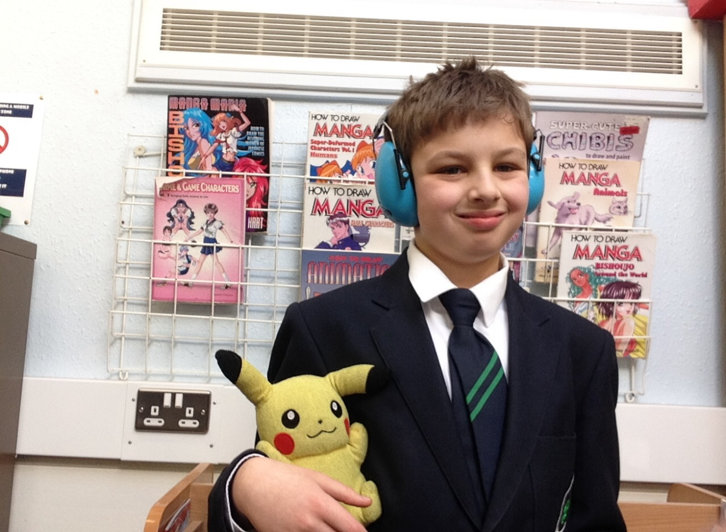
“Priestnall is really good because they have many autistic students and they understand us. I think I will have a great time at Priestnall because they know how to deal with me and support me. Social time is great as I get to hang out with other students who like to share my interests.”
Bobby, aged 11

Slide 48
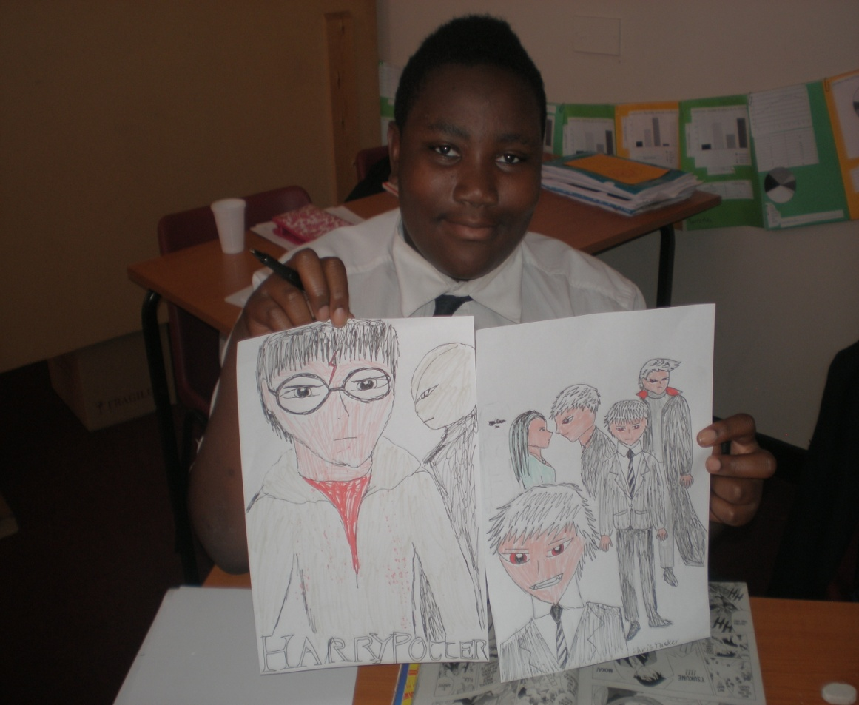
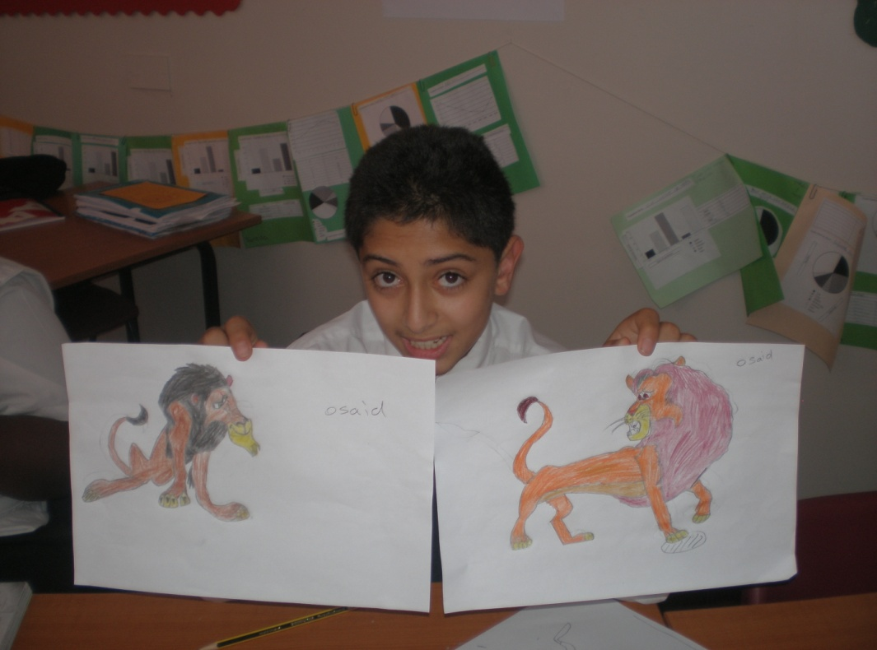
Chris, now aged 17
(pictured aged 13)
Osaid, now aged 19
(pictured aged 13)

Slide 49
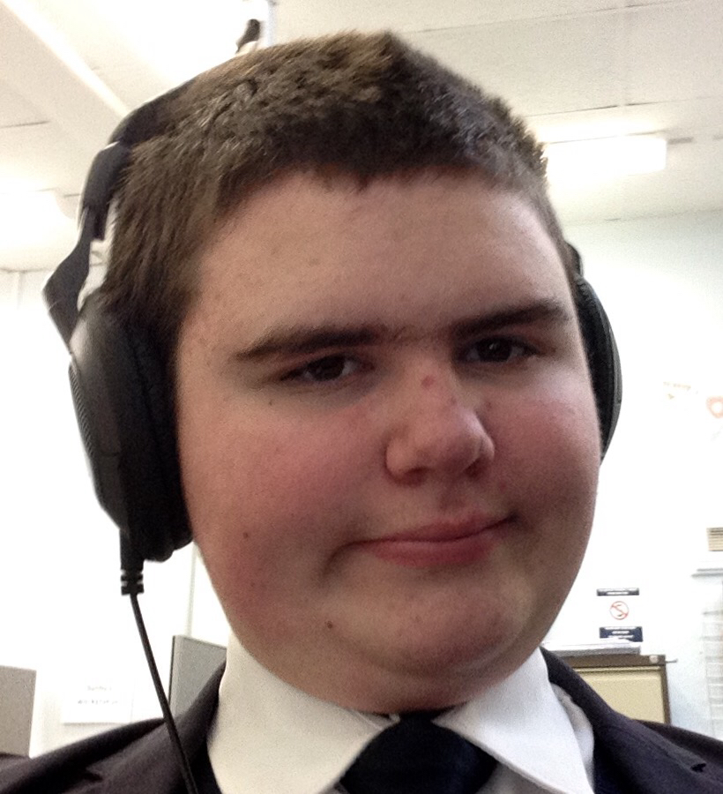
“At first it was very difficult for me at school but now I like to take on challenges and I like that here there are safe rooms for you to go to. I am good at maths.”
Jack, aged 14

Slide 50
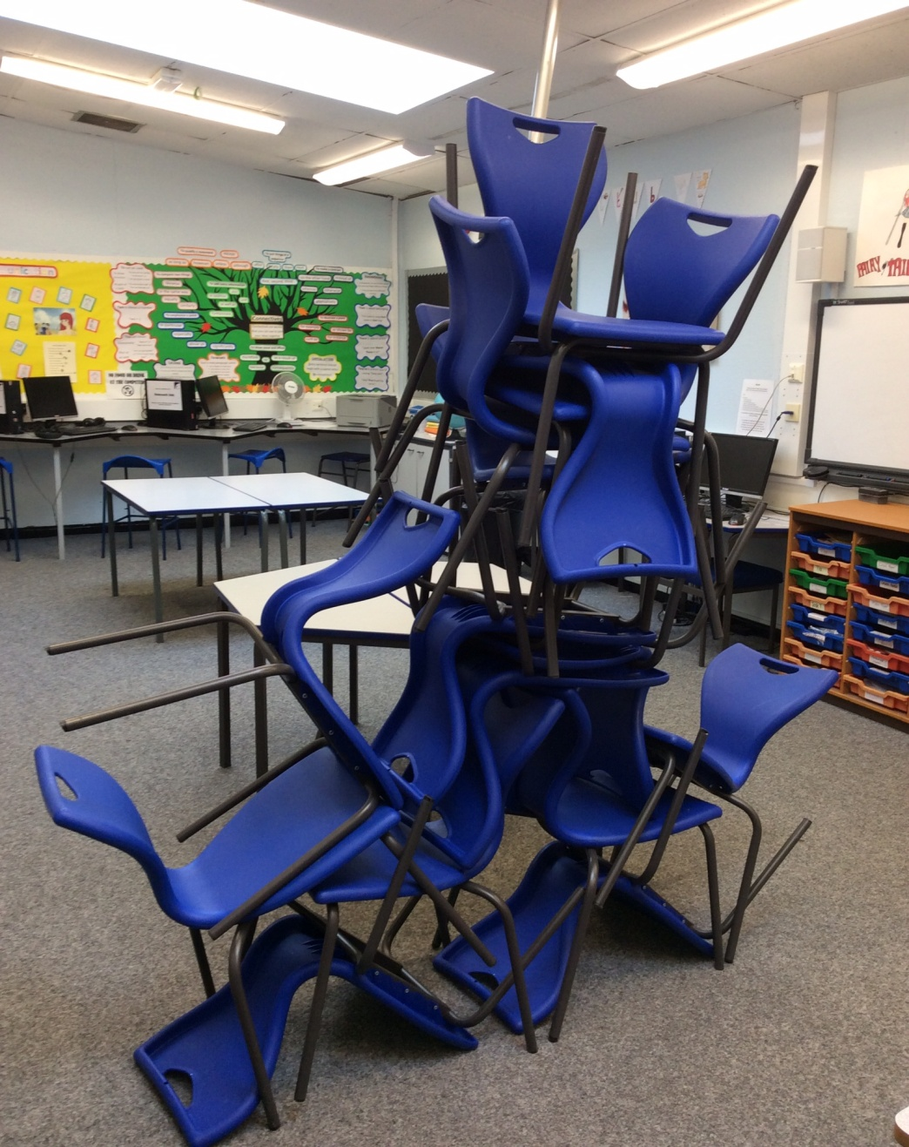

Slide 52
Blog links:
Peer support for autistic students: Bobby’s story
http://blog.optimus-education.com/peer-support-autistic-students-bobby%E2%80%99s-story
Autism and education: key points and resources
http://blog.optimus-education.com/autism-and-education-key-points-and-resources
Girls and autism: what we need to know
http://blog.optimus-education.com/girls-and-autism-what-we-need-know

Slide 53
References (1)
Calder, L., Hill, V., & Pellicano, E. (2013) “Sometimes I want to play by myself”: under-standing what friendship means to children with autism in mainstream primary schools. Autism: The International Journal of Research and Practice, 17, 296–316
Connor, M. (2000) Asperger syndrome (autistic spectrum disorder) and the self-reports of comprehensive school students. Educational Psychology in Practice, 16, 285–296.
Department for Education. (2010) GCSE and equivalent results in England, 2009/10 (revised). London: DFE.
Department for Education. (2011) Special Educational Needs Information Act: An Analysis. Analysis. London: DFE.
Department for Education. (2013a) Children with Special Educational Needs 2013: An Analysis. London: DFE.
Department for Education. (2013b) Permanent and Fixed Period Exclusions from Schools in England: 2011 to 2012 Academic Year. London: DFE
Hebron, J., & Humphrey, N. (2014) Mental health difficulties among young people on the autistic spectrum in mainstream secondary schools: a comparative study. Journal of Research in Special Educational Needs, 14, 22–32.

Slide 54
References (2)
Humphrey, N., & Lewis, S. (2008) “Make me normal”: the views and experiences of pupils on the autistic spectrum in mainstream secondary schools. Autism, 12, 23–46.
Humphrey, N., Bond, C., Hebron, J., Symes, W. & Morewood, G. D. (Eds.) (2015) Autism and education (Sage Major Work). London: Sage
Morewood, G. D, Humphrey, N. & Symes, W. (2011) Mainstreaming autism: making it work. Good Autism Practice Journal 02.12.11, 62-68.
National Autistic Society (2011) Great Expectations. London: NAS.
Schroeder, J. H., Cappadocia, M. C., Bebko, J. M., Pepler, D. J., & Weiss, J. (2014) Shedding light on a pervasive problem: are view of research on bullying experiences among children with autism spectrum disorders. Journal of Autism and Developmental Disorders, 44, 1520–1534.
Sciutto, M., Richwine, S., Mentrikoski, J., & Niedzwiecki, K. (2012) A qualitative analysis of the school experiences of students with Asperger Syndrome

Slide 55
Neil Humphrey
@neilhumphreyUoM
Gareth D Morewood
@gdmorewood

