Slide 1
Seminar/Workshop 9 - The 21st Century SENCo;
roles, responsibilities and practical ideas
March 2016
Gareth D Morewood
www.gdmorewood.com

Slide 2
CONTENTS & AIMS OF SESSION
To provide clarification of the current SENCo roles and responsibilities
A brief clarification of the Children and Families Act (2014) and the law
To share with delegates practical ideas and strategies to support colleagues in school
To ensure you have comprehensive reference/links to additional materials

Slide 3





Slide 4
From September 2014 …
Under the new SEND arrangements good practice is still good practice
Keeping the focus on young people having an excellent opportunity in preparation for adulthood, irrespective of their starting point, specific educational needs or disability is vital
Focussing on outcomes and aspirations; not targets and statements of need
FROM September 2014 – a key message

Slide 5
What do reforms mean for SENCos?
  The SENCo role is a strategic one working with the senior leadership to review and refresh the SEND provision and then with the classroom/subject teacher to review its practice ensure every child with SEND gets the personalised (and appropriate) support that they need.

Slide 6
What do reforms mean for SENCos?
  The role involves:
  overseeing day-to-day operation of school’s SEND provision;
  coordinating provision for children with SEND;
  liaising with designated teacher where a Looked after Child has SEND;
  advising on graduated approach to SEND Support;
  advising on use of delegated budget/other resources;
  liaising with parents/carers of children with SEND;
  links with other education settings and outside agencies;
  liaising with potential next providers of education;
  working with head and governors on Equality Act; and
  ensuring that SEND records are up to date.

Slide 7
Remember – still…
‘The SENCo must be a qualified teacher working at the school. A newly appointed SENCo must be a qualified teacher and, where they have not previously been the SENCo at that or any other relevant school for a total period of twelve months, they must achieve a National Award in Special Educational Coordination within three years of appointment.’
(Code of Practice, 6.85)

Slide 8
What do reforms mean for teachers?
‘The classroom teacher plays a central role constantly reviewing and monitoring progress and setting targets for the child.’
(Code of Practice, section 6.45-6.56)
Classroom and subject teachers are at the heart of the new SEND Support system, driving the movement around the four stages (assess, plan, do, review) of action with the support guidance of the SENCo and specialist staff.

Slide 9
What do reforms mean for teachers?
The classroom teacher should:
Focus on outcomes for the child: be clear about the outcome wanted from any SEND support
Be responsible for meeting special educational needs: use the SENCo strategically to support the quality of teaching, evaluate the quality of support and contribute to school improvement
Have high aspirations for every student: set clear progress targets for students and be clear about how the full range of resources are going to help reach them
Involve parents/carers and students in planning and reviewing progress: seek their views and provide regular updates on progress

Slide 10
Also worth remembering…
What the reforms means for Headteachers::
Should take overall responsibility for implementing the SEND reforms
Ensure that the SENCo is able to influence strategic decisions about SEN
Ensure the wider school community understands the implications of the reforms for whole school improvement (from governors to classroom teachers and teaching assistants)
Put in place arrangements to ensure parents /carers are regularly engaged in discussions about the progress of their child (at least three times a year)

Slide 11
Also worth remembering…
What the reforms mean for Headteachers:
Ensure a process is in place for involving parents/carers and young people in reviewing provision and planning for those currently on school action/plus and any newly identified students with SEND
Develop relationship with post 16 providers and explore how you will support students with SEND with their transition to post 16 education

Slide 12
Key Information & The Law…
See additional hand-out

Slide 13
Priestnall School’s commitment…
  a whole-school approach to improving the provision for, progress of, and outcomes for all our students including those with SEND
  providing plenty of opportunity for high-quality training and CPD to ensure we develop our skills and capacity to meet the needs of all our students including those with SEND
  ensuring young people and parents/carers are at the heart of decision-making – proper joint working & co-production
  to monitor and evaluate effectively through evidence the impact of provision on the achievement of students with SEND as part of inclusive policy and practice

Slide 14
How to adapt and develop…
Much has been written about the ‘themes’ of the new Code…
For me it is important to understand key ‘whole school’ decisions…
I recently wrote about my key ‘top three’ in the reincarnated blog – SENCology:
    1. An inclusive curriculum offer
    2. Leadership that values diversity and a truly inclusive ‘whole-school approach’
    3. The education of staff, other adults and peers

Slide 15
Early identification of need & a graduated approach…
Assess – Plan – Do – Review
Including new focus on mental health:
1. Communication and interaction
2. Cognition and learning
3. Social, mental and emotional health
4. Sensory and/or physical

Slide 16
Using TAs & Support Staff… (1)
Deploying additional adults to simply ‘answer’ the deficit in attainment is NOT the key…
‘Best Buys’ are what works well for you…
Support Staff are essential as part of a whole-school approach; not simply THE answer on its own…
REMEMBER …
…effective support is essential for students with SEND and other vulnerable groups to make progress – additional adults form an important part of that support – when used effectively!

Slide 17
Support models – how many can you think of?
‘Velcroed’ support
‘Helicopter’ support
‘Bridge Builder’ support
Class / year support
Specialist support
Subject-specific support

Slide 18

Using TAs & Support Staff… (2)
Workforce (all staff)
Parents/carers
Other agencies – independent supporters/keyworkers etc.
Don’t forget Teaching Assistants CAN be invaluable
Successful Classroom Partnerships: Making the most of teaching assistants
© Gareth D Morewood 2013, Published by Optimus Education.
ISBN 978-1-907927-38-6; Foreword by Professor Neil Humphrey. June 2013

Slide 19
Additional thought is required…
Transition & preparation for adulthood…
Priestnall School NEETS for 2013, 2014 & 2015 – ZERO
Multi-agency working: accountability & impact…
Leadership & Governance…
  Role of the SENCo
  Role of SEN Governor
  School’s self-evaluation of SEND – provision & impact – outcomes for young people

Slide 20
21st Century Children…(1) - a key message!
The young people in our schools are very different now, than 15 years ago...
Neo-natal survival rates and advances in medicine mean more children are surviving with complex needs and are now in our classes...
Learning & Teaching is different now; it has to be ... so we have to evolve too…
Our schools need to respond to meet ‘modern need’…

Slide 21
21st Century Children (2)
The modern generation of children and young people includes:
  rare chromosomal disorders
  some who survived extreme prematurity or multiple disabilities at birth
  and those affected by prenatal drug and alcohol abuse
These children have complex learning difficulties and disabilities
(CLDD). They learn and respond differently to previous generations
of children with profound and multiple / severe learning difficulties.

Slide 22
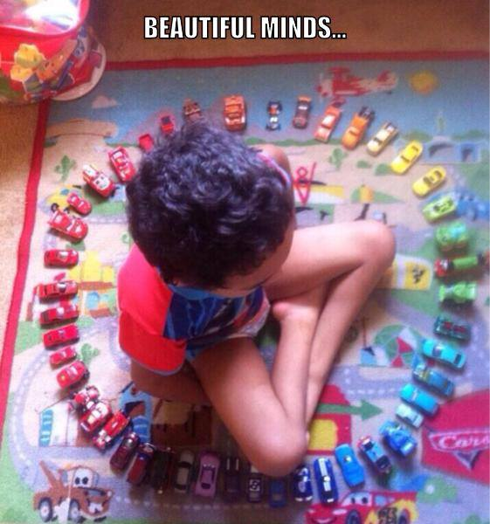

Slide 23





Slide 24





Must-haves for your schools…

Slide 25
Have high aspirations for every young person…
Ensure that all analysis/impact measures/data is done inclusively…
Change cultures of segregation in your settings – start with analysis…
Ensure that the highest aspirations are for all…
Be clear about how targets will help students develop and prepare for the next stage of their education, or for adulthood…
Engage in metacognative approaches with students – see Student Passports (for example)

Slide 26
Ways forward – what can be done now…
Using Metacognition with Student Passports
Develop a new way of supporting students and teacher’s understanding
Lots of different ideas, but our Student Passports have been hugely successful
Based on ‘high impact’ research; engages students in ‘learning to learn’ - metacognative approaches … and (most importantly?)…

Slide 27
Student Passport
Teacher
Teaching Assistant
Parent/ Carer
Student /Learner
Keeps the young person central to provision
Essential as part of our student centred approach
A useful tool to engage parents/carers

Slide 28

Measuring Impact…
Why do you do certain interventions?
How do you know they are effective?
What is the impact?
Do they dovetail with whole-school provision?
How to you track progress?
[Literacy and English judged by HMI as ‘outstanding’, 2013, & Case Study, Feb 2014]

Slide 29
Consider ‘hidden disabilities’ …
What does that mean to you?
How would you define a Hidden (or ‘invisible) Disability?
Consider what this term means to you?
How many young people do you work with?
‘If children’s perceptions of people who are different from themselves are based on stereotypical thinking it is likely that they will retain this misinformation for the rest of their lives unless positive steps are taken to counter this learning.’
(Brown, 1998)

Slide 30
So, what is a ‘hidden disability’?
Hidden (or ‘invisible’) Disabilities is an umbrella term that captures a whole spectrum of hidden disabilities or challenges that are primarily neurological in nature
Some people have difficulty understanding how a student’s disability can be so debilitating
Educating peers and training staff is essential in meeting the needs of a rapidly growing cohort in our schools
The majority of impairments are not visible – less than 8% of disabled people use wheelchairs.
Disability in the United Kingdom 2012: Facts and Figures Papworth Trust

Slide 31
How many did you think of?
ADHD
Anxiety disorders
Allergies
Asperger Syndrome
Attachment disorders
Asthma
Autism
Bipolar disorder
Brain injuries
Chronic fatigue syndrome
Crohn's disease
Depression
Dyslexia
Dyspraxia
Epilepsy
Food allergies
Irritable Bowel Syndrome
Lactose Intolerance
Lupus
Migraines
Multiple Sclerosis
Psychiatric disabilities
N.B. This is not an exhaustive list

Slide 32
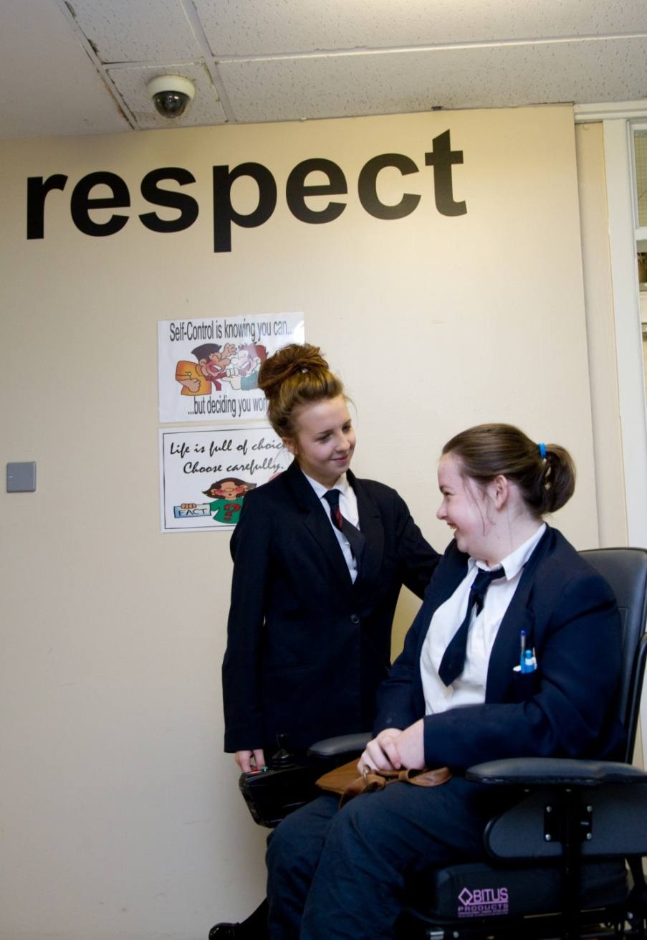
‘The education of the peer group is an essential part of moving towards a truly inclusive community’
Gareth D Morewood, 2011

Slide 33
Considering Autism – what research says…
Students with an ASC are around 8 times more likely to be permanently excluded from school than students without SEND (0.27% compared to 0.04%) (DCSF, 2009; 2010)
Difficulties in social interaction and communication can increase the risk of and exposure to bullying and social isolation (NAS, 2006)
Typical cognitive profile and preferred learning style of students with an ASC can challenge professional assumptions about teaching and learning (Jordan, 2005)
Preference for routine, predictability and low sensory stimulation is at odds with the noisy, bustling and often chaotic mainstream school environment – meaning it can be a very stressful place for students with an ASC (Carrington & Graham, 2001)

Slide 34
What do I need to know?
Research has indicated that an ‘autism friendly’ environment makes a significant difference to learning outcomes:
    physical environment
    social environment
    communication environment
    emotional environment
Morewood, Humphrey & Symes, (2011) Mainstreaming autism: making it work. Good Autism Practice, 12, 62-68.

Slide 35
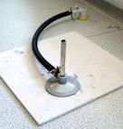


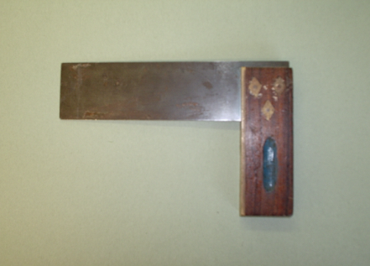
Strategies to develop and use…
Remember to use visual supports as much a possible:
BUNSEN BURNER
TRY
SQUARE

Slide 36
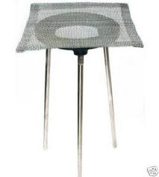

Reduce uncertainty in your lessons…
Pencil, Ruler & Rubber
Tripod & Gauze

Slide 37
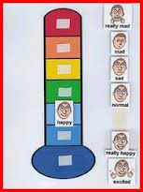


Emotional Regulation … key!!!
Supporting emotional regulation is essential…

Slide 38
How can you develop provision?
There is a clear need to be pro-active with supportive systems…
NOT re-active with sanctions and punitive measures…
Strip each incident/situation back to the starting points – what can be done differently?
How can provision evolve to minimise risks?

Slide 39

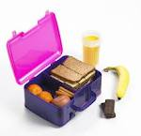





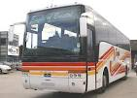
Chester Zoo
Don’t forget to wear your trainers. Bring your pack lunch and a coat in case it rains.
Leave home at
8:15 am
Register in the Nurture Room
Be in school at
8:30 am
Coach leaves at 9:00 am. Will not wait if late
Arrive at Chester Zoo
Coach returns to school for 3:15 pm

Slide 40





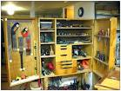

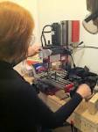



2) Watch teachers demonstrations (very IMPORTANT).
3) Its practical time. Hang up blazer and put on your apron.
1) Sit down and wait for teachers instructions.
office.
REMEMBER
1. To tell the teacher if you need to leave the class.
2. If you feel angry or stressed go to blue chair in Mr Morewood’s office.
4) Don’t forget to put on your safety glasses when using the machines.
5) Use equipment safely and carefully.
6) Put equipment away neatly.

Slide 41








1. Arrive to lesson. Sit down and write down Date, Title and Objective.
2. Listen and watch the teachers demonstration.
3. If you have a comment or question put your hand up.
4. Remember to record (write up) your results when doing your experiments.
5. If instructed to wear safety goggles keep them on at all times.
REMEMBER
To tell a teacher if you need to leave the classroom.
If you are feeling stressed or angry go to blue chair in Mr Morewood’s office.

Slide 42
Positive engagement and messages…
Positive texts, letters, e-mails, ‘phone calls …
Empower the under-dog – arm parents/carers with positives
A real re-focus on positive engagements also supports elements of the new Code:
    Preparation for adulthood
    Engagement with parents/carers
    Supporting young people in their decision-making & understanding
    Provides clear evidence of areas of success

Slide 43
Ensure clear communication with parents/carers
Keep parents/carers informed
Make sure they know who to contact and how
Provide honest communication – no long-term benefit in providing anything but the truth
Listen to parents/carers – give them time
Try to avoid uncertainty/misinterpretation
MOREWOOD, G. D., & BOND, C. (2012) Understanding Parental confidence in an inclusive high school: a pilot survey. Support for Learning, Vol. 27 No.2, p53-58 Wiley Blackwell Publishing.

Slide 44
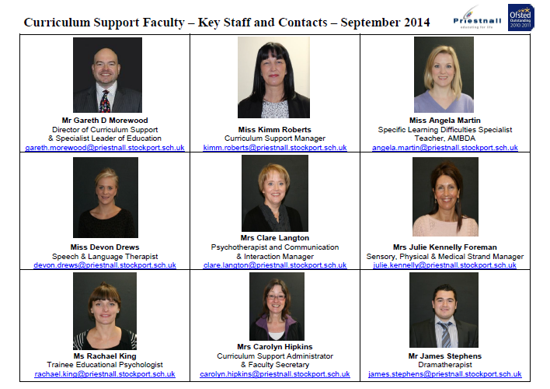

Slide 45
Most important advice…
Remember the law trumps all …
Ensure you know ‘absolute’ information:
    Irwin Mitchell Factsheets & Template letters
    IPSEA – on-line training
    Douglas Silas
    Brown Jacobson
Always be absolutely open and transparent – engage parents/carers positively and pro-actively
Keep the young person central to everything
Remain resolute and solution-focussed
Read SENCology for an on-going account!

Slide 46
Every teacher is responsible for meeting special educational needs…
No amount of extra support will make up for gaps in the quality of teaching…
The ability to be flexible, identify SEND and adapt learning & teaching to different needs are core parts of the Teacher’s Standards (2012)…
The quality of teaching for students with SEND should be a key part of the school’s appraisal and professional development arrangements…

Slide 47

Inclusive provision…
Inclusive quality-first teaching
Personalised approached to targeting support & interventions
Must be part of a ‘whole-school approach’
MOREWOOD, G. D. (2012) Is the ‘Inclusive SENCo’ still a possibility? A personal perspective. Support for Learning, Vol. 27 No.2, p73-76, Wiley-Blackwell Publishing.
SEND for Classroom Teachers:
Preparing for quality first,
inclusive teaching
© Gareth D Morewood 2014, Published by Optimus Education.
Foreword by Professor Des Hewitt

Slide 48

The ‘Bananarama’ Principle…
It ain’t what you do it’s the way that you do it…
So how do you spend to ‘get results’?
Or, what does the evidence say is a good investment or a poor investment for your students?
It ain’t what you spend but the way that you spend it… what works for one, may not for others!
Quoted from Prof Steve Higgins

Slide 49

Learning isn’t always the same ...

Slide 50
New ways of working…
‘Insanity: doing the same thing over and over again and expecting different results.’
(?)
Trainee Educational Psychologists
Speech and Language Therapist
Postgraduate student placements
Drama therapist
Dance & Movement Therapist

Slide 51

RESILIENCE
RISK

Slide 52
Not understanding or being understood can be very frustrating and can lead to outbursts and challenging behaviour…
Evidence suggests that many students with a history of presenting behavioural challenges experience underlying Speech and Language difficulties or hidden SEND…
Develop positive inclusive teaching strategies as a whole-school approach – DO NOT just ‘react’ to presenting behaviour.

Slide 53
Key messages…
Work in partnership – proper co-production takes time – not overnight!
Ensure that the young person is central to everything – proper engagement not ‘lip-service’!
Ensure documentation and information is easy to understand and clear – no need for complex policies!
Get a good understanding of the law!
Work on developing a ‘solution-focussed’ mind-set driven by positive outcomes for all…

Slide 54
SENCo skills are still the same…
A lead professional
An advocate and knowledge/information manager
A commissioner and broker
A resource manager
A partnership manager
A quality assurer
A facilitator
A solution assembler
Cheminais in Morewood, G. D (2008) the 21st Century SENCo
www.gdmorewood.com

Slide 55

Have we found the final piece?

Slide 56
Personalisation…
Above all – remember to be…
      adaptable,
      innovative,
      empathetic,
      and ... open minded.
Remember that not one strategy fits all … but strategies for one may well benefit others … think about the individual …

Slide 57


Slide 58
A timely reminder that Every Child Still Matters
Being Healthy
Staying Safe
Enjoying and Achieving
Making a Positive Contribution
Economic Wellbeing

Slide 59
Gareth D Morewood
Director of Curriculum Support & Specialist Leader of Education, Priestnall School, Stockport
Honorary Research Fellow, University of Manchester
www.gdmorewood.com
@gdmorewood

Slide 60
NAHT CONTACTS
Main Contacts
  Telephone number: 01444 472472
  Website: www.naht.org.uk
Direct dial for Events team: 01444 472405
or email: events@naht.org.uk
Website: www.naht.org.uk/welcome/naht-events

Slide 61
Thank you

